Slide 1
Module 4: Green Finance Risk Management
GREEN FINANCE Micro-Credential | University of Twente (UT)
WP3 Training Materials

Slide 2
What this module covers
Identify, measure, and manage climate-related financial risks in banks and portfolios
Frameworks: TCFD and TNFD for climate and nature risk assessment
Scenario analysis with NGFS pathways and Integrated Assessment Models
Carbon metrics, financed emissions, and Climate Value-at-Risk (CVaR)
Climate stress testing: design, execution, and supervisory practice
All applied to ASEAN, with equal coverage of Vietnam, Thailand, and the Philippines

Slide 3
Learning outcomes
Classify climate risks (physical, transition, liability) and map transmission channels
Apply the TCFD and TNFD frameworks for internal risk assessment
Model climate scenarios using NGFS pathways and IAMs
Calculate financed emissions, carbon metrics, and Climate VaR for a portfolio
Design climate stress tests and evaluate supervisory approaches
Evaluate ASEAN climate vulnerability and adaptation finance

Slide 4
The six lessons at a glance
1. Climate risk taxonomy, transmission, and materiality (Vietnam / Mekong)
2. TCFD and TNFD risk-assessment frameworks (Thailand / BOT)
3. Scenario analysis: NGFS pathways to IAMs (Philippines / typhoons)
4. Carbon metrics and Climate VaR (Vietnam / banking)
5. Climate stress testing (Thailand / 2011 floods)
6. ASEAN climate vulnerability and adaptation (Philippines / resilience)

Slide 5
Why climate risk is a financial risk
Natural disasters caused around USD 250 billion of losses worldwide in 2023, USD 95 billion of it insured
Climate risk cannot be diversified away: it is correlated, non-diversifiable, and non-linear
Carney's "tragedy of the horizon" (2015): impacts fall beyond most planning cycles
The Module 4 / Module 5 boundary: Module 4 manages risk; Module 5 reports it
Source: Munich Re (2024). Natural disaster figures 2023. Media information, 9 January 2024.

Slide 6
Lesson 1: Climate risk taxonomy
Three categories: physical (acute and chronic), transition, and liability
Transition risk drivers: the TCFD's four (policy and legal, technology, market, reputation), to which this module adds behaviour
Separately, four transmission channels carry it into the balance sheet: credit, market, operational, liquidity. Credit dominates for ASEAN banks, whose balance sheets are loan-heavy
Double materiality: how climate affects the firm, and how the firm affects climate

Slide 7
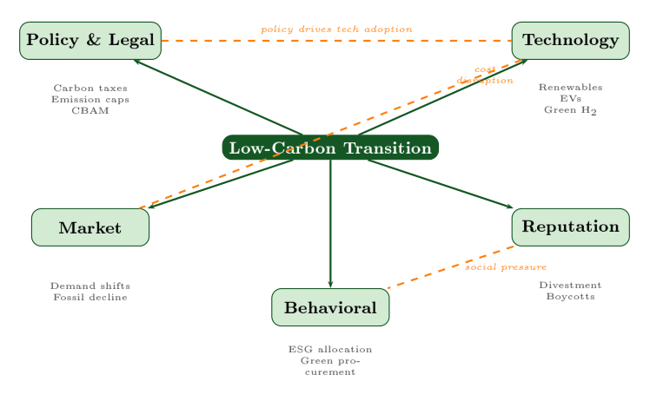
Lesson 1: The drivers of transition risk
The TCFD's four transition-risk drivers (policy and legal, technology, market, reputation), with behaviour added as a fifth by this module.

Slide 8
Lesson 2: TCFD and TNFD
TCFD: four pillars: Governance, Strategy, Risk Management, Metrics & Targets
The Risk Management pillar is the operational core for risk professionals
TNFD extends the approach to nature via the LEAP process
In Module 4 these are risk-assessment tools; disclosure belongs to Module 5

Slide 9
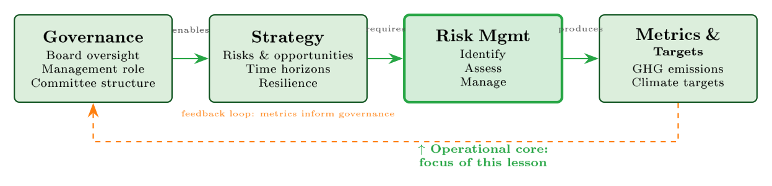
Lesson 2: The TCFD four-pillar framework
The four TCFD pillars, with Risk Management as the operational core.

Slide 10
Lesson 3: Scenario analysis and climate modeling
Scenarios explore plausible futures under deep uncertainty, not predictions
NGFS results version 5.0, November 2024: seven scenarios in four categories, being orderly transition, disorderly transition, hot world, and too little, too late
For ASEAN the binding case is a hot world (Current Policies, high physical risk); Fragmented World is the too-little-too-late case, high on both
IAMs link climate pathways to macro variables, sector shocks, and portfolio losses
Source: NGFS (2024). NGFS Scenarios: narratives and key findings. Box 1, NGFS Scenario framework, page 9. Results version 5.0, released November 2024 (Phase V).

Slide 11
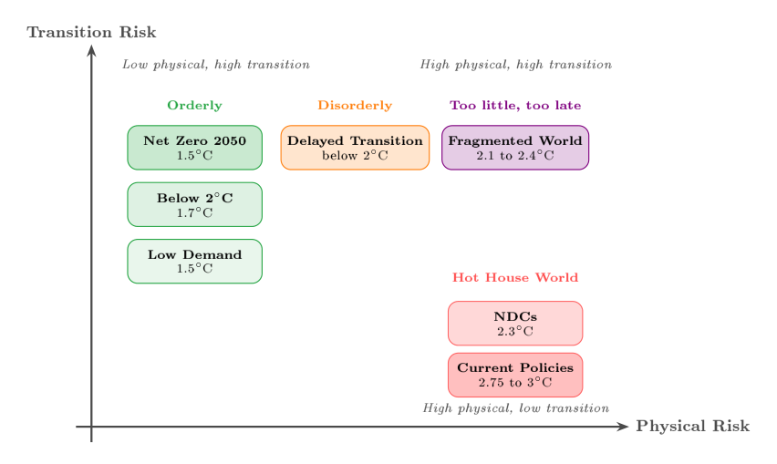
Lesson 3: The NGFS scenario framework
NGFS scenarios positioned across physical and transition risk.

Slide 12
Lesson 4: Carbon metrics and Climate VaR
A bank's financed emissions (Scope 3, Category 15) average more than 700 times its direct emissions
WACI normalises carbon intensity by revenue; PCAF scores data quality
Implied Temperature Rise gauges portfolio alignment
Climate VaR decomposes portfolio loss into physical and transition components
Source: CDP (2021). Finance sector's funded emissions over 700 times greater than its own. Press release, 28 April 2021.

Slide 13
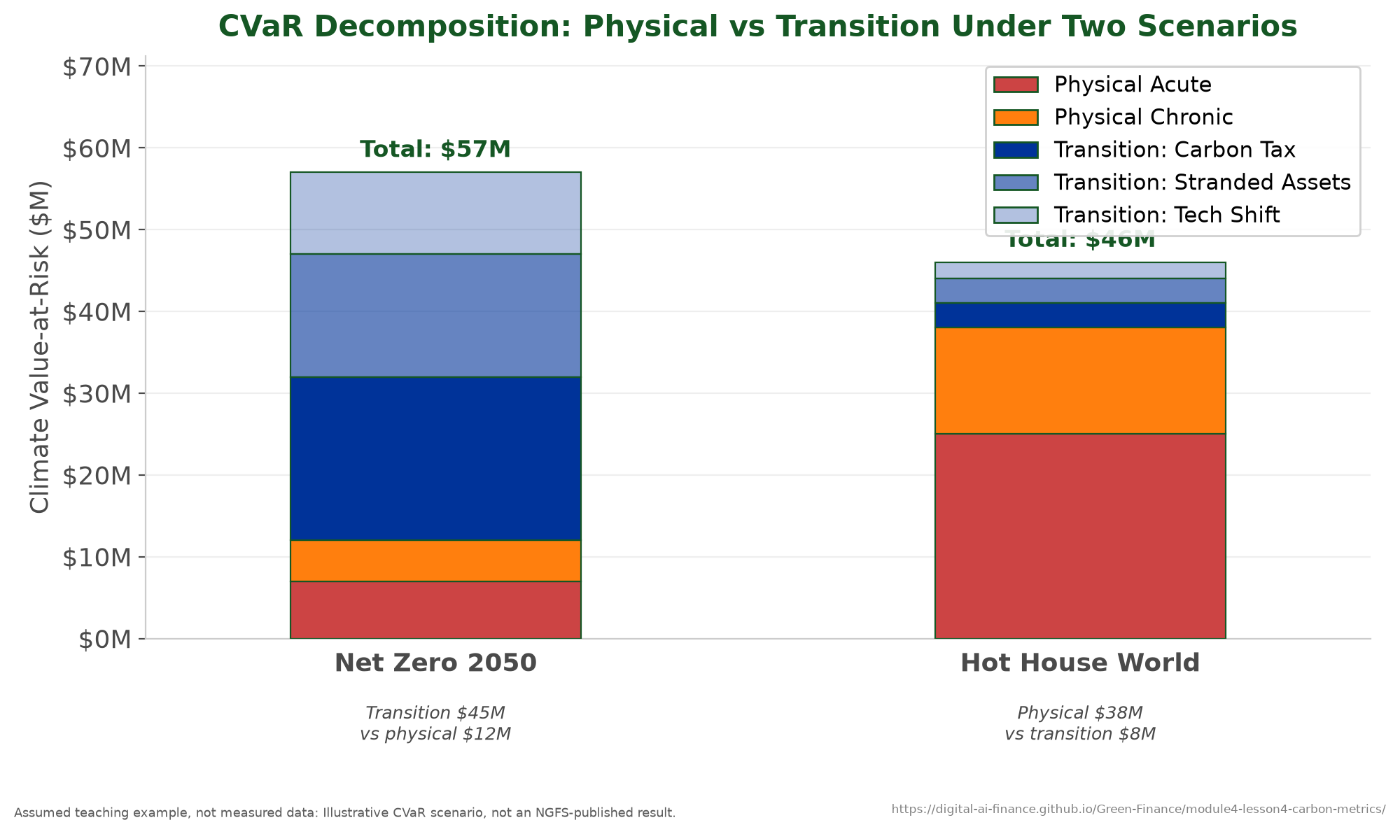
Lesson 4: Climate VaR decomposition
Climate VaR split into physical and transition components.

Slide 14
Lesson 5: Climate stress testing
Forward-looking test of resilience under a climate scenario
Supervisory practice: ECB, Bank of England, and emerging ASEAN supervisors
Transmission: scenario, to sector shocks, to losses, to post-stress capital
The headline output is the post-stress capital adequacy ratio

Slide 15
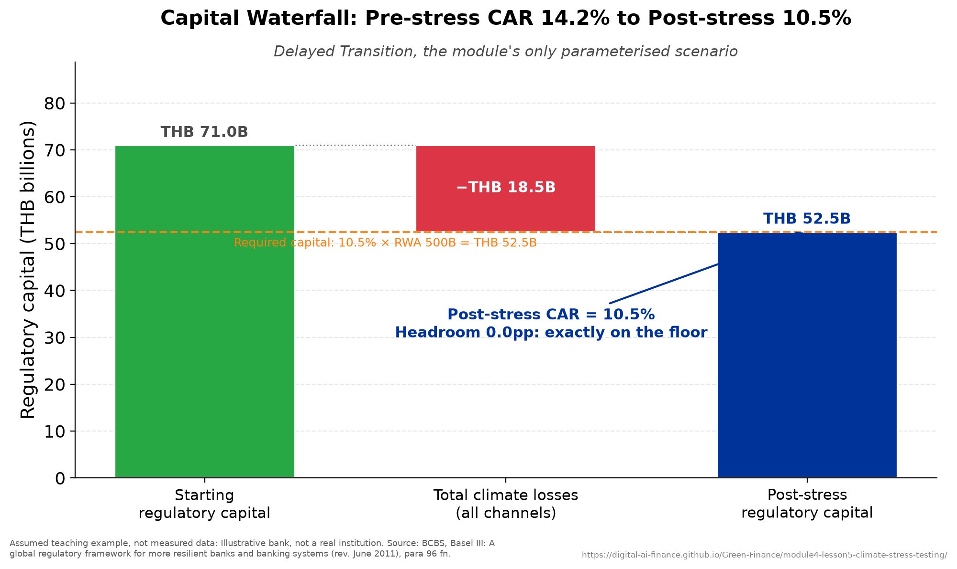
Lesson 5: Capital loss under stress
A CET1 capital waterfall from starting capital to post-stress ratio.

Slide 16
Lesson 6: ASEAN climate vulnerability
ASEAN is a climate risk hotspot: high exposure, high vulnerability, low readiness
Equal coverage of Vietnam, Thailand, and the Philippines
A large adaptation finance gap, only partly closed by blended finance
Capstone: an integrated risk assessment, Risk = Hazard x Exposure x Vulnerability

Slide 17
Lesson 6: Comparative country risk
Qualitative comparison: each country's signature hazard and the sector it reaches. Named characteristics, not scores.
Vietnam
Thailand
Philippines
Signature hazard
Mekong Delta salinity and sea-level rise
River and flash flooding
Typhoon landfall
Exposed sector
Agriculture and aquaculture lending
Manufacturing and its supply chains
Coastal property and regional banks
Case in this module
The agricultural portfolio, and the CVaR inversion
The 2011 floods and the BOT stress test
The typhoon capstone stress test

Slide 18
Practical activity: Thailand catastrophe tail risk
A self-contained 45-60 minute quantitative teaching case
From hazard (extreme-value fit) to loss, tail risk (VaR and CVaR), and solvency
Four phases: risk visualisation, capital adequacy, reinsurance strategy, climate implications
Runs at foundation level (solvency arithmetic) or PhD level (full extreme-value model)

Slide 19
Assessment
Fifteen multiple-choice questions across all six lessons, with an answer key
One applied exercise tied to the Thailand case (solvency and reinsurance)
A four-dimension grading rubric: understanding, technical, critical, communication
Micro-credential assessment is 100 percent coursework

Slide 20
Key takeaways
Climate risk is a financial risk: classify it, measure it, then manage it
Frameworks (TCFD, TNFD), scenarios (NGFS), metrics (CVaR), and stress tests form one toolkit
ASEAN is distinctive: physical risk dominates and adaptation finance is scarce
Module 4 manages risk; Module 5 reports and communicates it

Slide 21
Acknowledgments
Developed by the University of Twente for WP3 of GREEN FINANCE (Erasmus+ CBHE)
Generative AI as a writing and research assistant: Claude (Anthropic), Opus 4.8 and Opus 5, July 2026 to submission on 11 September 2026
Confined to brainstorming, language editing, literature classification, and coding assistance
Every cited source checked against the original; every figure states its provenance
The authors remain fully responsible for accuracy, references, and conclusions
Released under a Creative Commons Attribution 4.0 International licence (CC BY 4.0)

Slide 22
Thank you
Module 4: Green Finance Risk Management | University of Twente
Co-funded by the European Union | GREEN FINANCE, Grant 101237817

