Slide 1
Module 4: Green Finance Risk Management
Teaching edition | GREEN FINANCE Micro-Credential
University of Twente (UT)

Slide 2
Climate risk is a financial risk.
Classify it, measure it, then manage it. That order is the module.

Slide 3
Where we are going
Taxonomy: what kind of risk is this, and how does it reach the balance sheet
Frameworks: TCFD and TNFD as risk-assessment tools
Scenarios: NGFS pathways, and why a scenario is not a forecast
Metrics: financed emissions, carbon intensity, and Climate Value-at-Risk
Stress testing: from a scenario to a post-stress capital ratio
ASEAN: where all of it lands, in Vietnam, Thailand, and the Philippines

Slide 4
Learning outcomes
Classify climate risks and map their transmission channels into a bank
Apply the TCFD and TNFD frameworks for internal risk assessment
Model climate scenarios using NGFS pathways and Integrated Assessment Models
Calculate financed emissions, carbon metrics, and Climate VaR for a portfolio
Design a climate stress test and read a supervisor's results
Evaluate ASEAN climate vulnerability and the adaptation finance gap

Slide 5
A bank's loans turn a changing climate into a financial risk
Bank and loan
A bank lends savers' deposits to borrowers, who owe the money back
Portfolio
Every loan or investment an institution holds, taken together
Financial risk
An uncertain future in which some outcomes cost money
Systematic risk
One cause, such as a regional drought, hitting many borrowers at once
Non-linear
Losses that jump once a tipping point is crossed
Tragedy of the horizon
The worst damage lands after the years anyone is judged on
Counterparty
The other party to a loan, trade or insurance contract
From zero, with worked examples: the Start-from-Scratch Overview

Slide 6
USD 250bn
Global natural disaster losses, 2023
Natural disasters caused around USD 250 billion of losses worldwide in 2023, USD 95 billion of it insured.
Source: Munich Re (2024). Natural disaster figures 2023. Media information, 9 January 2024.

Slide 7
Why this risk resists the usual defences
It is correlated: a warming world moves every exposure in the same direction
It is non-diversifiable: there is no counterparty on the other side of the trade
It is non-linear: damages rise far faster than the driver that causes them
It is Carney's "tragedy of the horizon" (2015): impacts fall beyond most planning cycles

Slide 8
Module 4 manages risk. Module 5 reports it.
Module 4: assessing
Module 5: disclosing
• TCFD and TNFD as internal risk-assessment tools
• Scenario analysis and stress testing
• Carbon metrics and Climate VaR
• Question: how exposed are we, and what do we do about it
• TCFD and TNFD as disclosure frameworks
• ISSB, SFDR, and CSRD reporting requirements
• Assurance and accountability
• Question: what must we tell the market, and how

Slide 9
1
Climate Risk Taxonomy
Physical, transition, liability. Transmission channels. Materiality. ASEAN case: Vietnam, the Mekong Delta.

Slide 10
Climate raises the chance of default and the loss once collateral is damaged
1
2
3
4
5
6
PD and LGD
The chance a borrower stops repaying, and the share of the loan then lost
EAD and EL
Amount owed at default; expected loss is PD times LGD times EAD
Collateral
Property pledged to a bank, which it sells if a loan goes unpaid
Deposits
Savers' money held by a bank and owed back to them
Pathway
A labelled what-if route for emissions and warming
TCFD
Task Force on Climate-related Financial Disclosures
From zero, with worked examples: Start-from-Scratch Companion 1, Climate Risks

Slide 11
Before you can manage a risk, you must classify it
1
2
3
4
5
6
Physical risk: the climate itself, acute (event-driven) and chronic (gradual)
Transition risk: the shift to a low-carbon economy
Liability risk: litigation, adaptation failure, and greenwashing claims
The taxonomy is not academic: each category reaches the bank by a different route

Slide 12
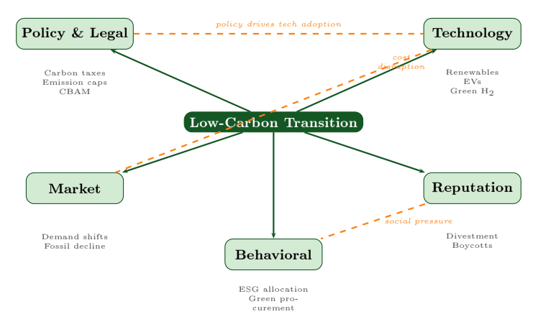
Transition risk arrives through separate, named channels
1
2
3
4
5
6
The TCFD's four transition-risk drivers (policy and legal, technology, market, reputation), with behaviour added as a fifth by Module 4.

Slide 13
The two risk families behave differently, and must be modelled differently
1
2
3
4
5
6
Physical
Transition
• Acute: floods, typhoons, heatwaves
• Chronic: sea-level rise, salinity, heat stress
• Worst under a high-warming pathway
• Dominates in ASEAN
• The TCFD's four drivers: policy and legal, technology, market, reputation
• Plus behaviour, added as a fifth by Module 4
• Driven by the speed of the policy response
• Worst under a disorderly pathway
• Dominates in carbon-intensive economies

Slide 14
Credit is the channel that matters most for an ASEAN bank
1
2
3
4
5
6
Credit: borrowers default when their assets or cash flows are hit
Market: repricing of exposed securities and collateral
Operational: the bank's own branches, staff, and systems
Liquidity: deposit flight and funding stress after a large event

Slide 15
A carbon cost the borrower cannot pass on shortens its distance to default
Advanced
Developed further in Merton (1974), On the Pricing of Corporate Debt
1
2
3
4
5
6
In the Merton model a borrower defaults when its assets fall below its debt, and a carbon cost it keeps lowers those assets:
cost kept = p · E · (1 − s)
DD = [ln(V / D) + (μ − σ² / 2) T] / (σ √T)
PD = N(−DD)
where p is the carbon price per tonne, E the borrower's emissions in tonnes, s the share of the cost passed on to customers, V the asset value net of the cost kept, D the debt due at horizon T, μ and σ the drift and volatility of V, N the standard normal distribution function, and DD the distance to default
A cost kept lowers V and DD and raises PD; a borrower that passes the whole cost on (s = 1) keeps its default probability.

Slide 16
Double materiality asks the question twice
1
2
3
4
5
6
Financial materiality: how does climate affect the firm
Impact materiality: how does the firm affect climate
A portfolio can look safe on one and exposed on the other
Both are needed before Module 5 asks you to report anything

Slide 17
2
TCFD and TNFD
Four pillars, the Risk Management pillar in depth, and the LEAP process for nature. ASEAN case: Thailand and the Bank of Thailand.

Slide 18
A bank governs and manages climate and nature risk before it discloses it
1
2
3
4
5
6
TNFD
Taskforce on Nature-related Financial Disclosures
GHG
Greenhouse gas, mainly carbon dioxide from burning fossil fuels
Governance
Who in a bank sets how much risk it accepts, and who checks it
Managing a risk
Acting on it inside the firm: spotting, measuring and limiting it
Disclosing a risk
Reporting it to outsiders such as investors and regulators
Natural capital
The stock of nature, such as wetlands, that the economy relies on
Collateral haircut
A cut to the value a bank counts for collateral, in case its price falls
From zero, with worked examples: Start-from-Scratch Companion 2, Frameworks

Slide 19
A framework is what makes two banks' answers comparable
1
2
3
4
5
6
TCFD gives four pillars: Governance, Strategy, Risk Management, Metrics and Targets
The order is deliberate: governance first, measurement last
The Risk Management pillar is the operational core for a risk professional
TNFD extends the same logic from climate to nature

Slide 20
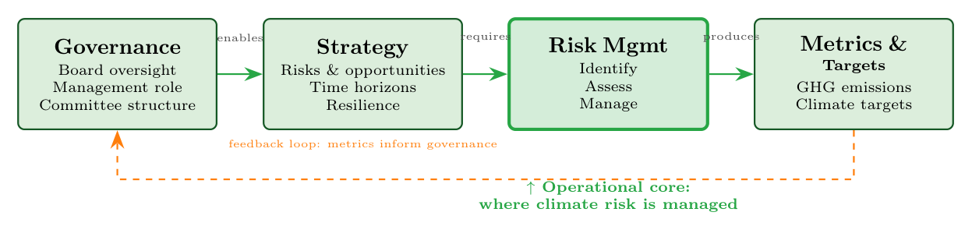
The four pillars, with Risk Management as the operational core
1
2
3
4
5
6
The four pillars of the TCFD framework; the Risk Management pillar is the operational core.

Slide 21
Integrating climate into enterprise risk management
1
2
3
4
5
6
Identify: which exposures, which hazards, which horizons
Assess: score materiality by sector and geography
Manage: limits, pricing, collateral haircuts, exit paths
Monitor: the metrics that Module 5 will later ask you to disclose

Slide 22
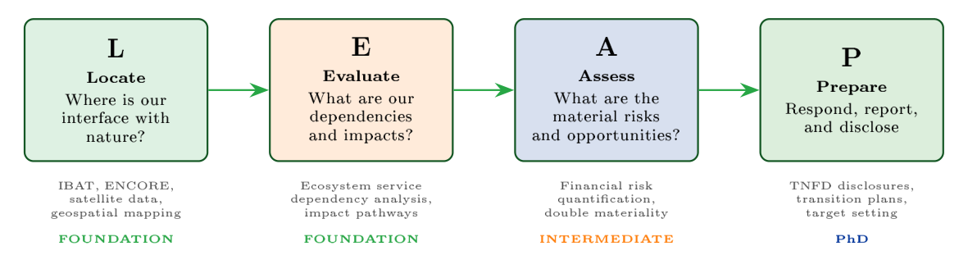
Nature risk gets its own process: Locate, Evaluate, Assess, Prepare
1
2
3
4
5
6
The TNFD LEAP process: Locate, Evaluate, Assess, Prepare.

Slide 23
3
Scenario Analysis
NGFS pathways, the transmission chain, and Integrated Assessment Models. ASEAN case: the Philippines and typhoons.

Slide 24
The odds of a climate future are unknown, so banks plan with scenarios
1
2
3
4
5
6
NGFS
Network for Greening the Financial System
NDCs
Nationally Determined Contributions
Deep uncertainty
A future whose odds are unknown, which is why banks use scenarios
Balance sheet
What a bank owns, mostly loans, and what it owes, mostly deposits
Discount rate
The rate that shrinks a future amount into today's money
From zero, with worked examples: Start-from-Scratch Companion 3, Scenarios

Slide 25
A scenario is not a forecast.
It is a disciplined answer to "what would we do if", under uncertainty too deep for a probability.

Slide 26
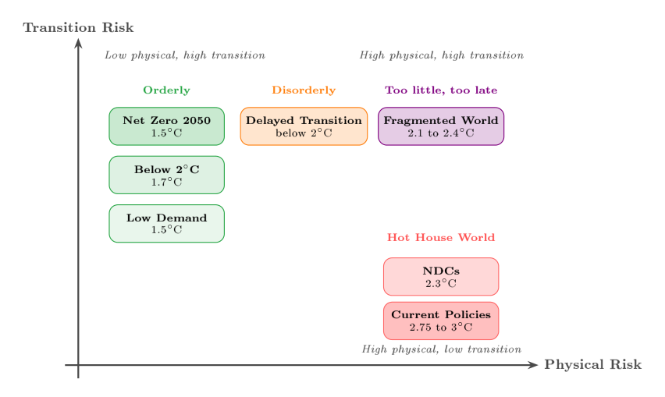
The NGFS set is organised by how much of each risk you get
1
2
3
4
5
6
The NGFS scenario framework across physical and transition risk.

Slide 27
For ASEAN, the frightening scenario is not the disorderly one
1
2
3
4
5
6
The usual worry: Disorderly
The ASEAN inversion: Hot House World
• Late, abrupt policy tightening
• Sharp repricing of carbon-intensive assets
• Transition risk dominates
• The binding case for European banks
• Policy never arrives, warming continues
• Physical damage compounds over decades
• Physical risk dominates
• The binding case here. Fragmented World, high on both, is the likelier one

Slide 28
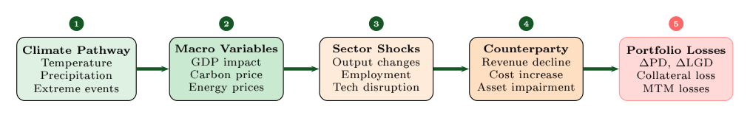
From a warming pathway to a number on the balance sheet
1
2
3
4
5
6
From climate pathway to portfolio losses: the scenario transmission chain.

Slide 29
Where the uncertainty lives
Advanced
Developed further in the Lesson 3 lecture deck, Scenario Analysis
1
2
3
4
5
6
Integrated Assessment Models link emissions, temperature, and damages
Damage functions are the weakest link, and they differ by an order of magnitude
The discount rate can matter more than the climate assumption
Report the range, not a point estimate, and say which assumption drives it

Slide 30
4
Carbon Metrics and Climate VaR
Financed emissions, WACI, data quality, and Value-at-Risk. ASEAN case: a Vietnamese bank's inversion.

Slide 31
Carbon is counted in tonnes by scope before Climate VaR turns it into a loss
1
2
3
4
5
6
tCO2e
Tonnes of carbon-dioxide equivalent, one unit for all greenhouse gases
Scopes 1 to 3
A firm's own fuel, the power it buys, and the rest of its value chain
Financed emissions
The share of a borrower's emissions counted against its lender
Attribution
A loan's share of the borrower's value, times the borrower's emissions
WACI
Weighted average carbon intensity: emissions per unit of revenue
PCAF
Partnership for Carbon Accounting Financials, which scores data quality
VaR
Value-at-Risk: a loss exceeded only rarely over a set period
CVaR
Climate Value-at-Risk: expected loss in value under a climate scenario
From zero, with worked examples: Start-from-Scratch Companion 4, Carbon Metrics and Climate VaR

Slide 32
1
2
3
4
5
6
700x
Financed versus direct emissions
A bank's financed emissions (Scope 3, Category 15) average more than 700 times its direct emissions.
Source: CDP (2021). Finance sector's funded emissions over 700 times greater than its own. Press release, 28 April 2021.

Slide 33
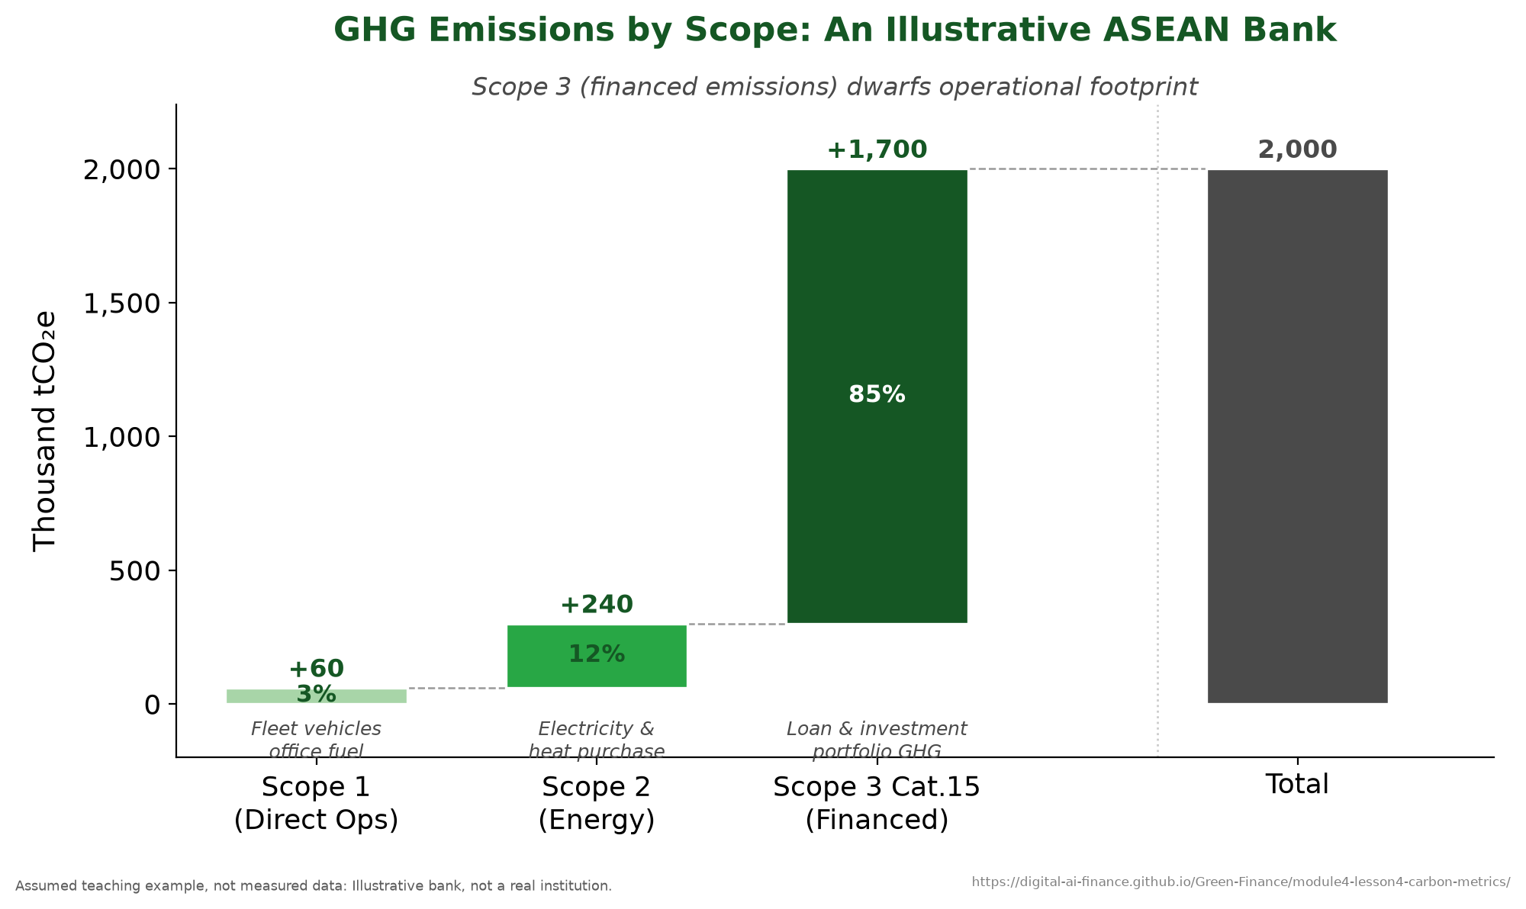
A bank's carbon is in its loan book
1
2
3
4
5
6
GHG emissions by scope: the financed-emissions waterfall.

Slide 34
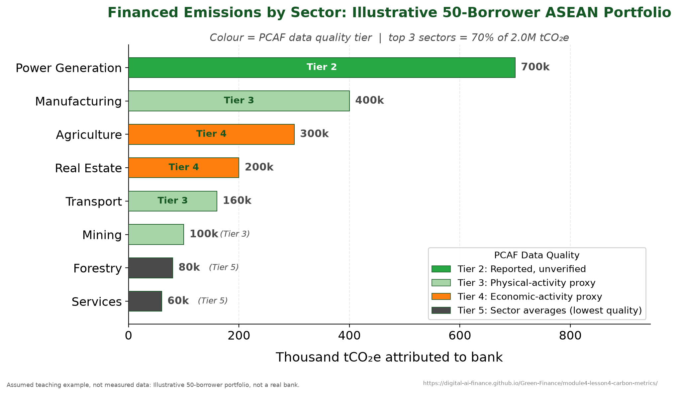
Attribution decides how much of a borrower's carbon is yours
1
2
3
4
5
6
Attributing a borrower's emissions to the lender.

Slide 35
Three metrics, three different questions
1
2
3
4
5
6
Financed emissions: how much carbon does this portfolio finance in total
WACI: how carbon-intensive is it per unit of revenue, so portfolios compare
Implied Temperature Rise: what warming path is this portfolio consistent with
None of them is a loss estimate. That comes next.

Slide 36
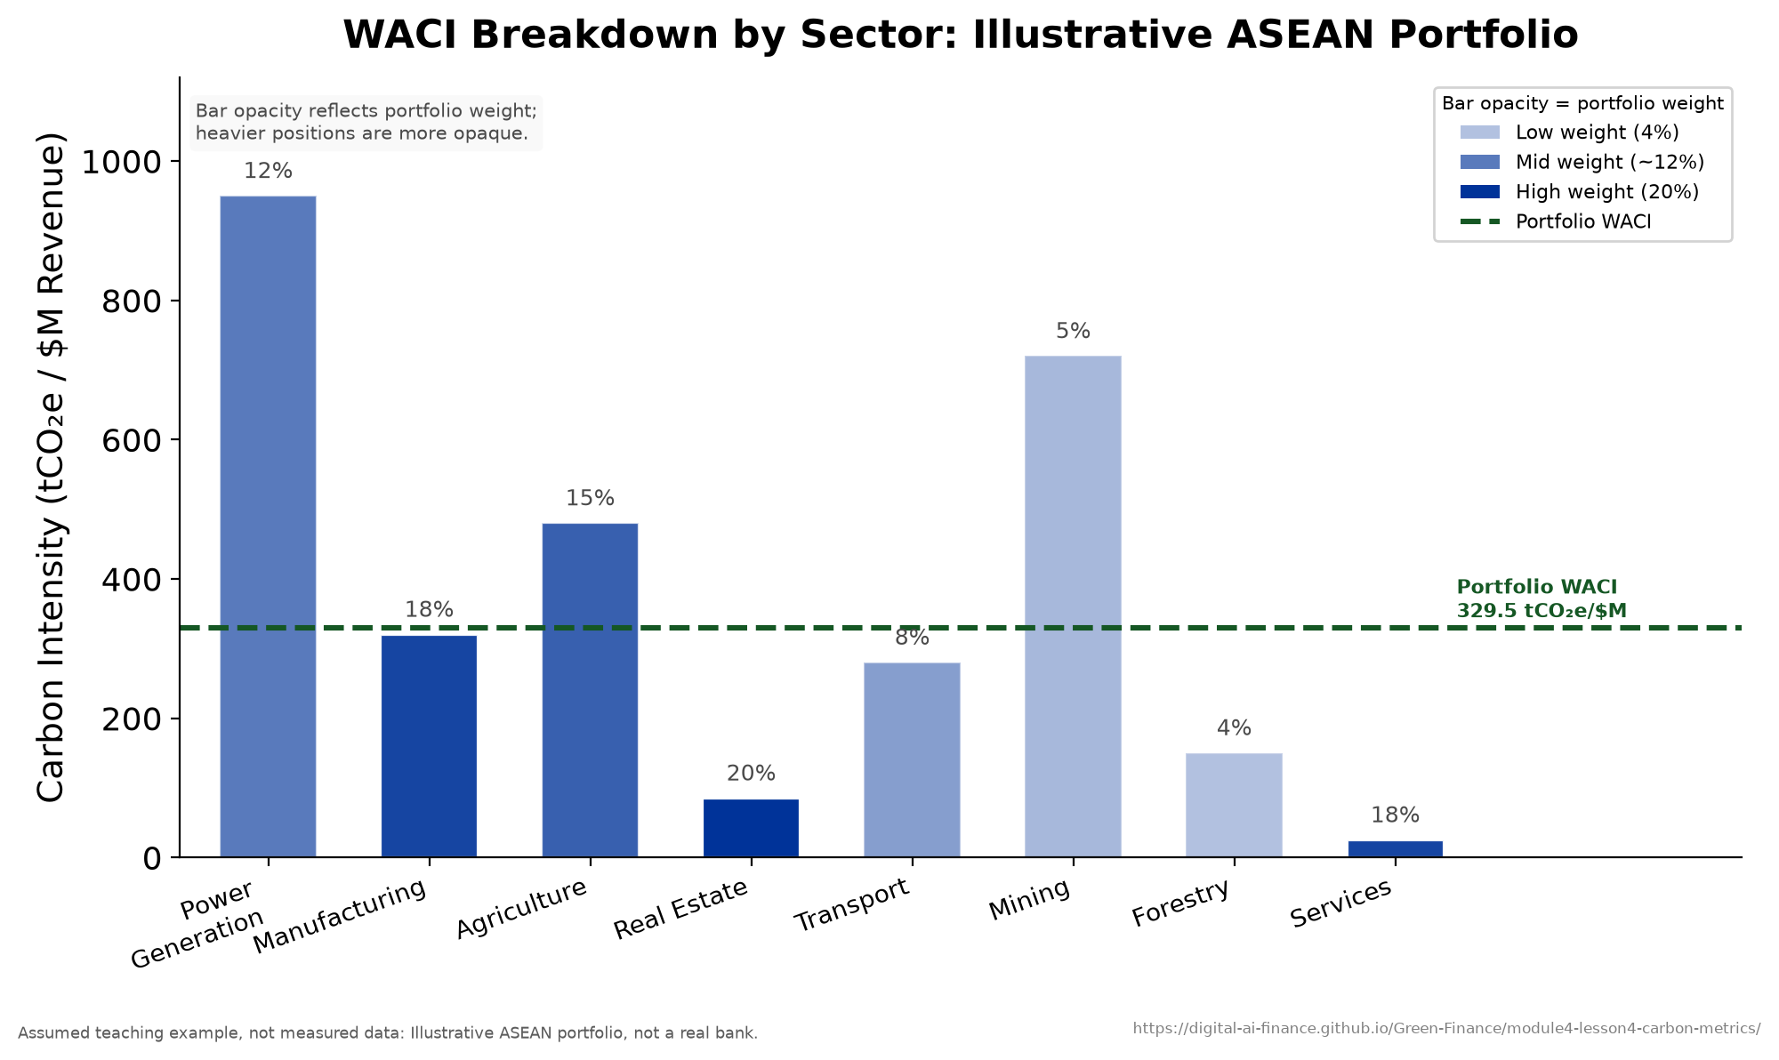
Power generation dominates the intensity of an ASEAN portfolio
1
2
3
4
5
6
Portfolio WACI broken down by sector.

Slide 37
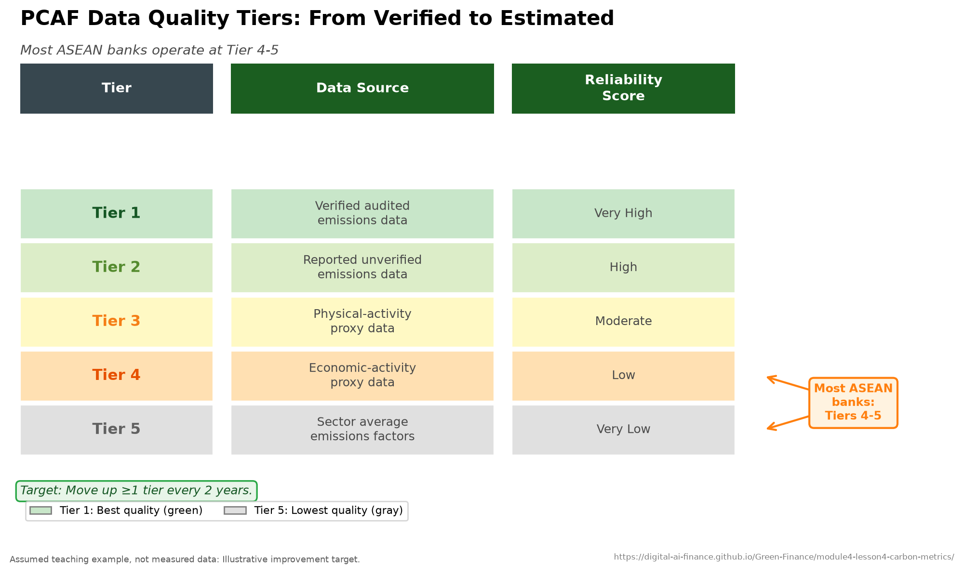
Always quote the data-quality tier with the number
1
2
3
4
5
6
PCAF data-quality score tiers.

Slide 38
Errors in estimated emissions move together and survive the portfolio sum
Advanced
Developed further in the 2006 IPCC Guidelines for National Greenhouse Gas Inventories, Volume 1, Chapter 3
1
2
3
4
5
6
Financed emissions add each borrower's attributed emissions, and each estimate has a relative error:
FE = Σ_{i} a_{i} E_{i}
σ_{i} = r_{i} · a_{i} E_{i}
Var(FE) = Σ_{i} Σ_{j} ρ_{ij} σ_{i} σ_{j}
where a_{i} is the attribution factor of loan i, E_{i} the borrower's estimated emissions, r_{i} the relative error of that estimate, σ_{i} its error in tonnes, and ρ_{ij} the correlation between the errors of two estimates
Estimates drawn from the same sector averages share their errors; with every ρ_{ij} equal to one, the book's relative error is the average of the r_{i} weighted by a_{i} E_{i}, however many loans it holds.

Slide 39
Advanced
Developed further in the Lesson 4 lecture deck, Carbon Metrics and Climate VaR
Climate VaR turns a measurement into a loss.
Expected loss of portfolio value under a stated scenario, split into physical and transition components.

Slide 40
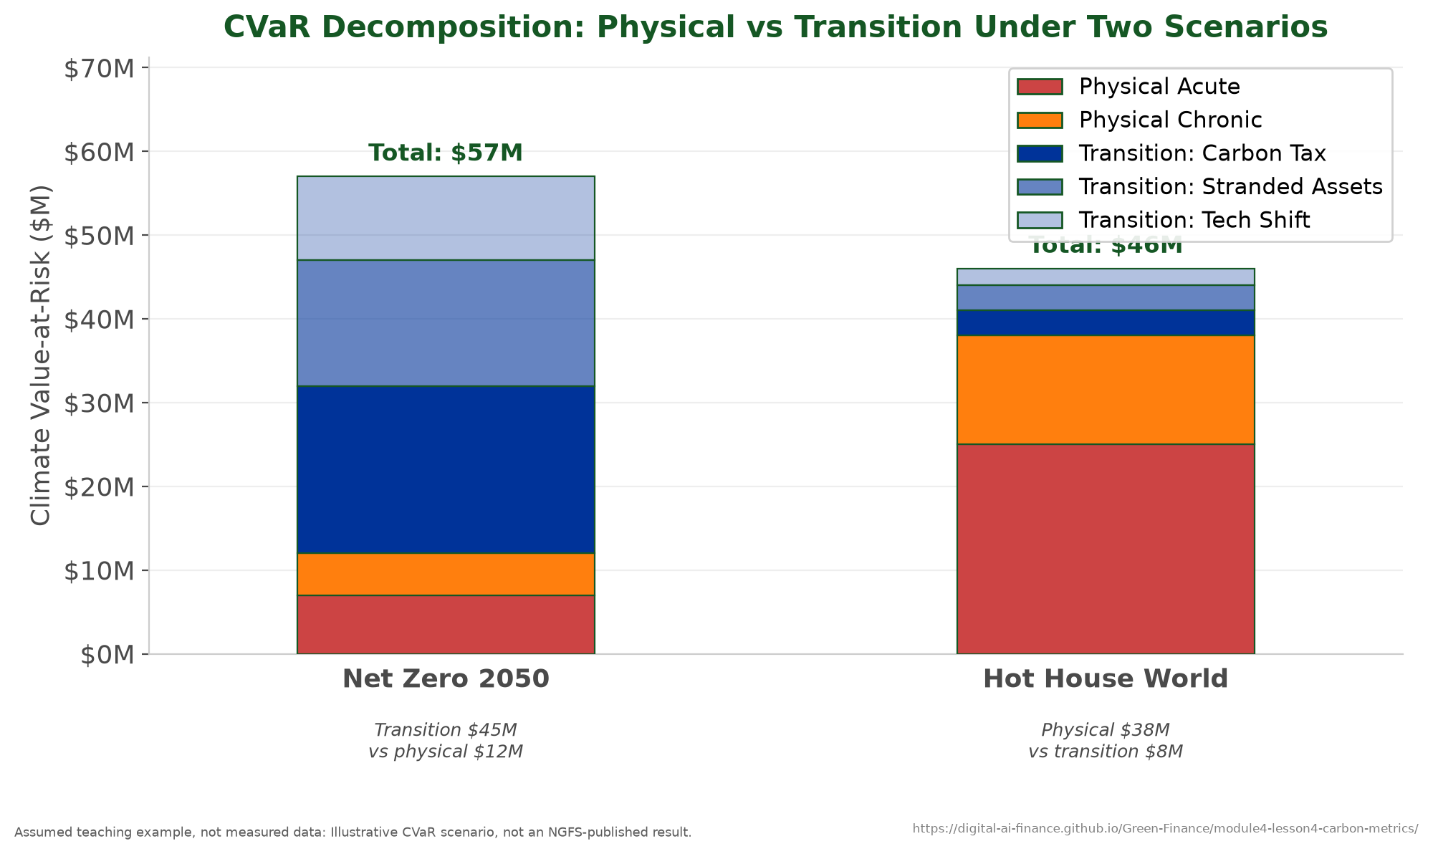
Which component dominates is a property of the scenario
Advanced
Developed further in the Lesson 4 lecture deck, Carbon Metrics and Climate VaR
1
2
3
4
5
6
Climate VaR decomposed into physical and transition components.

Slide 41
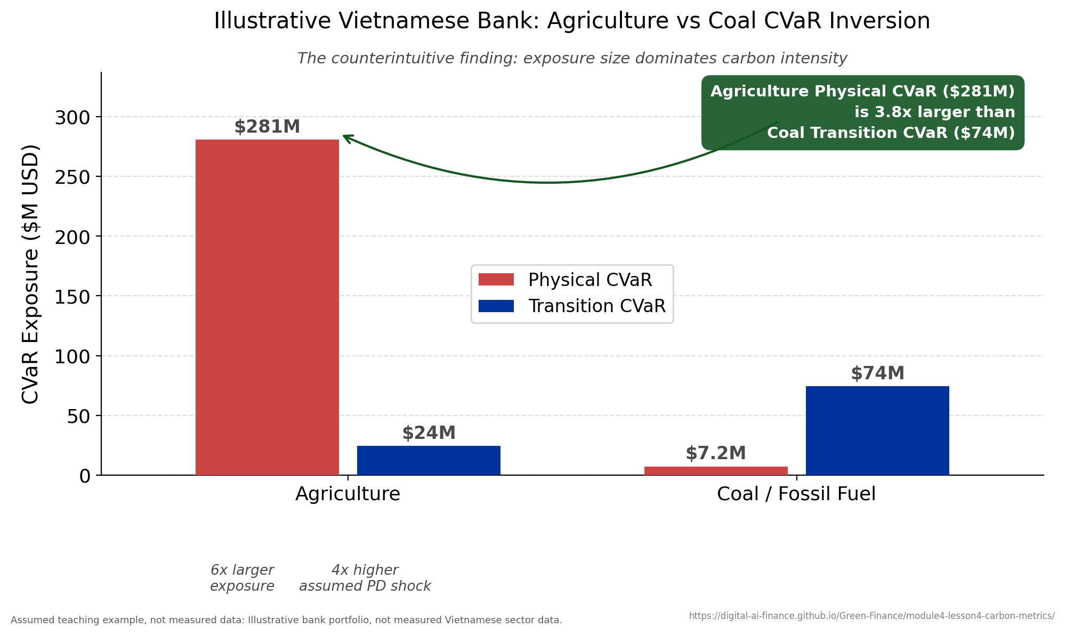
Vietnamese agriculture outranks coal on Climate VaR
Advanced
Developed further in the Lesson 4 lecture deck, Carbon Metrics and Climate VaR
1
2
3
4
5
6
The Vietnam agriculture-coal Climate VaR inversion.

Slide 42
5
Climate Stress Testing
Design, the supervisory landscape, and the path to capital. ASEAN case: Thailand and the 2011 floods.

Slide 43
A stress test takes losses from capital and compares the ratio with a minimum
1
2
3
4
5
6
Capital
A bank's own money, the cushion that absorbs losses
RWA
Risk-weighted assets: loans scaled by how risky each one is
CAR
Capital adequacy ratio: capital divided by risk-weighted assets
Minimum and buffer
The legal floor for the ratio, and the cushion required above it
Basel III
The international rules that set how much capital a bank must hold
Percentage points (pp)
The gap between two percentages, found by subtraction
Static balance sheet
The loan book held fixed for the whole stress horizon
CET1
Common Equity Tier 1: a bank's highest-quality capital, mainly its shares
From zero, with worked examples: Start-from-Scratch Companion 5, Stress Testing

Slide 44
A stress test asks one question and answers it with one number
1
2
3
4
5
6
The question: does the bank stay above its regulatory minimum under this scenario
The answer: the post-stress capital adequacy ratio
Everything between the two is modelling choice, and every choice moves the answer
Which is why design transparency matters more than the headline figure

Slide 45
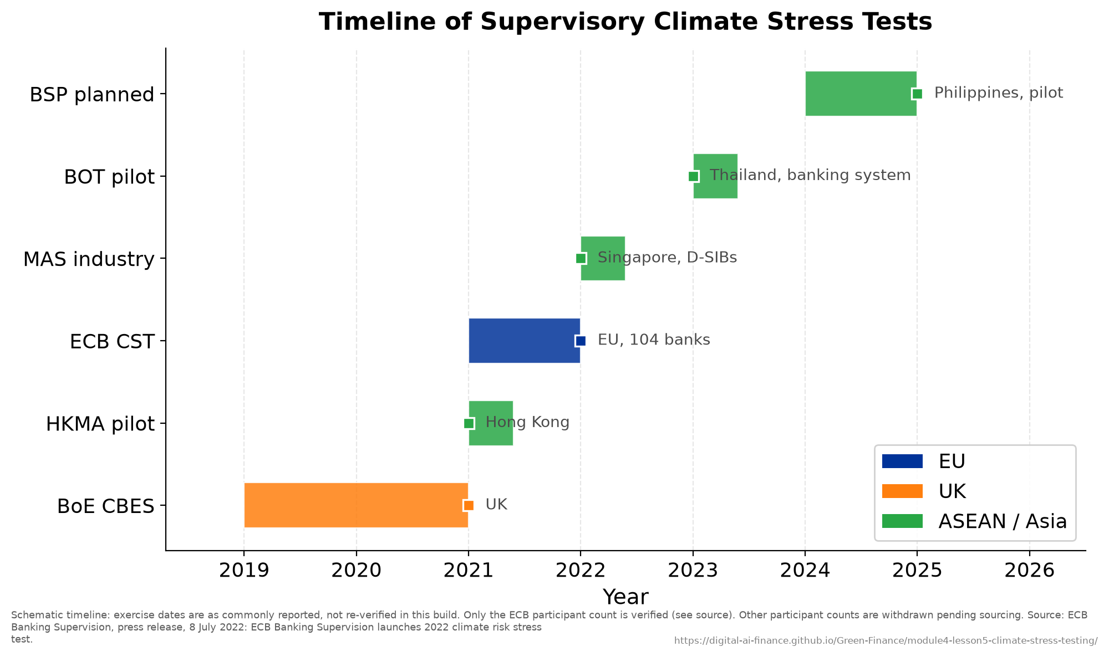
Supervisors converged on this practice in barely a decade
1
2
3
4
5
6
Timeline of supervisory climate stress tests.

Slide 46
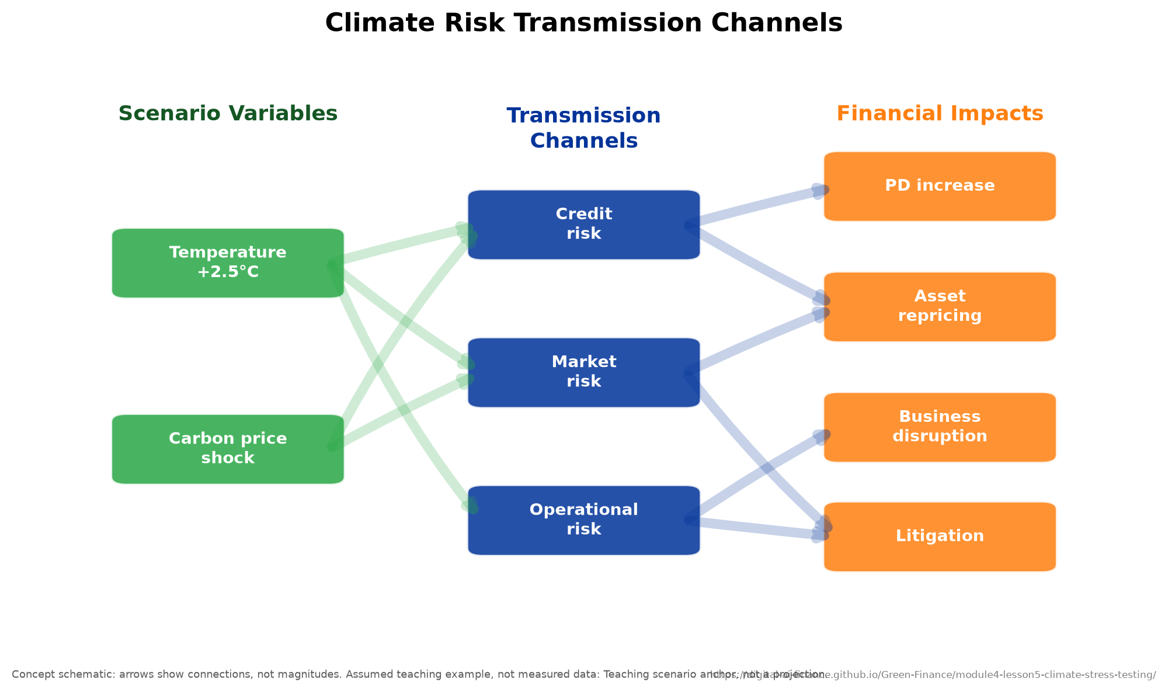
The scenario reaches capital through named channels
1
2
3
4
5
6
Stress transmission channels from scenario to capital.

Slide 47
In a large loan book one common factor turns a stressed PD into a capital charge
Advanced
Developed further in Vasicek (2002) and in the Basel Framework, IRB approach: risk weight functions
1
2
3
4
5
6
Each borrower's assets move with a common factor Z and a shock of their own, so a large book's loss rate depends on Z alone:
L(Z) = LGD · N( [N⁻¹(PD) − √ρ · Z] / √(1 − ρ) )
K = LGD · [ N( [N⁻¹(PD) + √ρ · N⁻¹(q)] / √(1 − ρ) ) − PD ]
where Z is the standard normal common factor, ρ the share of each borrower's asset variance it explains, N and N⁻¹ the standard normal distribution function and its inverse, q the confidence level of the charge, and K the capital per unit of exposure before the maturity adjustment
K is the loss rate in the worst factor outcome that q allows, less the expected loss PD · LGD; a scenario enters through the stressed PD in both terms.

Slide 48
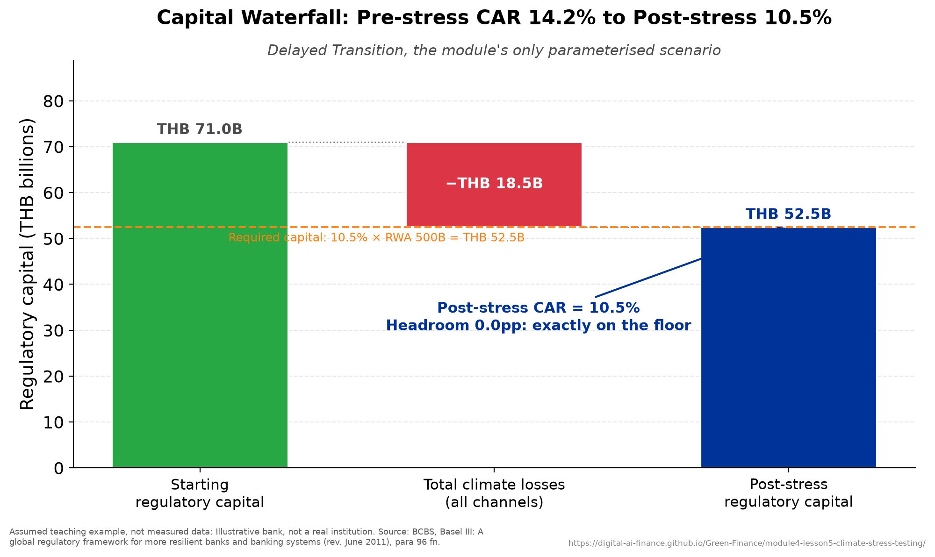
Losses consume the buffer above the regulatory minimum
1
2
3
4
5
6
The capital-loss waterfall under stress.

Slide 49
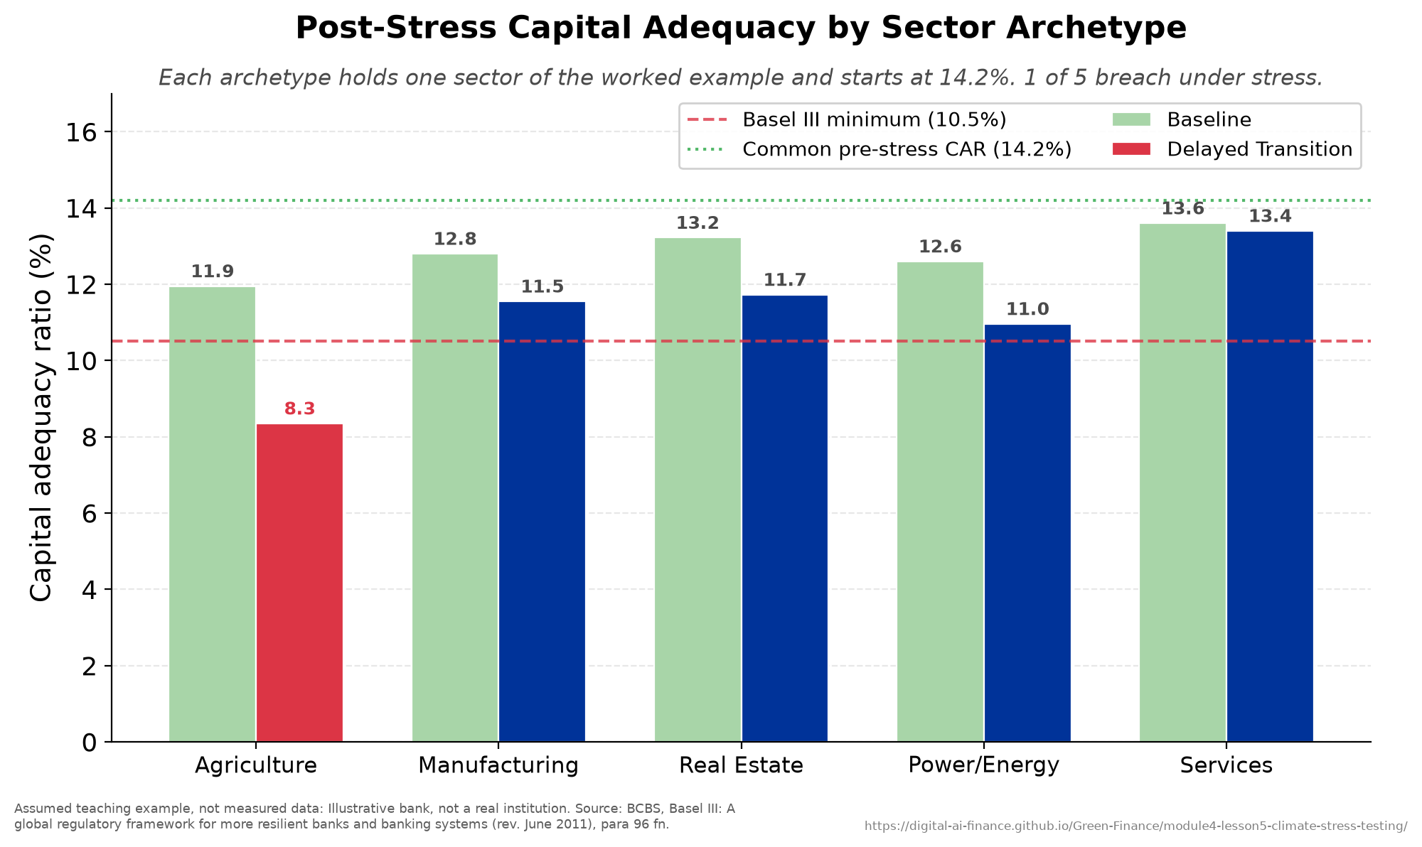
Under a hot-house scenario, some banks breach the minimum
1
2
3
4
5
6
Capital adequacy ratio, before and after the stress.

Slide 50
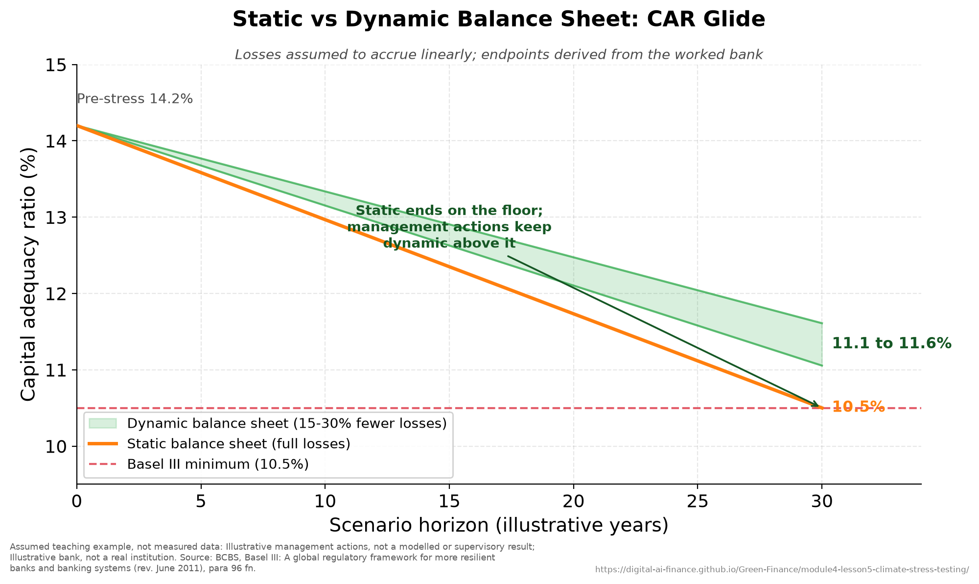
The same portfolio, two assumptions, two capital paths
1
2
3
4
5
6
Static versus dynamic balance-sheet capital paths.

Slide 51
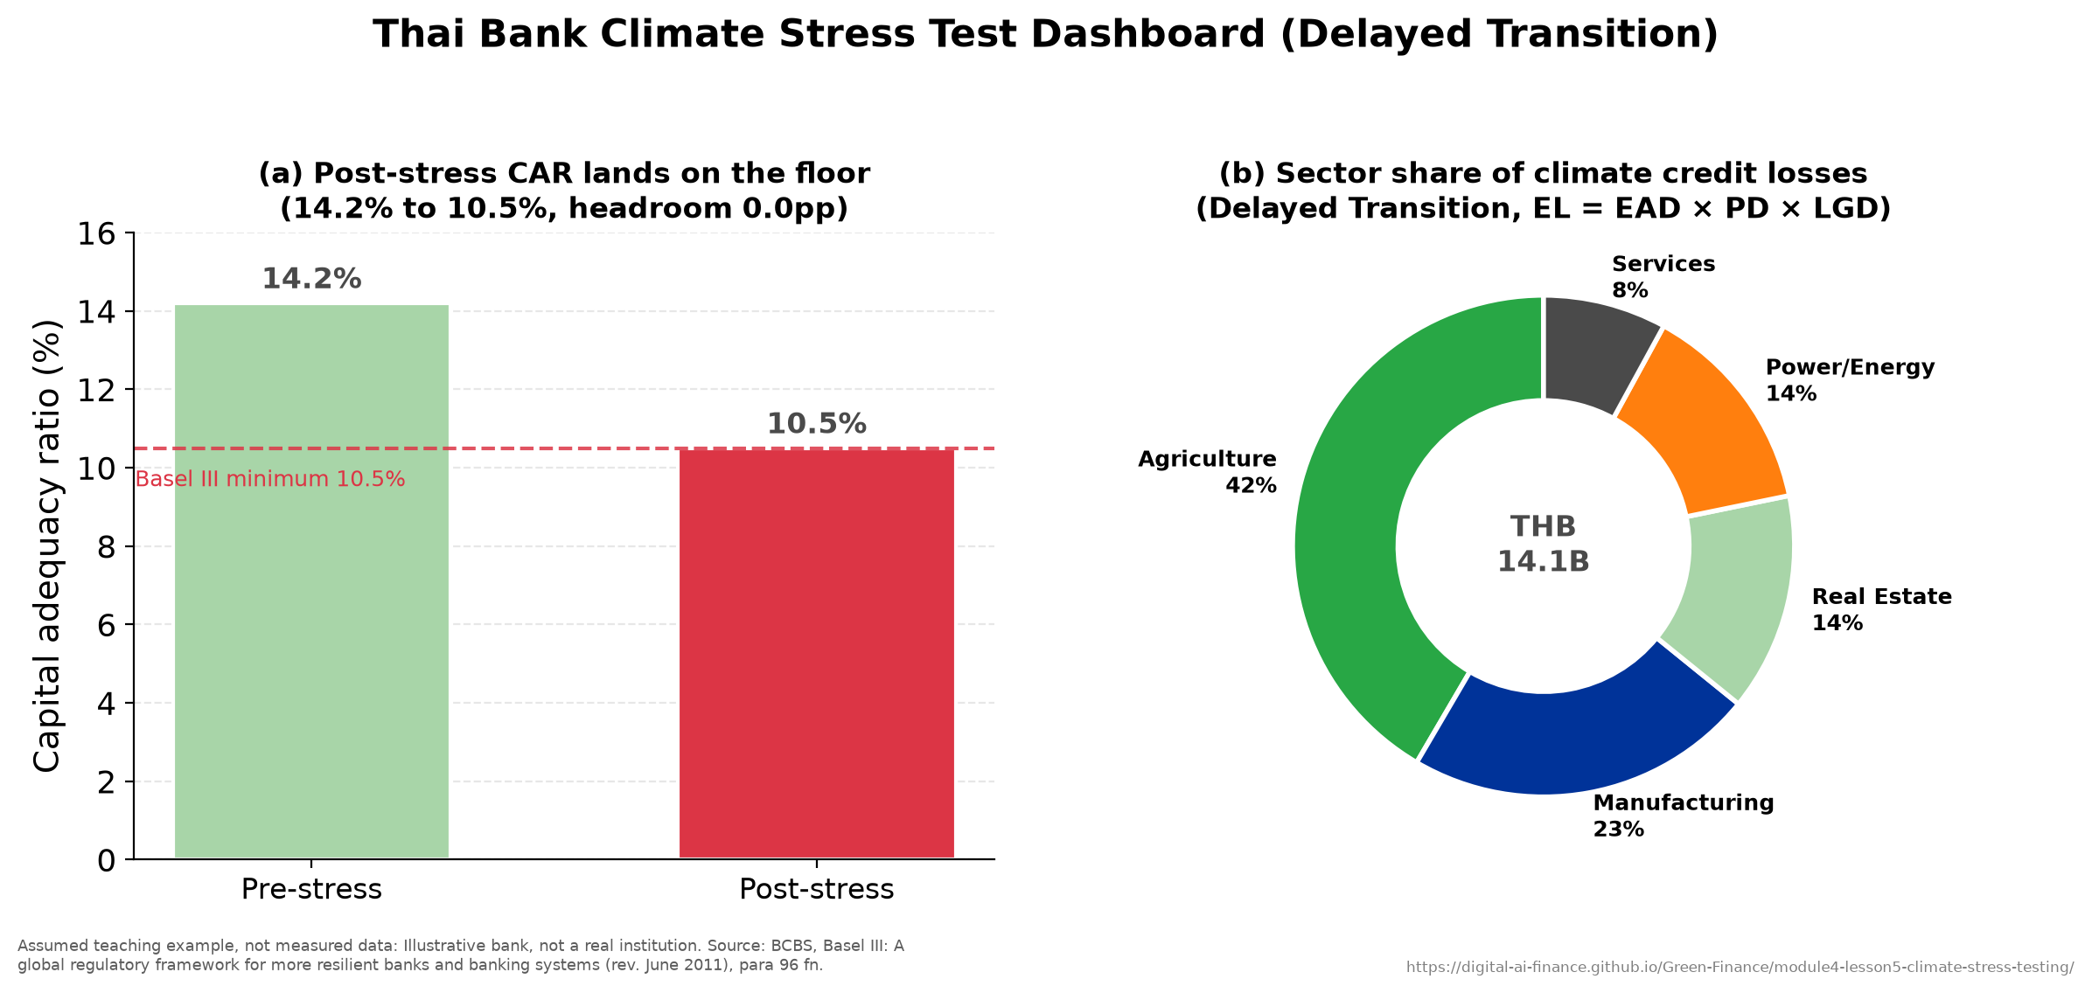
Thailand: physical risk, led by agriculture, dominates
1
2
3
4
5
6
Thailand 2011 floods: a stress-test dashboard.

Slide 52
6
ASEAN Climate Vulnerability
Regional risk, the adaptation finance gap, and the bridge to Module 5. ASEAN case: a Philippine capstone stress test.

Slide 53
Adaptation finance lowers vulnerability; blended finance draws private money in
1
2
3
4
5
6
Adaptation finance
Money that lowers vulnerability to climate damage
Blended finance
Public money takes the first loss so private investors will join
BOT and BSP
Bank of Thailand; Bangko Sentral ng Pilipinas
Fiscal space
Room in a government's budget to spend on recovery
Readiness
A country's economic, governance and social capacity to act
Mitigation finance
Money that cuts greenhouse-gas emissions
Risk transfer
Passing a loss to another party, as insurance or a catastrophe bond does
From zero, with worked examples: Start-from-Scratch Companion 6, ASEAN Climate Vulnerability

Slide 54
ASEAN scores high on all three terms at once
1
2
3
4
5
6
Risk = Hazard x Exposure x Vulnerability, and the region is exposed on each
Hazard: typhoons, floods, sea-level rise, heat
Exposure: dense coastal population and coastal economic activity
Vulnerability: high dependence on agriculture, limited fiscal space to absorb shocks

Slide 55
High hazard, high exposure, high vulnerability, low readiness
1
2
3
4
5
6
Schematic: the three terms of the risk identity, not measured values.
Hazard
Exposure
Vulnerability
x
x
Typhoons, floods, sea-level rise, heat
Dense coastal population and coastal activity
Agricultural dependence, limited fiscal space
All three terms are high across the region at once, which is what makes it a hotspot.

Slide 56
Expected annual loss is exposure times damage averaged over flood depth
Advanced
Developed further in Pickands (1975) and in Huizinga, De Moel and Szewczyk (2017)
1
2
3
4
5
6
A depth-damage curve D(h) gives the fraction of value a flood of depth h destroys, and averaging it over the year's flood depth gives the expected loss:
EAL = E · ∫ D(h) f(h) dh
P(H − u > y | H > u) = (1 + ξ y / β)^{−1/ξ}
where E is the exposed value, H the year's maximum flood depth with density f, u a high depth threshold, y the excess over it, and ξ and β the shape and scale of the generalized Pareto distribution that excesses over a high threshold approach
The generalized Pareto tail supplies the rare, deep floods that a short record holds few of, and D(h) is largest at those depths.

Slide 57
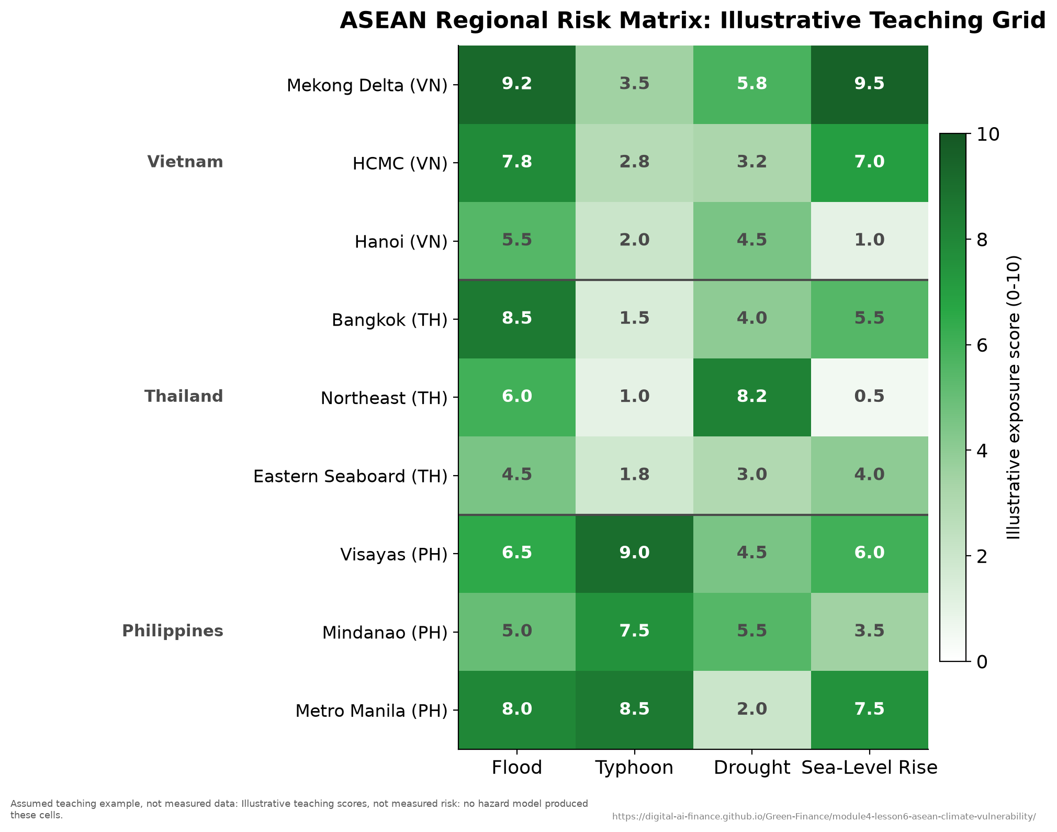
Risk concentrates on the central plain
1
2
3
4
5
6
Spatial distribution of ASEAN climate risk.

Slide 58
Three countries, three different problems
1
2
3
4
5
6
Qualitative comparison: each country's signature hazard and the sector it reaches. Named characteristics, not scores.
Vietnam
Thailand
Philippines
Signature hazard
Mekong Delta salinity and sea-level rise
River and flash flooding
Typhoon landfall
Exposed sector
Agriculture and aquaculture lending
Manufacturing and its supply chains
Coastal property and regional banks
Case in Module 4
The agricultural portfolio, and the CVaR inversion
The 2011 floods and the BOT stress test
The typhoon capstone stress test

Slide 59
Two value-at-risks add when the losses rise and fall together
Advanced
Developed further in Sklar (1959) and in Embrechts, McNeil and Straumann (2002)
1
2
3
4
5
6
The value-at-risk VaR_{α} is the loss exceeded with probability 1 − α, and for two losses X and Y:
VaR_{α}(X + Y) = VaR_{α}(X) + VaR_{α}(Y) for comonotone X and Y
F(x, y) = C( F_{X}(x), F_{Y}(y) )
λ_{U} = lim_{u→1} P( F_{Y}(Y) > u | F_{X}(X) > u )
where comonotone losses both increase with one common cause, F is the joint distribution, F_{X} and F_{Y} its two marginals, C the copula coupling them, and λ_{U} the upper tail dependence
Losses a regional typhoon drives together have λ_{U} near one: at a high α they exceed their value-at-risks together, as comonotone losses do.

Slide 60
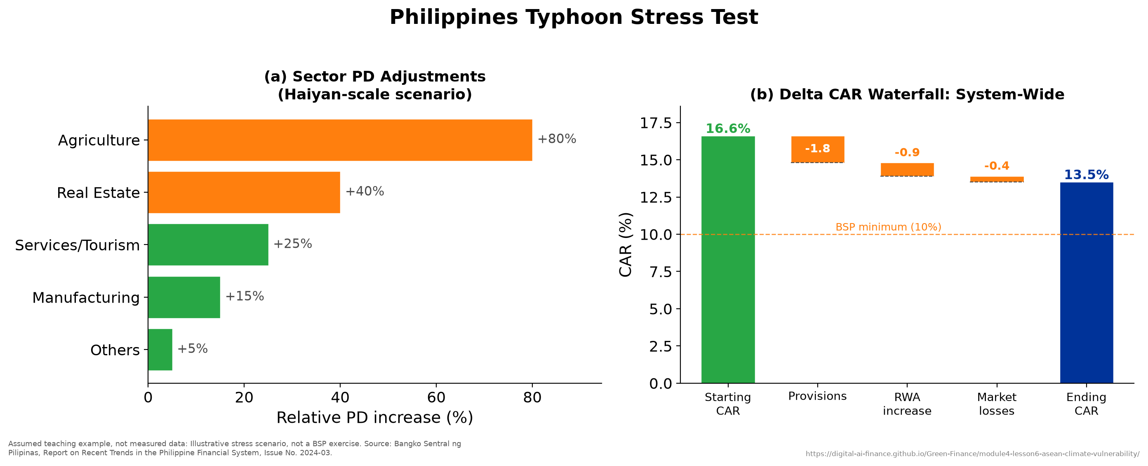
The capstone: aggregate capital holds while regional banks breach
1
2
3
4
5
6
Philippines Category-5 typhoon stress-test dashboard.

Slide 61
Adaptation finance is the binding constraint here
1
2
3
4
5
6
Mitigation finance dominates the flows; adaptation attracts far less
Adaptation returns are avoided losses, which are hard to price and to sell
Blended finance and risk-transfer instruments close part of the gap
This is where green finance policy meets climate risk management

Slide 62
Practice and Assessment
One applied activity, one assessment, and the bridge onward.

Slide 63
Practical activity: Thailand catastrophe tail risk
Advanced
Developed further in the participant handout, Appendix A
A self-contained 45-60 minute quantitative teaching case
From hazard (extreme-value fit) to loss, tail risk (VaR, Conditional VaR), solvency
Four phases: risk visualisation, capital adequacy, reinsurance strategy, climate implications
Runs at foundation level (solvency arithmetic) or at PhD level (full extreme-value model)

Slide 64
Assessment
Fifteen multiple-choice questions across all six lessons, with an answer key
One applied exercise tied to the Thailand case (solvency and reinsurance)
A four-dimension grading rubric: understanding, technical, critical, communication
Micro-credential assessment is 100 percent coursework

Slide 65
What to take away
Climate risk is a financial risk: classify it, measure it, then manage it
Frameworks, scenarios, metrics, and stress tests are one toolkit, not four
In ASEAN physical risk dominates and adaptation finance is scarce
Module 4 manages risk; Module 5 reports and communicates it

Slide 66
Acknowledgments
Developed by the University of Twente for WP3 of GREEN FINANCE (Erasmus+ CBHE)
Generative AI as a writing and research assistant: Claude (Anthropic), Opus 4.8 and Opus 5, July 2026 to submission on 11 September 2026
Confined to brainstorming, language editing, literature classification, and coding assistance
Every cited source checked against the original; every figure states its provenance
The authors remain fully responsible for accuracy, references, and conclusions
Released under a Creative Commons Attribution 4.0 International licence (CC BY 4.0)

Slide 67
Thank you
Module 4: Green Finance Risk Management | University of Twente
Co-funded by the European Union | GREEN FINANCE, Grant 101237817

