Slide 1
Module 4: Green Finance Risk Management
University of Twente | 15 October 2026
GREEN FINANCE, Erasmus+ CBHE 101237817
Notes:
0:00 to 0:01, 1 minute.
Say: Welcome the room and give the shape of the slot, two hours and a quarter: an opening of five minutes, six lessons of sixteen to twenty-three minutes, a close of three minutes, and five minutes for questions at the end of the slot. Module 4 is the University of Twente's module of the GREEN FINANCE micro-credential. It teaches how a bank classifies, measures and manages climate risk, with Vietnam, Thailand and the Philippines as the cases throughout.
Ask: Ask for a show of hands: who works with a bank's credit data, who supervises banks, who teaches finance? Expect a mix of bank staff and academics, and set the pace of the arithmetic slides by the bank staff in the room.
Misconception: Climate risk is a topic for the sustainability office. The class treats it as a financial risk and uses the tools of credit risk: expected loss, scenarios and capital ratios.

Slide 2
A Thai bank's capital and the climate loss it can absorb
Regulatory capital
THB 71 billion
Risk-weighted assets
THB 500 billion
Basel III minimum and buffer
10.5 %; the Bank of Thailand asks 11 %
Predict How large a climate loss, in THB billion, takes the bank to 10.5 %? Write down a number.
Illustrative bank, not a real institution. Source: BCBS, Basel III: A global regulatory framework for more resilient banks and banking systems (rev. June 2011), para 64; Bank of Thailand, Notification 12/2555, capital requirements.
Notes:
0:01 to 0:03, 2 minutes.
Say: This is the question the module answers. The bank is illustrative: its capital and its risk-weighted assets are those of chapter 5's worked example. The 10.5 percent is Basel III's minimum total capital ratio of 8.0 percent plus the 2.5 percent conservation buffer. The Bank of Thailand adds the same buffer to its own minimum of 8.5 percent and asks 11 percent; the foot of the slide cites both. Lesson 5 computes the answer at each floor, and the close compares it with the room's guesses.
Ask: Every delegate writes a number on paper and keeps it. Collect three aloud now and write them in a corner of the board. Expect answers from THB 5 billion to THB 50 billion.
Misconception: A climate loss has to be catastrophic to threaten a bank's capital. The answer depends on the gap between the bank's ratio and its floor, a few percentage points of risk-weighted assets, and the room computes it in Lesson 5.

Slide 3
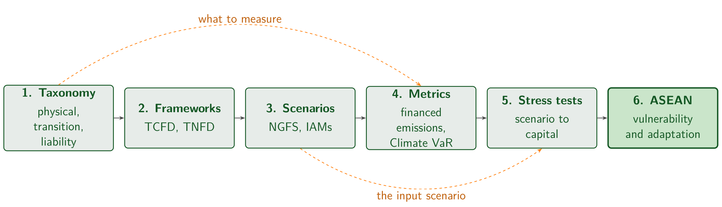
Each of the six lessons uses the ones before it
The six lessons and the order they depend on. Measurement needs the taxonomy; stress testing needs the scenarios.
Notes:
0:03 to 0:04, 1 minute.
Say: Lesson 1 names the risk and Lesson 2 the framework a bank manages it in. Lesson 3 supplies the scenarios, Lesson 4 the measures, Lesson 5 the stress test that combines them, and Lesson 6 applies all of it to Vietnam, Thailand and the Philippines. The two dashed edges are the dependencies that matter most: measurement needs the taxonomy, and stress testing needs the scenarios.
Ask: Which lesson does the room expect to be hardest? Expect Lesson 4 or 5, the quantitative ones. Say that each lesson has one check question, answered by a show of hands.
Misconception: The six lessons are independent topics. Each uses the one before it, and the Thai bank of the previous slide returns in Lesson 5 with the tools of Lessons 1 to 4.

Slide 4
Students learn to classify, measure and manage climate risk in ASEAN
This module addresses climate-related financial risks and their management within financial institutions and investment portfolios.
Students learn to classify, measure, and manage climate risks using TCFD/TNFD frameworks, NGFS scenarios, carbon metrics, Climate Value‑at‑Risk (CVaR), and stress testing.
All concepts are applied to the ASEAN context with equal coverage of Vietnam, Thailand, and the Philippines.
Notes:
0:04 to 0:05, 1 minute.
Say: These are the agreed learning outcomes of Module 4, in the words of the module description. Classify is Lessons 1 and 2, measure is Lessons 3 and 4, manage is Lesson 5, and the ASEAN context is Lesson 6 and every worked example: a Mekong rice book, a Thai bank, a Philippine typhoon.
Ask: Ask which of the three verbs, classify, measure or manage, the room's institutions do best today. Expect classify from most, and measure from a few of the banks.
Misconception: The module teaches climate disclosure. It teaches the risk management a disclosure reports on, and reporting belongs to another module of the micro-credential.

Slide 5
1
Climate-related financial risks
How does a hotter climate raise the expected loss on a Mekong Delta rice loan book?
Notes:
0:05 to 0:06, 1 minute.
Say: Lesson 1 names the risk before anything is measured. Climate risk reaches a bank in three families, physical damage, transition policy and liability claims, and each family arrives through the credit, market, operational and liquidity channels the bank already manages. By the end of the lesson the room computes what 2 degrees of warming do to the expected loss of a rice portfolio.
Ask: Put the question to the room and take three answers in thirty seconds. Expect 'farmers default', 'the land loses value' and 'deposits fall'. Write them on the board: the answer slide at the end of the lesson returns to them.
Misconception: Climate risk is an environmental topic for the sustainability team. The lesson treats it as credit risk, measured with the expected-loss formula every credit officer in the room already uses, and warming reaches the loss through that formula.

Slide 6
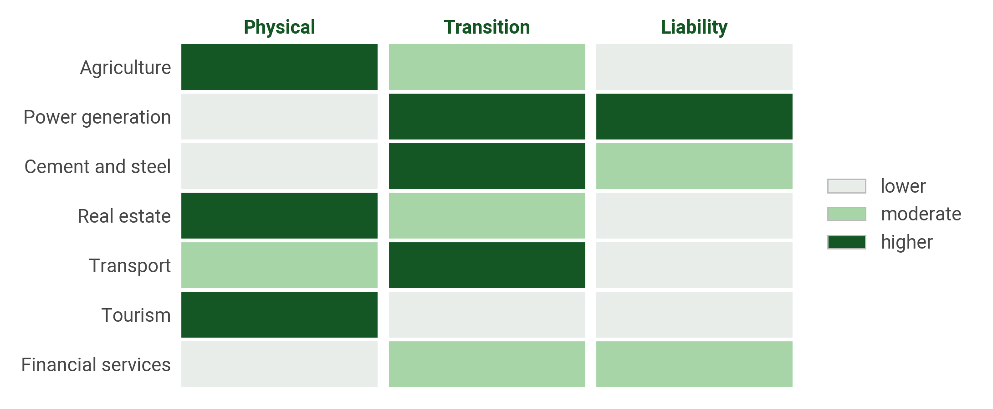
Three families of climate risk fall on different sectors
1
2
3
4
5
6
Seven sectors against the three legs of the taxonomy, in three named bands set by teaching judgement.
Notes:
0:06 to 0:07, 1 minute.
Say: Physical risk is damage from hazards: acute, such as a typhoon, or chronic, such as saltwater intrusion in the Delta. Transition risk is repricing from policy, technology and preferences as the economy decarbonises. Liability risk is a claim against a borrower for climate harm or for a disclosure failure. The bands restate chapter 1's qualitative argument in three levels and have no score.
Ask: Which sector is dark in two columns? Expect power generation, high on transition and on liability. Then ask where agriculture falls: high on physical, moderate on transition. Ask the bank staff which of the seven rows their largest book is in.
Misconception: A bank with no fossil-fuel lending has little climate risk. Agriculture, real estate and tourism have the highest physical exposure in the grid, and those are the books ASEAN banks hold.

Slide 7
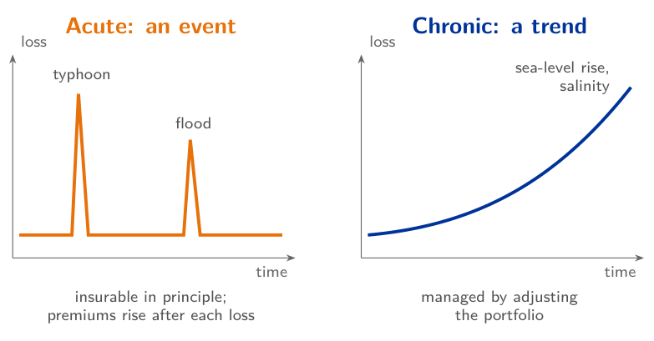
Physical risk is damage from hazards: acute events and chronic trends
1
2
3
4
5
6
Physical risk: losses when a climate hazard damages assets, cuts output or stops operations.
Acute
Events such as Philippine typhoons and the 2011 Thailand floods, insurable in principle
Chronic
Trends such as sea-level rise and Mekong Delta salinity, largely uninsurable
Insured share
Of about USD 250 billion of disaster losses in 2023, USD 95 billion was insured
Source: Munich Re (2024); World Bank (2012).
Notes:
0:07 to 0:08, 1 minute.
Say: Physical risk is the loss a hazard causes. Acute hazards are events: a typhoon over the Visayas, the 2011 floods over Thailand's industrial estates. Chronic hazards are trends: the rising sea, saltwater moving further into the Mekong Delta each dry season. An event can be insured, at a price that rises after every loss; a trend cannot, so a chronic hazard calls for a change of portfolio. Physical risk reaches credit through the borrower's income, which raises default probability, and through the collateral, which raises loss given default.
Ask: Which of your books faces an acute hazard, and which a chronic one? Expect typhoons from the Philippine delegates and salinity from the Vietnamese.
Misconception: Insurance takes physical risk off the bank. Most disaster losses are uninsured, in ASEAN more than elsewhere, so they stay with borrowers and their lenders.

Slide 8
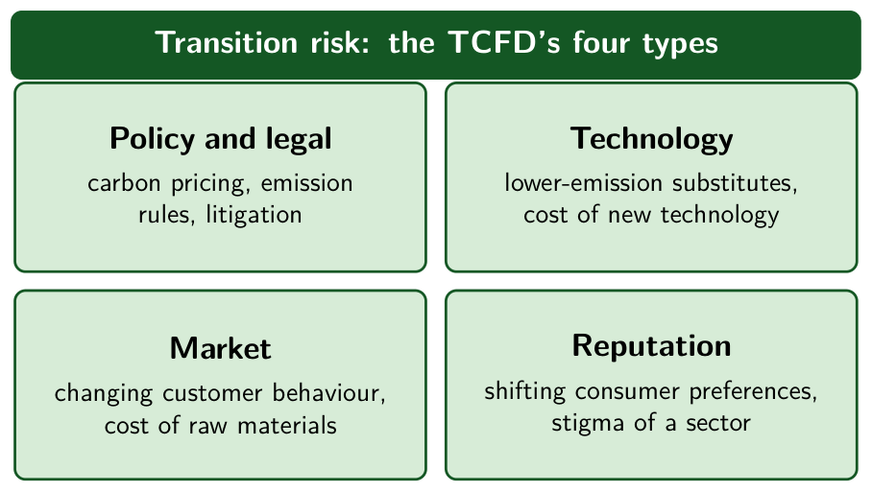
Transition risk: the move to a low-carbon economy strands assets
1
2
3
4
5
6
Transition risk: losses from the move to a low-carbon economy, through policy and law, technology, markets and reputation.
Four types
Policy and legal, technology, market and reputation; buyers' behaviour is a market risk
Stranded assets
Coal plants retired early, reserves left in the ground, buildings below efficiency standards
For ASEAN exporters
A carbon charge applies to EU imports of steel and cement from 2026
Source: TCFD (2017), Final Report, Figure 1 and Table 1; European Commission, Carbon Border Adjustment Mechanism.
Notes:
0:08 to 0:09, 1 minute.
Say: Transition risk comes from the move to a low-carbon economy: a carbon price, a coal phase-out, cheaper solar power, buyers who ask for low-carbon goods. The TCFD sorts it into four types: policy and legal, technology, market and reputation. It grows with policy ambition, where physical risk grows with warming, so a disorderly transition brings high transition risk and less physical risk, and a hot house world the reverse. Stranded assets are its sharpest form: a coal plant retired before its loan is repaid. From 2026 the EU charges for the carbon in imported steel and cement, which reaches ASEAN exporters and their lenders.
Ask: Which borrower in your book would a carbon price hurt first? Expect coal power and cement; then ask about the steel exporters.
Misconception: Transition risk belongs to fossil-fuel lenders alone. A carbon price reaches every carbon-intensive supply chain, including manufacturers that export to the EU.

Slide 9
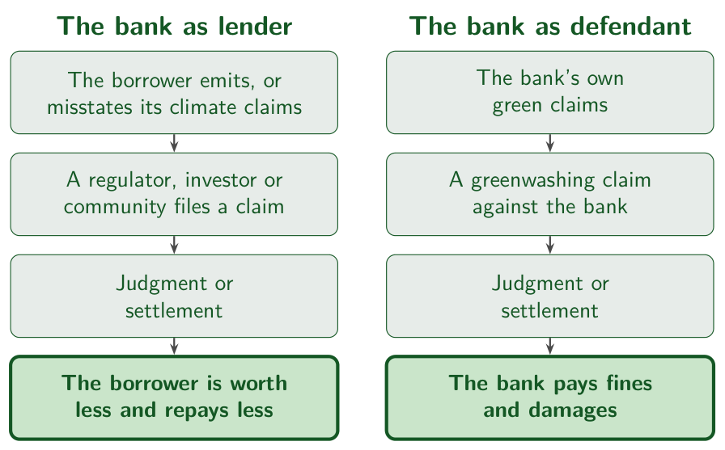
Liability risk reaches the lender through the courts
1
2
3
4
5
6
Liability risk: losses from legal claims over climate harm, a failure to adapt, or misleading climate statements.
Litigation
Setzer and Higham count 2,341 climate cases as of 2023
Greenwashing
Regulators and investors act against green claims the numbers do not support
The bank, twice
As lender to a defendant whose value falls, and as a defendant over its own green claims
Source: Setzer and Higham (2023).
Notes:
0:09 to 0:10, 1 minute.
Say: Liability risk is the third family, and the one that reaches the lender through a court. Claims come from people harmed by emissions, from those hurt by a failure to adapt to a known hazard, and from investors and regulators misled by green claims. Setzer and Higham count 2,341 climate cases by 2023. A bank is hit twice: a judgment lowers what the borrower is worth and its ability to repay, and the bank's own green claims can take it to court as a defendant.
Ask: Has a borrower of yours published a net-zero pledge it cannot meet? Expect hesitation; then ask what the bank's own sustainability report promises.
Misconception: Liability risk falls on emitters alone. A bank that finances a defendant shares its loss, and a bank that sells green products faces the same greenwashing claims.

Slide 10
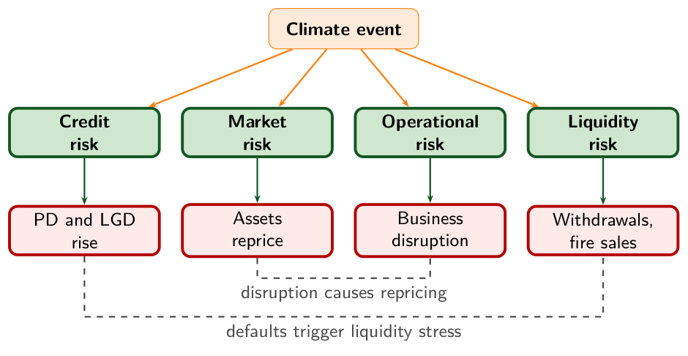
One climate event moves credit, market, operational and liquidity risk at once
1
2
3
4
5
6
A climate event moves credit, market, operational and liquidity risk together, and the channels amplify one another.
Notes:
0:10 to 0:11, 1 minute.
Say: Follow one flood through the figure. Borrowers default more and recover less: credit risk. Collateral and securities reprice: market risk. Branches and data centres stop: operational risk. Depositors withdraw and assets are sold into a falling market: liquidity risk. A bank organises its risk functions by these four channels, and one flood reaches all of them in the same week.
Ask: Which channel would your institution's risk report pick up first, and which last? Expect credit first, through provisions, and liquidity last. Ask a delegate from a bank how long the credit channel takes to show in the provisions.
Misconception: Each channel can be modelled on its own. The two dashed lines are the interactions between them: defaults trigger liquidity stress, and business disruption causes market repricing.

Slide 11
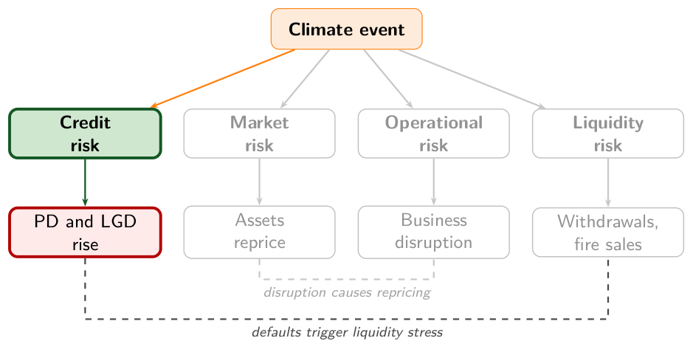
Credit risk: climate raises default probability and loss given default
1
2
3
4
5
6
Credit risk: the borrower repays less than it owes, by defaulting or by leaving a smaller recovery.
How climate reaches it
Drought lifts default probability (PD), floods lift loss given default (LGD), drawn lines lift exposure (EAD)
What the bank does
Scenario PD and LGD, limits by sector and region, shorter tenors, lower loan-to-value limits
Basel expects
Principle 8: climate risk over the whole credit life cycle, from onboarding to monitoring
Source: BCBS (2022), Principles for the effective management and supervision of climate-related financial risks, Principle 8, paragraphs 35 to 37.
Notes:
0:11 to 0:12, 1 minute.
Say: Credit risk is the loss when a borrower repays less than it owes. Climate moves all three terms of expected loss. Income falls, so default probability rises. Collateral is damaged or loses value, so loss given default rises. Borrowers under stress draw their unused lines, so exposure at default rises. Credit is the largest channel for ASEAN banks, which dominate financial intermediation in the region. The Basel Committee's Principle 8 asks for climate risk over the whole credit life cycle, and names shorter tenors and lower loan-to-value limits as mitigants.
Ask: Where does your institution record a borrower's flood risk today: in the credit memo, in the collateral valuation, or nowhere? Expect 'nowhere' from several delegates.
Misconception: Climate needs a new risk category. It enters through PD, LGD and EAD, the parameters the bank already estimates.

Slide 12
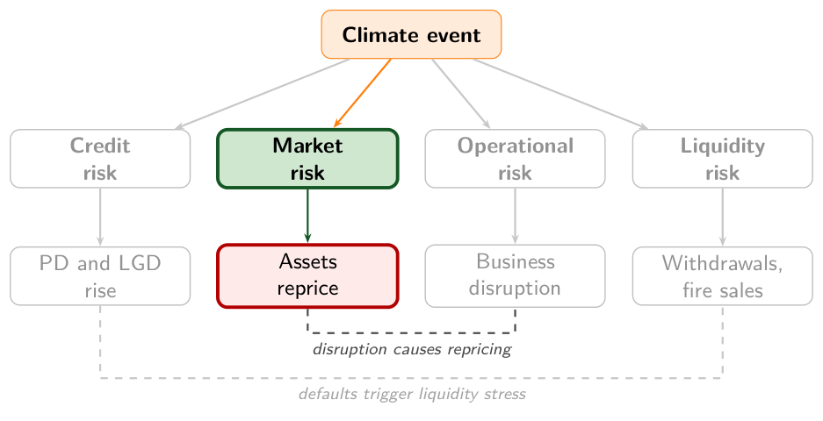
Market risk: assets reprice before any borrower defaults
1
2
3
4
5
6
Market risk: losses on the instruments the bank holds when prices, rates or spreads move.
How climate reaches it
A carbon price reprices carbon-heavy issuers before any default; flood maps reprice property
What the bank does
A sudden climate shock on the trading book, the cost of hedges, the value of bonds held
Basel expects
Principle 9: how climate drivers change the value and volatility of instruments held
Source: BCBS (2022), Principles for the effective management and supervision of climate-related financial risks, Principle 9, paragraphs 38 to 40.
Notes:
0:12 to 0:13, 1 minute.
Say: Market risk is the loss on what the bank holds when prices move. Climate news moves prices before any borrower misses a payment: a carbon price announcement lowers the value of a coal utility's bonds the same day. The Basel Committee suggests a sudden shock scenario for the trading book, and asks banks to consider that hedges may cost more, or disappear, in a disorderly transition. For most ASEAN banks the trading book is small next to the loan book, so the channel matters most for their bond portfolios and for the value of property collateral. Lesson 4's Climate VaR, a loss of value under one scenario, applies to this channel.
Ask: Which securities in your treasury portfolio would lose value first under a carbon tax? Expect coal issuers first and government bonds last.
Misconception: Market risk waits for defaults. Prices move on the policy announcement, often years before a borrower's cash flow falls.

Slide 13
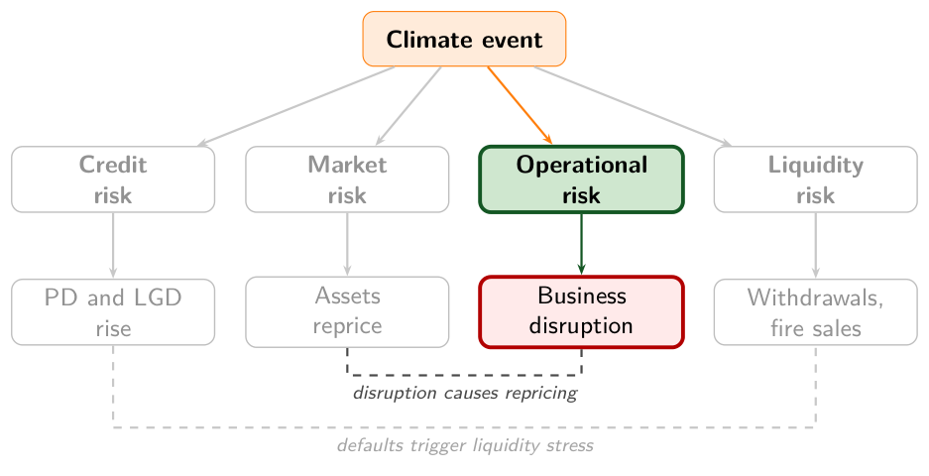
Operational risk: a flood stops the bank's own branches and systems
1
2
3
4
5
6
Operational risk: loss from failed processes, people and systems, or from external events, in the Basel definition.
How climate reaches it
Flooded branches and data centres, staff cut off, outsourced services down, greenwashing fines
What the bank does
Hazard maps of its own sites and suppliers, recovery tests, a record of climate loss events
Basel expects
Principle 11: business continuity plans that account for physical risk drivers
Source: BCBS (2022), Principles for the effective management and supervision of climate-related financial risks, Principle 11, paragraph 42.
Notes:
0:13 to 0:14, 1 minute.
Say: Operational risk is the bank's own loss: its processes, people and systems fail, or an external event stops them. A flood is such an event. In the 2011 Thailand floods industrial estates stood under water for weeks, and a bank with branches, back offices and borrowers in the flooded provinces faces operational, credit and liquidity stress at once. The Basel definition includes legal risk, so fines for misleading green claims count here too. Principle 11 asks banks to plan business continuity for physical hazards.
Ask: Where is your institution's main data centre, and what is its flood exposure? Expect few delegates to know; ask who would.
Misconception: Operational risk is an IT matter. A climate event stops people and branches as well as systems, and the continuity plan has to cover the borrowers' region as well as the head office.

Slide 14
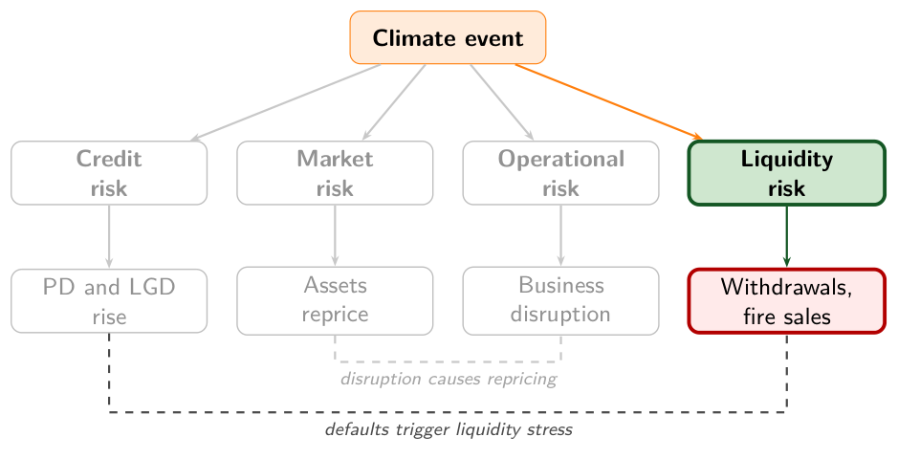
Liquidity risk: withdrawals and drawdowns arrive with the losses
1
2
3
4
5
6
Liquidity risk: the bank cannot meet its cash outflows without selling assets at a loss or borrowing at a penalty.
How climate reaches it
After a disaster, deposits are withdrawn, credit lines drawn, and buffer bonds lose value
What the bank does
A liquidity coverage ratio stress with a climate event in the scenario
Basel expects
Principle 10: climate effects on net cash outflows and on the value of liquidity buffers
Source: BCBS (2022), Principles for the effective management and supervision of climate-related financial risks, Principle 10, paragraph 41.
Notes:
0:14 to 0:15, 1 minute.
Say: Liquidity risk is the failure to pay cash when it is due without a fire sale. A disaster raises outflows and lowers the buffer in the same week: households withdraw deposits to rebuild, firms draw their credit lines to pay staff and suppliers, and the bonds the bank holds for liquidity may lose value. Defaults and withdrawals come in the same weeks, so credit losses and liquidity stress coincide. The liquidity coverage ratio compares high-quality liquid assets with net cash outflows under stress; Principle 10 asks banks to put climate events into that stress.
Ask: In a typhoon region, what happens to a rural bank's deposits in the month after landfall? Expect withdrawals; ask where the bank would borrow.
Misconception: Liquidity stress follows only a bank run. A regional disaster produces the same outflows with no loss of confidence in the bank.

Slide 15
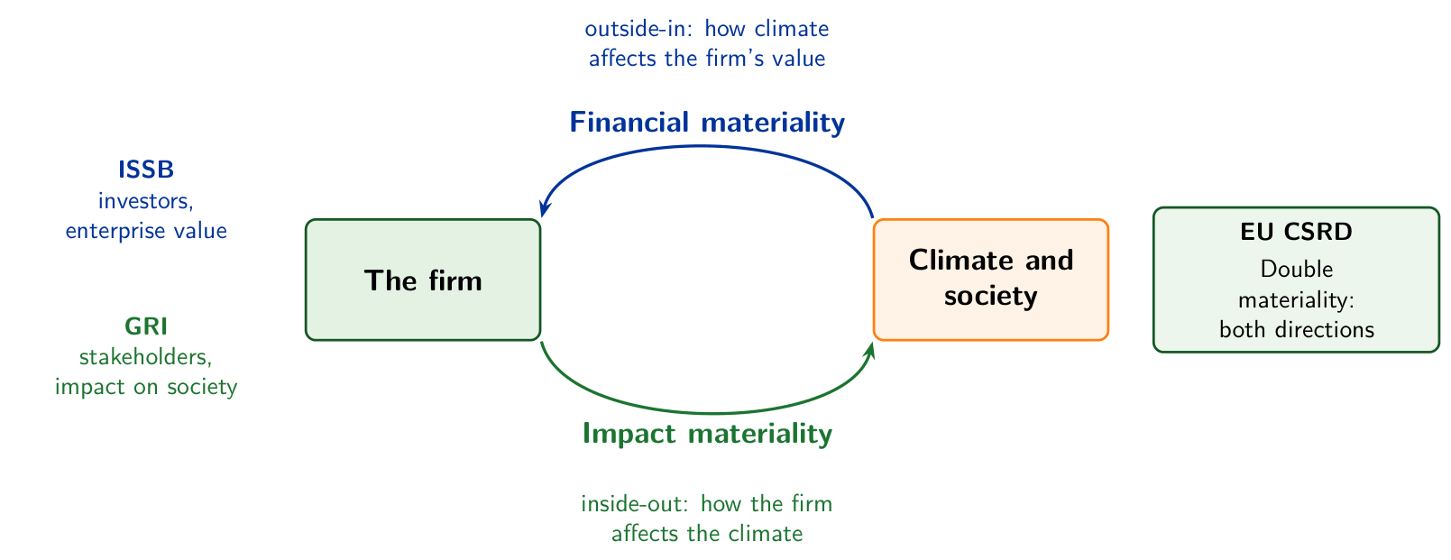
Financial materiality is outside-in, impact materiality inside-out
1
2
3
4
5
6
ISSB asks how climate affects the firm's value, GRI how the firm affects climate; the EU CSRD asks both.
Notes:
0:15 to 0:16, 1 minute.
Say: Materiality decides which climate risks a bank must act on and report, and the standards define it in two directions. Financial materiality is outside-in: how climate changes a firm's cash flows and value, the view of the ISSB standards. Impact materiality is inside-out: how the firm changes the climate and society, the view of the GRI standards. The EU CSRD requires both, double materiality. A Vietnamese coal-fired plant under a state purchase agreement has low financial materiality for some years and high impact materiality.
Ask: For your largest corporate borrower, is climate material in one direction, the other, or both? Expect bank staff to answer outside-in, the view of credit risk; then ask which direction a report under the EU CSRD needs.
Misconception: Impact materiality is the sustainability office's concern and leaves credit risk alone. Impact becomes financial when a carbon price, a regulation or a court makes the firm pay for it, and a bank that watches only the outside-in view learns of it late.

Slide 16
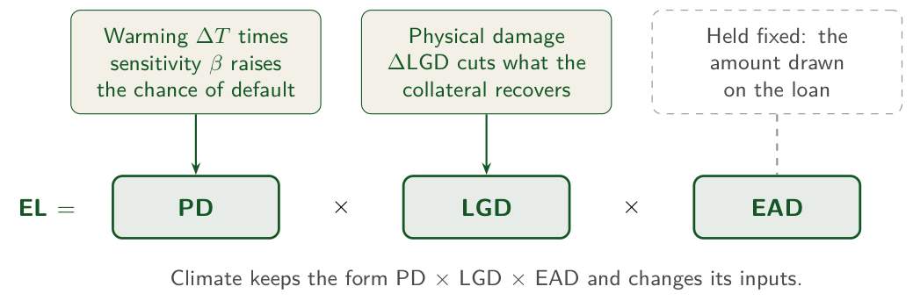
Climate multiplies default probability and adds to loss given default
1
2
3
4
5
6
EL_{climate} = PD_{base}(1 + ΔT·β) × (LGD_{base} + ΔLGD) × EAD
PD_{base}: default probability today. ΔT: warming beyond today's climate, °C. β: the sector's climate sensitivity. LGD_{base}: loss given default today. ΔLGD: collateral lost to physical damage. EAD: exposure at default, held fixed.
Notes:
0:16 to 0:18, 2 minutes.
Say: Expected loss is PD times LGD times EAD, the identity every credit officer knows. Climate puts a multiplier on PD, one plus warming times sensitivity, and an add-on on LGD for damaged collateral, and keeps exposure at its value today. The figure shows how: warming times sensitivity raises PD, physical damage cuts what the collateral recovers, and EAD is held fixed.
Ask: Read the formula term by term with the room. What does β measure? Expect 'how much the default rate rises per degree of warming'. Chapter 1 puts it near 0.35 for agriculture, 0.25 for energy and 0.05 for technology.
Misconception: Climate risk needs a new model. The formula is the bank's own expected-loss identity with two climate adjustments inside it, so the bank's existing credit data feed it.

Slide 17
A Mekong Delta rice portfolio at plus 2.0 °C
1
2
3
4
5
6
Default probability today
5.0 %
Climate sensitivity β, agriculture
0.35 per °C
Warming beyond today, ΔT
plus 2.0 °C
Loss given default today
60 %, plus 5 points of collateral damage
Exposure at default
USD 300 million, unchanged
Predict Expected loss today is USD 9.0 million. Write down the percentage rise you expect at plus 2.0 °C.
Illustrative Mekong Delta rice portfolio, chosen to make the mechanism visible.
Notes:
0:18 to 0:20, 2 minutes.
Say: Every number on the slide is an illustrative teaching value from chapter 1, chosen to make the mechanism visible, and the foot of the slide says so. The portfolio lends USD 300 million to rice farmers in the Delta. Exposure stays fixed at USD 300 million, so the only thing that moves is the climate. The Delta itself is measured: it is home to 18 million people (World Bank, 2022), and its hazards are chronic: saltwater intrusion and a rising sea. The Philippines faces the acute kind: about 20 tropical cyclones enter its area of responsibility each year and 8 or 9 cross the country (PAGASA).
Ask: Everyone writes a number before the next slide: by what percentage does expected loss rise? Expect most guesses between 30 and 70 percent, anchored on the PD multiplier, 1 + 2.0 × 0.35 = 1.7. Ask two delegates to say their number aloud.
Misconception: Two degrees of warming is a small shock because two is a small number. The sensitivity turns it into a 70 percent rise in default probability before loss given default has moved.

Slide 18
Expected loss rises 84 percent, from USD 9.0 million to 16.6 million
1
2
3
4
5
6
1
Climate-adjusted PD = 0.05 × (1 + 2.0 × 0.35) = 0.085, or 8.5 %
2
Climate-adjusted LGD = 60 % + 5 points = 65 %
3
Expected loss today = 0.05 × 0.60 × USD 300 million = USD 9.0 million
4
Expected loss at plus 2.0 °C = 0.085 × 0.65 × USD 300 million = USD 16.6 million
USD 7.6 million of added loss, a rise of 84 percent
Illustrative Mekong Delta rice portfolio, chosen to make the mechanism visible.
Notes:
0:20 to 0:23, 3 minutes.
Say: Work it on the board in the slide's order. Step 1 multiplies PD by 1.7. Step 2 adds five points to LGD. Steps 3 and 4 are one formula with the old inputs and then the new ones. The difference, USD 7.6 million, is the loss the scenario adds to this book.
Ask: Who predicted a rise above 80 percent? Expect few hands. Ask one of them what they saw that the others missed, and hold the answer for the check on the next slide.
Misconception: The rise in expected loss equals the rise in default probability. PD rises 70 percent and expected loss 84 percent, and the check on the next slide asks the room where the difference comes from.

Slide 19
A 70 percent rise in default probability and an 84 percent rise in expected loss
Check
1
2
3
4
5
6
Default probability rises 70 percent and expected loss 84 percent. Where do the other 14 points come from?
A
Exposure at default grows in the warmer scenario
B
Default correlation among farmers in the same delta
C
Loss given default rises from 60 to 65 percent
D
A separate climate term added to expected loss
Illustrative Mekong Delta rice portfolio, chosen to make the mechanism visible.
Notes:
0:23 to 0:25, 2 minutes.
Say: Read the stem aloud, then the four options. The room votes by show of hands, A to D, in twenty seconds. Count each letter aloud and write the counts on the board.
Ask: Before showing the answer, ask one delegate from the largest group to defend their letter in one sentence, and one from the second largest.
Key: C is the key. A tempts because exposure grows in a real book and raises expected loss, and the example holds exposure at USD 300 million. B tempts because correlation shapes the distribution of portfolio losses; expected loss is a sum over loans, and correlation leaves the sum unchanged. D tempts because the lesson adds climate to the formula, and it adds it inside the three existing terms.

Slide 20
The loss given default moves too
1
2
3
4
5
6
C Loss given default rises from 60 to 65 percent
Why
The two rises multiply: 1.70 × 1.083 = 1.84. A 70 percent rise in PD and an 8.3 percent rise in LGD make an 84 percent rise in expected loss.
Tempting: A, Exposure at default grows in the warmer scenario
Exposure growth raises expected loss in a real book, and the example holds exposure at USD 300 million in both columns.
Takeaway Climate enters expected loss through its terms, and their rises multiply.
Illustrative Mekong Delta rice portfolio, chosen to make the mechanism visible.
Notes:
0:25 to 0:27, 2 minutes.
Say: Show the multiplication: 1.70 × 1.083 = 1.84, so the 14 points are the rise in LGD compounding with the rise in PD. Then return to the question of the lesson's first slide. A hotter climate raises default probability through lost harvests and lowers recovery through damaged land and equipment, and both reach expected loss, which the bank books as provisions.
Ask: Which of the answers on the board from the first slide named both routes? Ask the delegate who gave it to restate it with the two terms of the formula.
Misconception: Climate risk is a separate risk type with a number of its own. It is expected loss with climate-adjusted inputs, which is why lesson 4 can price it and lesson 5 can stress it.

Slide 21
2
TCFD and TNFD risk assessment
A supervisor opens a bank's climate report. What does the supervisor look for first?
Notes:
0:27 to 0:28, 1 minute.
Say: TCFD, the Task Force on Climate-related Financial Disclosures, set four pillars for what a firm reports on climate: governance, strategy, risk management, and metrics and targets. TNFD, its counterpart for nature, applies the same structure to biodiversity and ecosystems. The lesson teaches the assessment that stands behind the report.
Ask: Take answers for thirty seconds. Expect 'the emissions numbers' and 'the targets'. Keep them on the board: the answer slide at the end of the lesson returns to them.
Misconception: Climate work at a bank is a disclosure exercise. Supervisors read the disclosure as evidence of risk management, so the lesson starts from the risk management and reaches the report last.

Slide 22
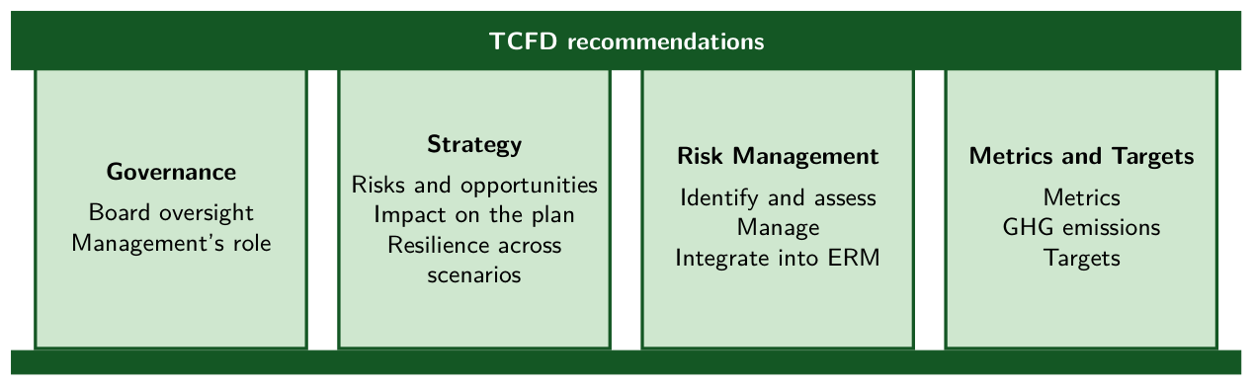
Four pillars, with Risk Management as the operational core
1
2
3
4
5
6
Governance, Strategy, Risk Management, and Metrics and Targets: the four pillars of the TCFD recommendations of 2017.
Notes:
0:28 to 0:29, 1 minute.
Say: Governance asks who is accountable: the board and its committees. Strategy asks what climate does to the business plan over which horizons. Risk Management asks how the bank identifies, assesses and manages climate risk. Metrics and Targets asks what it measures, such as emissions and targets. The first three are processes; the fourth is the output that reaches the public, and the dashed loop feeds it back to governance.
Ask: Which pillar does a credit officer work in? Expect Risk Management. Ask one credit officer what a climate line in a credit memo would say.
Misconception: The four pillars are four separate reports. They form one system: governance sets the appetite, strategy and risk management apply it, and the metrics report what the three produce.

Slide 23
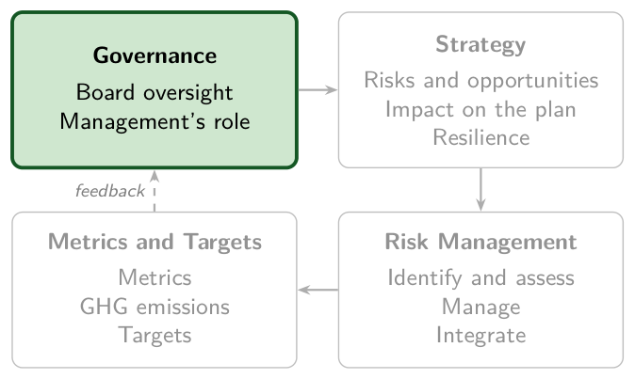
Governance: the board oversees climate risk and management runs it
1
2
3
4
5
6
Governance: the organization's governance around climate-related risks and opportunities, in the TCFD's words.
TCFD asks
The board's oversight of climate risks and opportunities, and management's role in managing them
In a bank
The board's risk committee sets a climate risk appetite and names the executive who answers for it
Basel expects
Principle 2: the board assigns climate responsibilities and oversees the risks
Source: BCBS (2022), Principles for the effective management and supervision of climate-related financial risks, Principle 2, paragraphs 15 to 17; TCFD (2017), Final Report, Figures 2 and 4.
Notes:
0:29 to 0:30, 1 minute.
Say: Governance is the first pillar: who in the bank answers for climate risk. The TCFD asks for two disclosures, the board's oversight of climate-related risks and opportunities and management's role in assessing and managing them. In a bank that means a board committee, usually the risk committee, that sets a climate risk appetite and reviews it, and a named executive who answers for climate risk from day to day. The Basel Committee's Principle 2 asks the board and senior management to assign climate responsibilities and to oversee the risks.
Ask: Who in your institution answers to the board for climate risk: the chief risk officer, the head of sustainability, or nobody by name? Expect a mix; the head of sustainability places climate outside the risk function.
Misconception: Governance means a sustainability committee. The pillar asks for board oversight of climate as a financial risk, by the committee that oversees credit and market risk.

Slide 24
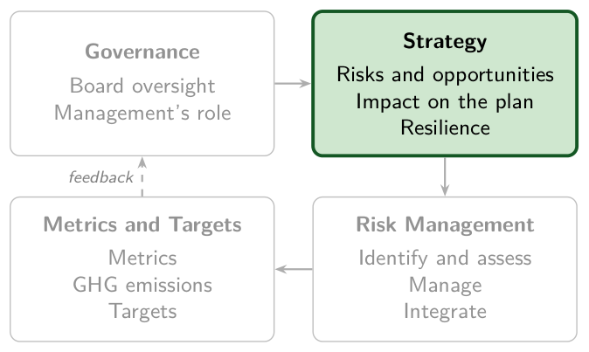
Strategy: what climate does to the business plan over three horizons
1
2
3
4
5
6
Strategy: the actual and potential impacts of climate risks and opportunities on the business, strategy and planning.
TCFD asks
Risks over the short, medium and long term, their impact on the plan, its resilience across scenarios
In a bank
Which sectors and regions the loan book grows or leaves, tested against the NGFS scenarios
Basel expects
Principle 1: climate risks over various horizons, built into the business strategy
Source: BCBS (2022), Principles for the effective management and supervision of climate-related financial risks, Principle 1, paragraphs 12 to 14; TCFD (2017), Final Report, Figures 2 and 4.
Notes:
0:30 to 0:31, 1 minute.
Say: Strategy asks what climate does to the bank's business and to its plan. The TCFD asks for three disclosures: the risks and opportunities the bank has identified over the short, medium and long term, their impact on the business and its financial planning, and the resilience of the strategy under different climate scenarios, one of them 2 degrees or lower. For a bank the strategy is the shape of its loan book: which sectors and regions it grows and which it leaves. The NGFS scenarios of Lesson 3 are the tool the third disclosure asks for. The Basel Committee's Principle 1 asks banks to build material climate risks, over various horizons, into their business strategy.
Ask: Name one sector your institution would lend less to under Net Zero 2050, and one it would lend more to. Expect coal power for the first and renewables or efficient buildings for the second.
Misconception: Strategy is a statement of green ambitions. The TCFD asks how the existing plan holds up under scenarios, a test of the business as it stands.

Slide 25
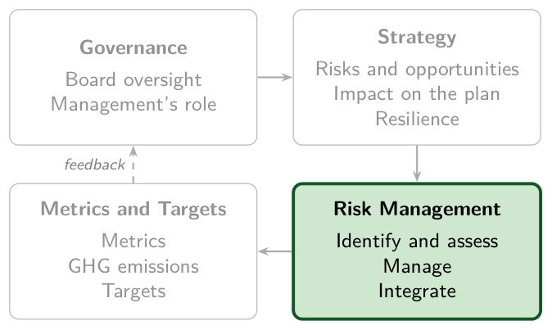
Risk Management: identify, assess and manage climate risk, then integrate it
1
2
3
4
5
6
Risk Management: the processes used by the organization to identify, assess and manage climate-related risks.
TCFD asks
How the bank identifies, assesses and manages climate risk, and integrates it into its ERM
In a bank
Exposure mapped by business line and region, scenario PD and LGD, thresholds applied in lending
Basel expects
Principle 6: identify, monitor and manage all material climate-related financial risks
Source: BCBS (2022), Principles for the effective management and supervision of climate-related financial risks, Principle 6, paragraphs 27 to 30; TCFD (2017), Final Report, Figures 2 and 4.
Notes:
0:31 to 0:32, 1 minute.
Say: Risk Management asks for the processes, and the TCFD names three disclosures: how the bank identifies and assesses climate risk, how it manages it, and how both are integrated into its overall risk management. Identifying and assessing means mapping physical and transition exposure by business line and region, and estimating scenario-adjusted PD and LGD. Managing means thresholds in the risk appetite, applied when the bank lends and invests. Integrating means the climate processes are part of enterprise risk management, the framework that already covers credit and market risk. The rubric of this lesson's example scores the same steps as four dimensions: identify, assess, manage and integrate. The Basel Committee's Principle 6 asks banks to identify, monitor and manage every material climate risk.
Ask: Where does climate risk enter a credit decision in your institution today: at onboarding, in the credit memo, in the limit, or nowhere? Expect 'the credit memo' from a few.
Misconception: A climate risk register is climate risk management. A register identifies; the pillar also asks how the risks are assessed, managed and integrated.

Slide 26
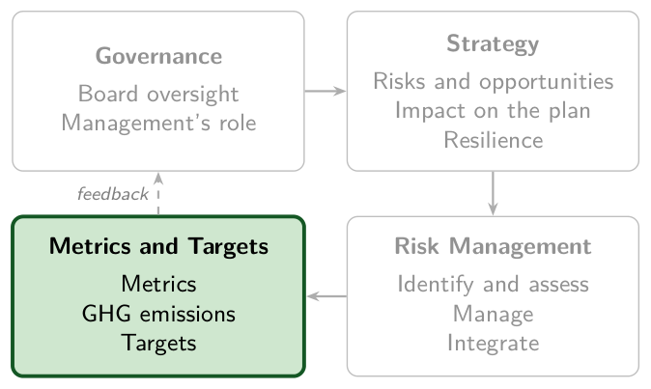
Metrics and Targets: what the bank measures and the goals it sets
1
2
3
4
5
6
Metrics and Targets: the metrics and targets used to assess and manage relevant climate-related risks and opportunities.
TCFD asks
The metrics in use; Scope 1, Scope 2 and, if appropriate, Scope 3 emissions; targets and results
In a bank
Financed emissions and carbon intensity of the loan book, and a target for each
Basel expects
Principle 7: risk data and internal reports that track material climate risks
Source: BCBS (2022), Principles for the effective management and supervision of climate-related financial risks, Principle 7, paragraphs 31 to 34; TCFD (2017), Final Report, Figures 2 and 4.
Notes:
0:32 to 0:33, 1 minute.
Say: Metrics and Targets asks what the bank measures and which goals it sets. The TCFD asks for three disclosures: the metrics used to assess climate risks and opportunities; Scope 1, Scope 2 and, if appropriate, Scope 3 greenhouse gas emissions; and the targets, with performance against them. For a bank, Scope 3 includes financed emissions, the emissions of its borrowers, and Lesson 4 measures them with the PCAF method. The Basel Committee's Principle 7 asks for risk data and internal reports that track material climate risks for the board.
Ask: Which of your institution's climate numbers is published, and which is used in a decision? Expect published emissions from several, and a number used in a decision from few.
Misconception: Metrics and Targets is where a bank starts. The pillar comes last in the TCFD's order, and a target needs a baseline the risk process has measured first.

Slide 27
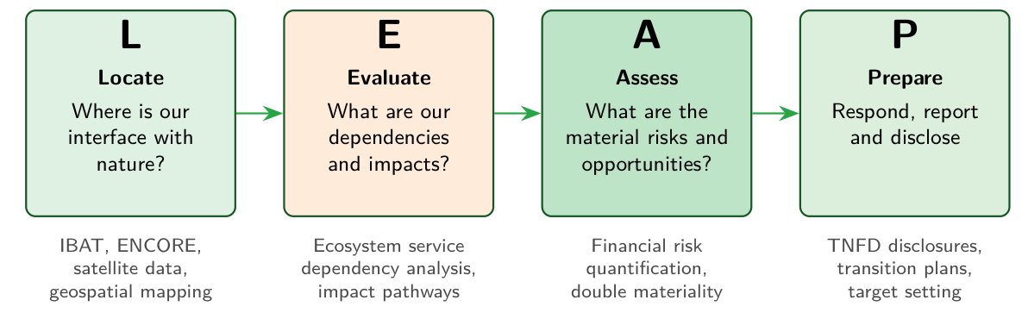
TNFD assesses nature risk in four steps: Locate, Evaluate, Assess, Prepare
1
2
3
4
5
6
TNFD, September 2023: the four pillars of TCFD, and LEAP, which starts where a borrower meets nature.
Notes:
0:33 to 0:34, 1 minute.
Say: The TNFD published its recommendations in September 2023. They keep the four TCFD pillars, with risk management widened to risk and impact management, and add LEAP, the process a bank runs to find its nature-related risk. Locate: where the borrower's sites meet nature, found with tools such as IBAT and ENCORE. Evaluate: what the borrower depends on, such as water, pollination and flood regulation, and what it damages. Assess: which of those are material risks. Prepare: respond, set targets and disclose.
Ask: Take a palm-oil or aquaculture borrower from your book. Which ecosystem service does it depend on, and where? Expect water and land; then ask whether the bank holds the coordinates of the borrower's sites, which Locate needs first.
Misconception: Nature risk is climate risk under another name. A deforestation rule or a collapsed fishery can hit a borrower in a year with no climate event, and no single metric sums nature the way tonnes of CO2 equivalent sum carbon, so LEAP starts from a map.

Slide 28
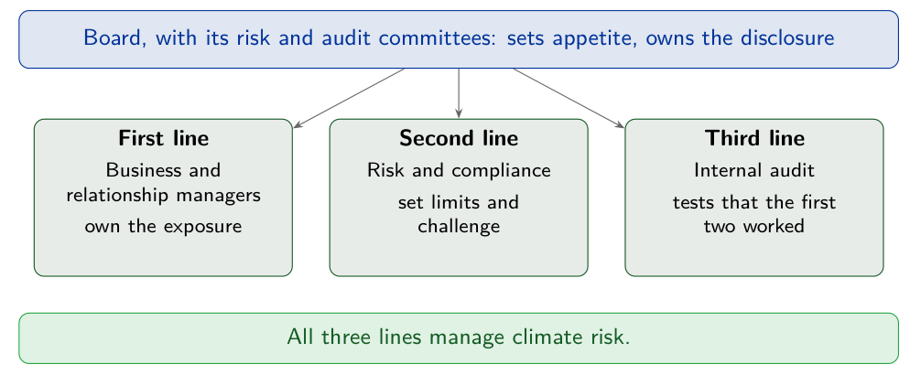
All three lines of defence manage climate risk
1
2
3
4
5
6
The board sets appetite; business lines own the exposure, risk sets limits and challenges, audit tests both.
Notes:
0:34 to 0:35, 1 minute.
Say: The three lines exist in every bank in the room. The first line, business and relationship managers, owns the exposure and gathers the borrower's climate data. The second, risk and compliance, sets limits and challenges the first. The third, internal audit, tests that the first two worked. The board and its risk committee set the appetite and own the disclosure.
Ask: Where in your institution would a climate limit be set, and who would challenge it? Expect the second line. Then ask who collects the borrower data: the first line, which is where most banks find their gap.
Misconception: Climate needs a new department. The figure puts climate into the three lines that exist already, and a new unit outside them leaves the credit decision unchanged.

Slide 29
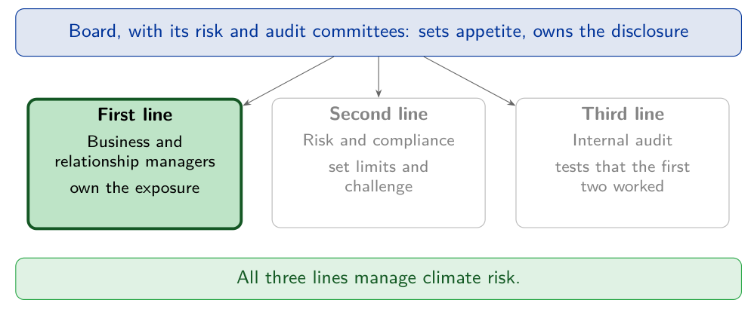
The first line owns the exposure and collects the borrower's climate data
1
2
3
4
5
6
First line: the business units and relationship managers who originate, price and hold the exposure.
Its climate tasks
Assess climate risk at onboarding, credit application, credit review and monitoring
In a credit memo
A flood-map check of the collateral and the borrower's transition plan
Basel expects
Principle 4: first-line staff able to recognise climate risk
Source: BCBS (2022), Principles for the effective management and supervision of climate-related financial risks, Principle 4, paragraphs 19 to 22.
Notes:
0:35 to 0:36, 1 minute.
Say: The first line is where the exposure is created: relationship managers and the business units that price and hold the loan. It owns the climate risk as it owns the credit risk, so it collects the data only the client can give: where the collateral stands, what the borrower emits and how it plans to transition. The Basel Committee's Principle 4 places climate assessments at onboarding, the credit application, credit review and ongoing monitoring, and asks that first-line staff know enough to recognise the risk.
Ask: Who in your bank would add a flood-map check to a credit memo, and who would train them to read it? Expect the credit department, then silence on training.
Misconception: The sustainability team handles climate risk. The team advises; the first line owns the exposure and makes the lending decision.

Slide 30
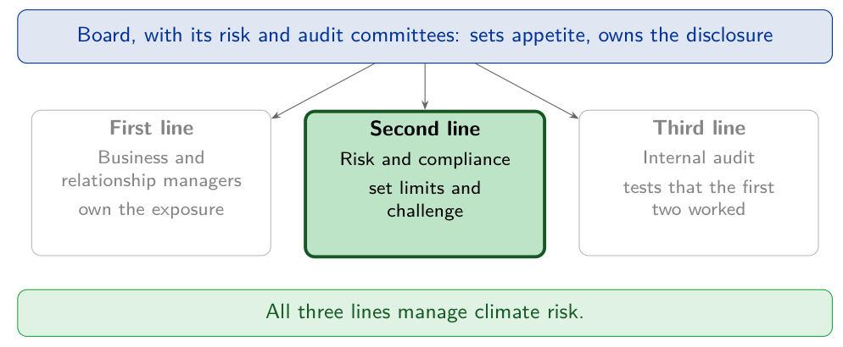
The second line sets limits and challenges the first line's assessment
1
2
3
4
5
6
Second line: the risk function and compliance, independent of the business they oversee.
Its climate tasks
Set climate limits by sector and region, build the scenario PD and LGD methods, monitor the book
Challenge
Re-examine the first line's climate assessment; compliance checks green claims against the rules
Basel expects
Principle 4: climate risk assessed and monitored independently of the first line
Source: BCBS (2022), Principles for the effective management and supervision of climate-related financial risks, Principle 4, paragraphs 19 to 22.
Notes:
0:36 to 0:37, 1 minute.
Say: The second line is the risk function and compliance. It turns the appetite the board approves into limits, for example a ceiling on lending to flood-prone districts or to coal power, builds the methods the first line uses, such as scenario-adjusted default probabilities, and monitors the book against them. Principle 4 asks it to assess and monitor climate risk independently of the first line and to challenge the first line's assessment. Compliance checks that the bank's green claims meet the rules, which is where greenwashing risk is caught.
Ask: Does your institution have a single climate limit today? Expect most answers to be no; ask which sector the first limit should cover.
Misconception: The risk function repeats the first line's work. It sets the limits and tests the assessment independently, so a weak first-line score is caught before the loan is booked.

Slide 31
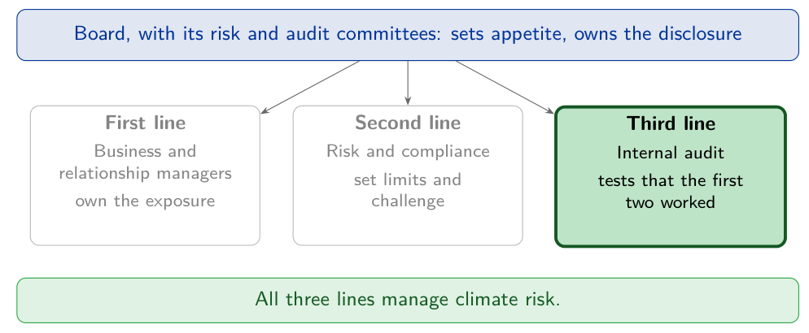
The third line tests whether the first two lines worked
1
2
3
4
5
6
Third line: internal audit, independent of both other lines and reporting to the board's audit committee.
Its climate tasks
Test the climate data, the models and the limits, and whether the disclosure matches practice
When to look again
After a change of method, business, risk profile or data quality
Basel expects
Principle 4: objective assurance on the control framework and on the first and second lines
Source: BCBS (2022), Principles for the effective management and supervision of climate-related financial risks, Principle 4, paragraphs 19 to 22.
Notes:
0:37 to 0:38, 1 minute.
Say: The third line is internal audit, and its object is the work of the first two lines. It samples credit memos for the climate check, re-performs a scenario calculation, compares the limits with the lending, and asks whether the published disclosure describes what the bank does. Principle 4 asks for an independent review and objective assurance of the whole control framework, and names the moments to look again: a new methodology, a change of business or risk profile, and a change in data quality.
Ask: When did internal audit last review anything climate-related at your institution? Expect 'never' or 'the sustainability report'.
Misconception: An audit of the sustainability report is enough. The report describes the process; the third line tests whether the credit, limit and model controls behind it work.

Slide 32
A maturity rubric scores four dimensions from 0 to 3
1
2
3
4
5
6
Score = Identify + Assess + Manage + Integrate
Each dimension scores from 0 to 3, so the total runs from 0 to 12.
0 to 3
4 to 6
7 to 9
10 to 12
Absent
Basic
Developing
Advanced
Teaching rubric of chapter 2, chosen by the module.
Notes:
0:38 to 0:40, 2 minutes.
Say: The rubric is chapter 2's teaching instrument, and no supervisor publishes it. Its four dimensions follow the risk-management cycle: identify the climate risks in the book, assess them, manage them with policies and limits, and integrate them into the bank's enterprise risk management. Each scores 0 to 3, and the total falls in one of four bands.
Ask: On which of the four dimensions would your own institution score lowest? Expect Assess or Integrate. Chapter 2 places most ASEAN institutions at the basic-to-developing stage, totals from 4 to 9.
Misconception: A bank with a long climate report is a mature bank. The rubric scores the risk process, and a bank can publish at length while scoring low on assessment and integration.

Slide 33
A hypothetical Thai commercial bank, scored on four dimensions
1
2
3
4
5
6
Identify
2 of 3
Assess
1 of 3: qualitative only, limited scenario work
Manage
2 of 3: sector policies, no portfolio steering
Integrate
1 of 3: reported apart from enterprise risk management
Predict Add the four scores and name the band. Then name the two moves that would raise the total most.
Hypothetical Thai commercial bank of chapter 2, illustrative scores. Teaching rubric of chapter 2, chosen by the module.
Notes:
0:40 to 0:42, 2 minutes.
Say: The four findings are chapter 2's, for a hypothetical Thai commercial bank of the kind the Bank of Thailand's phased TCFD mandate reached in 2025, after the domestic systemically important banks in 2024. The bank identifies its exposures and has sector policies; its assessment is qualitative, and it reports climate risk separately from the main enterprise risk management.
Ask: Each delegate writes the band and the two moves. Expect a split between basic and developing on the band, and scenario analysis and board oversight as the moves named most.
Misconception: A bank with sector policies in place is past the basic stage. Sector policies raise one dimension of four, Manage, and the band depends on the total of all four.

Slide 34
Six of twelve is basic
1
2
3
4
5
6
1
Total = 2 + 1 + 2 + 1 = 6
2
6 is in the 4 to 6 band: basic
3
Assess scores 1, lowest with Integrate: run NGFS scenario analysis on the loan book
4
Integrate scores 1, lowest with Assess: put climate risk into the board's risk-appetite statement
6 of 12, basic; the two moves raise Assess and Integrate
Hypothetical Thai commercial bank of chapter 2, illustrative scores. Teaching rubric of chapter 2, chosen by the module.
Notes:
0:42 to 0:45, 3 minutes.
Say: Add the scores aloud and place the total on the band strip of the rubric slide: chapter 2 places this bank in the basic band. The two moves worth most raise the two dimensions that score 1: NGFS scenario analysis raises assessment, and climate risk in the board's risk-appetite statement raises integration.
Ask: Whose band matched? Who named both moves? Ask a delegate who named a different move to say which dimension it raises.
Misconception: The next step for a basic bank is more disclosure. The two moves that raise the total most are internal: an analysis the risk function runs and a decision the board takes.

Slide 35
Financed emissions published, credit limits set without climate risk
Check
1
2
3
4
5
6
A bank publishes its financed emissions every year and feeds no climate risk into its credit limits. Which TCFD pillar has the gap?
A
Risk Management
B
Metrics and Targets
C
Governance
D
Strategy
Notes:
0:45 to 0:47, 2 minutes.
Say: Read the stem aloud, then the four pillars. The room votes by show of hands, A to D, in twenty seconds. Count each letter aloud and write the counts on the board.
Ask: Before showing the answer, ask one delegate who chose B and one who chose A to give their reason in one sentence each.
Key: A is the key. B tempts because the bank publishes exactly the numbers Metrics and Targets asks for, so the weakness looks like a data problem. C tempts because the board could order the limits changed; governance is oversight, and the gap is in the process below it. D tempts because limits shape the business; Strategy covers the business plan, and credit limits belong to Risk Management.

Slide 36
Risk Management is the gap
1
2
3
4
5
6
A Risk Management
Why
Credit limits are where a bank manages credit risk. Limits set without climate risk leave the Risk Management pillar with no climate content, whatever the bank publishes.
Tempting: B, Metrics and Targets
The bank publishes financed emissions, so Metrics and Targets has content. The weakness is upstream of the numbers.
Takeaway A supervisor reads a climate report for its risk management first.
Notes:
0:47 to 0:49, 2 minutes.
Say: Return to the opening question. The supervisor looks first at risk management, because a disclosure with no risk management behind it reports numbers that no credit decision uses. The Thai bank of the worked example scored 1 on assessment and 1 on integration: its weakness was in the same pillar as this bank's.
Ask: Compare with the answers on the board from the lesson's first slide. Did anyone name risk management or credit limits? Ask what evidence of climate in credit limits a supervisor would ask to see.
Misconception: Disclosure is the purpose of TCFD. The recommendations ask a firm to disclose how it governs and manages the risk, and a report with nothing to describe under Risk Management shows the gap to every reader.

Slide 37
3
Scenario analysis and climate modeling
Nobody can attach a probability to a hot house world. How does a bank plan for one?
Notes:
0:49 to 0:50, 1 minute.
Say: A bank's risk models estimate probabilities from history. Climate pathways have no history to estimate from, so supervisors ask banks for scenarios: coherent, conditional stories of how the climate, policy and the economy could develop, each run through the bank's own book. The lesson ends with a Philippine calibration and the question of which scenario an ASEAN bank should fear most.
Ask: Take two or three answers in thirty seconds. Expect 'stress it anyway' and 'use the worst case'. Keep them on the board for the answer slide at the end of the lesson.
Misconception: Scenario analysis is forecasting with a range. A scenario states no likelihood, and the bank compares outcomes across scenarios without weighting them.

Slide 38
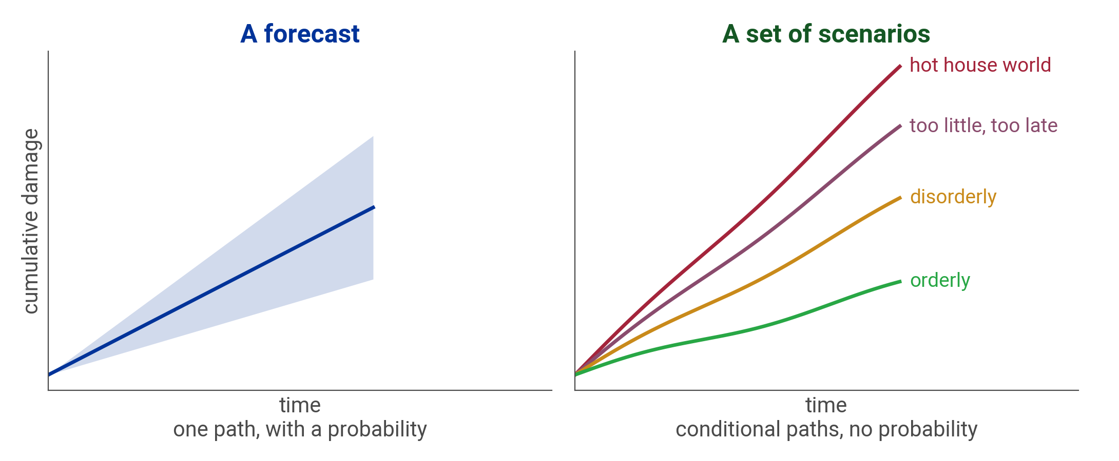
A forecast has a probability; a scenario set has none
1
2
3
4
5
6
A forecast is one path with a probability attached; a scenario set is conditional paths with none. The shapes are schematic.
Notes:
0:50 to 0:52, 2 minutes.
Say: The left panel is how a bank usually thinks: one central path and a band around it, with a probability attached. The right panel is a scenario set: four paths of cumulative damage, orderly, disorderly, too little too late and hot house, each internally consistent and none more likely than another. The axes have no numbers because the paths are shapes for teaching.
Ask: Ask a risk manager in the room which of the two panels the bank's capital planning uses today. Expect the forecast. Then ask what the board would do with four paths and no probabilities.
Misconception: The middle scenario is the most likely one. A scenario set has no middle in the probabilistic sense, and the bank reads the spread between paths as the size of what it cannot diversify away.

Slide 39
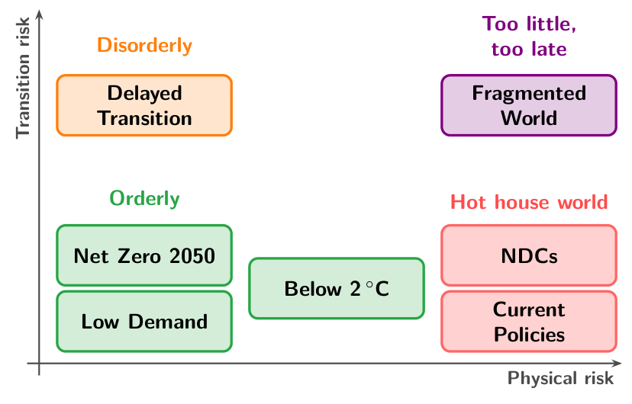
The NGFS scenarios are ordered by physical and transition risk
1
2
3
4
5
6
The seven NGFS scenarios of results version 5.0, November 2024, placed by physical and transition risk.
Notes:
0:52 to 0:53, 1 minute.
Say: The Network for Greening the Financial System publishes seven reference scenarios in four categories, placed by physical risk across and transition risk up. Orderly scenarios, such as Net Zero 2050, sit bottom left: early policy keeps both risks low. Delayed Transition is disorderly, top left: policy arrives late and abruptly. The hot house scenarios, NDCs and Current Policies, sit bottom right: they avoid transition costs and take the physical damage. Fragmented World, too little too late, is top right, high on both.
Ask: Where on the map does a fossil-heavy European bank fear most? Expect the top left. Ask each delegate to mark where their own book would fear most, and keep the marks for the check at the end of the lesson.
Misconception: The scenarios are forecasts of what will happen. They are what-if pathways, and the NGFS attaches no probability to any of them.

Slide 40
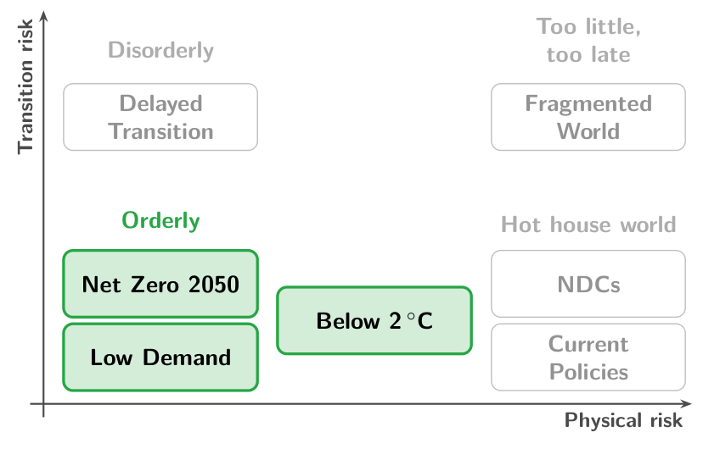
Orderly scenarios: early, gradual policy keeps both risks subdued
1
2
3
4
5
6
Orderly: ambitious climate policies introduced early and made gradually more stringent; both risks relatively subdued.
Scenarios
Net Zero 2050, Below 2 °C and Low Demand
Policy
Starts now and tightens gradually, so carbon prices rise on a known path
Risk that dominates
Transition cost, spread over decades, with physical risk relatively subdued
Source: NGFS (2024), Climate Scenarios Technical Documentation V5.0.
Notes:
0:53 to 0:54, 1 minute.
Say: The NGFS sorts its seven scenarios into four categories by what climate policy does and when. Orderly scenarios introduce ambitious policy early and make it gradually more stringent, so physical and transition risk both stay relatively subdued. Three scenarios are orderly: Net Zero 2050 and Low Demand, which limit warming to 1.5 degrees, and Below 2 degrees. A bank still pays a transition cost through its carbon-intensive borrowers, spread over decades.
Ask: Which of your borrowers pays the orderly transition's cost first? Expect coal power, cement and steel, and ask how long their loans run.
Misconception: An orderly transition costs nothing. Carbon-intensive borrowers pay its cost, spread over decades, and a bank that lends to them shares it.

Slide 41
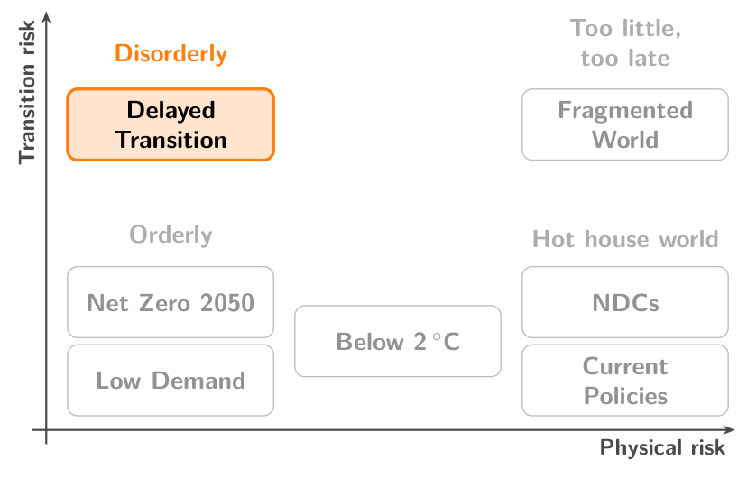
Disorderly scenarios: late or divergent policy raises transition risk
1
2
3
4
5
6
Disorderly: climate policies delayed or divergent across countries and sectors; subdued physical but high transition risk.
Scenario
Delayed Transition
Policy
Global emissions do not fall until 2030, then carbon prices rise sharply and abruptly
Risk that dominates
Transition, arriving abruptly: carbon-heavy borrowers reprice within a few years
Source: NGFS (2024), Climate Scenarios Technical Documentation V5.0.
Notes:
0:54 to 0:55, 1 minute.
Say: Disorderly scenarios delay climate policy or let it diverge across countries and sectors. Physical risk stays subdued and transition risk is high, because carbon prices may have to rise sharply and abruptly. The one disorderly scenario is Delayed Transition: global annual emissions do not fall until 2030, and policy then tightens fast enough to keep warming below 2 degrees. For a bank the loss comes as a repricing of carbon-intensive borrowers within a few years.
Ask: If policy tightened abruptly in 2030, which of your loans would still be outstanding? Expect infrastructure and power loans with long tenors.
Misconception: Waiting lowers the cost of the transition. Delay puts the same adjustment into fewer years and needs a higher carbon price to do it.

Slide 42
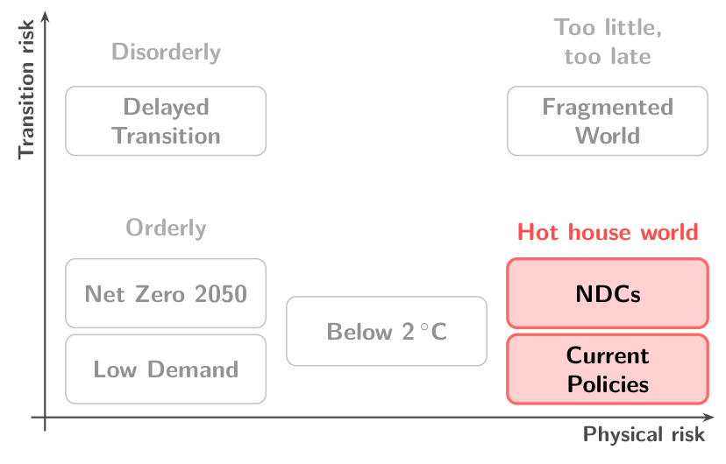
Hot house world: policy stops short and physical risk grows severe
1
2
3
4
5
6
Hot house world: some climate policies in some jurisdictions, and global efforts insufficient to halt significant warming.
Scenarios
Nationally Determined Contributions (NDCs), the pledges; Current Policies, the policies in force
Policy
No tightening beyond pledged targets, some not yet backed by policy, or beyond current law
Risk that dominates
Physical, rising through the century, with the least transition cost
Source: NGFS (2025), NGFS Scenarios: narratives and key findings.
Notes:
0:55 to 0:56, 1 minute.
Say: Hot house world scenarios implement some climate policy in some jurisdictions, but global efforts fall short of halting significant warming, and physical risk grows severe. Two scenarios are in this category: Nationally Determined Contributions, which includes every pledged target even where no policy yet backs it, and Current Policies, the least ambitious scenario, with only the policies in force today. The NGFS puts Current Policies at about 3 degrees of warming by the end of the century. Transition cost is lowest here, and physical damage rises every decade.
Ask: Which of your borrowers is exposed to a sea that keeps rising after 2050? Expect coastal real estate, ports and delta agriculture.
Misconception: Current Policies is the safe scenario because nothing changes. Policy stays as it is and the climate does not: physical damage grows every decade.

Slide 43
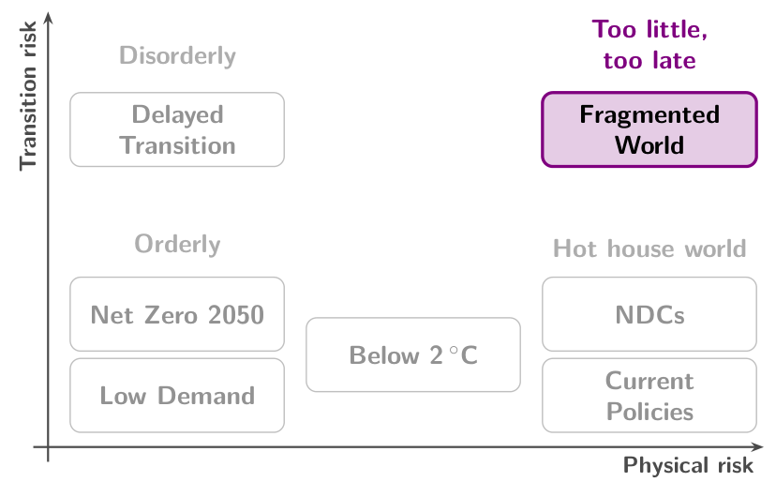
Too little, too late: a late, uneven transition leaves physical risk high
1
2
3
4
5
6
Too little, too late: a late and uncoordinated transition that fails to limit physical risks.
Scenario
Fragmented World
Policy
Climate action delayed and uneven across countries
Risk that dominates
Both: transition risk where policy tightens late, physical risk everywhere
Source: NGFS (2025), NGFS Scenarios: narratives and key findings.
Notes:
0:56 to 0:57, 1 minute.
Say: The fourth category, too little, too late, holds scenarios with a late and uncoordinated transition that fails to limit physical risks. Its one scenario is Fragmented World. Climate action is delayed and uneven across countries, so some face high transition risk where policy tightens late, and all face high physical risk. It is the only category high on both axes of the map, and the NGFS expects it to bring disruption in the short term and in the long term.
Ask: Which is harder for a bank to manage: one high risk, or two at once? Expect 'two', and note that in this scenario a book cannot set physical risk against transition risk.
Misconception: The four categories run from best to worst. They differ in kind, and each bank fears the one its own book is most exposed to.

Slide 44
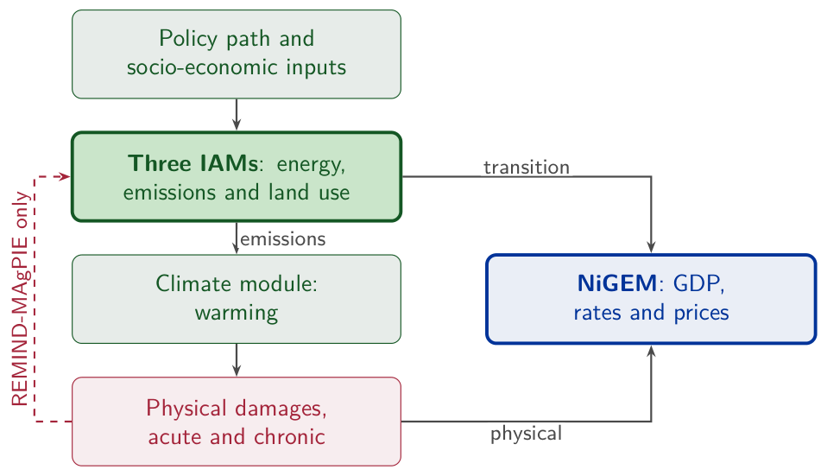
An integrated assessment model couples economy, energy and climate
1
2
3
4
5
6
Integrated assessment model (IAM): an economic, an energy and a climate module solved together, each feeding the next.
Three NGFS models
REMIND-MAgPIE, GCAM and MESSAGEix-GLOBIOM turn a policy path into energy use, emissions and land use
Physical damage
Enters the transition paths only in REMIND-MAgPIE's runs with integrated damages
To the economy
NiGEM, a macroeconomic model, turns the transition and the physical shocks into GDP, rates and prices
Source: NGFS (2024), Technical Documentation V5.0.
Notes:
0:57 to 0:58, 1 minute.
Say: Every number in an NGFS scenario, a carbon price or a GDP path, comes out of a chain of models. Three integrated assessment models, REMIND-MAgPIE, GCAM and MESSAGEix-GLOBIOM, turn a policy path into energy use, emissions and land use, and a climate module turns emissions into warming. The NGFS supplies acute and chronic physical damages for each scenario and keeps them out of the transition paths, except in REMIND-MAgPIE's runs with integrated damages. NiGEM, a macroeconomic model, then turns the transition and the physical shocks into GDP, interest rates and prices. The NGFS runs a scenario through several models where it can, so one scenario name can have more than one set of numbers.
Ask: Two models give one scenario two GDP paths. Which enters your stress test? Expect 'the worse one'; then ask how the bank would explain that choice to its supervisor.
Misconception: An IAM forecasts the economy. It computes a path consistent with its assumptions, so its GDP losses inherit the model's treatment of damages, and a bank quoting one names the model and the scenario.

Slide 45
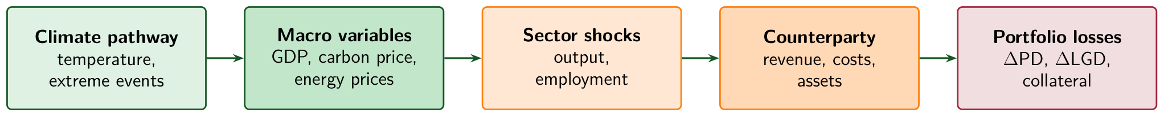
Scenario variables become default and loss rates
1
2
3
4
5
6
ΔPD_{sector} = −γ_{sector} × ΔGDP_{scenario}
LGD_{climate} = LGD_{base} + (1 − insurance) × damage
ΔGDP_{scenario}: the scenario's deviation of output from its baseline. γ_{sector}: the sector's default sensitivity to output. insurance: the insured share of physical damage. damage: the physical damage rate on collateral.
Notes:
0:58 to 1:00, 2 minutes.
Say: Chapter 3's transmission chain has five stages: the climate pathway, macro variables, sector shocks, the counterparty and portfolio losses. The two formulas are its last step. A fall in output raises default probability in proportion to the sector's sensitivity, and the minus sign turns a negative GDP deviation into a rise in PD. Loss given default rises by the share of physical damage no insurer pays.
Ask: Read the second formula with the room: what happens to LGD if insurance covers all damage? Expect 'nothing', and confirm it: with full cover the uninsured term is zero.
Misconception: The GDP shock is the whole story. Physical damage no insurer pays raises loss given default as well, and in ASEAN insurance penetration is thin.

Slide 46
Philippine agriculture when GDP falls 8 percent on a hot house path
1
2
3
4
5
6
GDP deviation, ΔGDP
−8 %
Default sensitivity, γ
1.5
Loss given default today
45 %
Share of damage insured
30 %
Physical damage rate
25 %
Predict Which rises by more percentage points: the default probability or the loss given default?
Illustrative Philippine agriculture calibration of chapter 3, chosen for teaching.
Notes:
1:00 to 1:02, 2 minutes.
Say: Chapter 3 calibrates Philippine agriculture under a hot house pathway. Output falls about 8 percent below its baseline, agricultural defaults respond with a sensitivity of 1.5, and a typhoon-prone loan book is 30 percent insured against a damage rate of 25 percent. Every input is an illustrative calibration value, and the foot of the slide says so.
Ask: Everyone writes PD or LGD, with a number of points for each if they can. Take a show of hands: who says PD moves more? Expect a majority for PD, the number a credit officer watches.
Misconception: Default probability is the only term a scenario moves. The uninsured share of physical damage moves loss given default as well.

Slide 47
Loss given default rises 17.5 points, default probability 12 points
1
2
3
4
5
6
1
ΔPD = −1.5 × (−8 %) = +12 points
2
Uninsured share = 1 − 0.30 = 0.70
3
LGD_{climate} = 45 % + 0.70 × 25 % = 62.5 %
4
LGD rises 62.5 − 45 = 17.5 points
LGD up 17.5 points, PD up 12 points
Illustrative Philippine agriculture calibration of chapter 3, chosen for teaching.
Notes:
1:02 to 1:05, 3 minutes.
Say: Step 1 applies the first formula: minus 1.5 times minus 8 is plus 12 points of default probability. Steps 2 to 4 apply the second: 70 percent of the damage is uninsured, 0.70 times 25 is 17.5 points, and LGD rises from 45 to 62.5 percent. In expected loss per unit of exposure the PD rise adds 0.12 × 0.45 = 0.054 and the LGD rise adds 0.175 times the base PD, so the LGD rise adds more only where the base default probability is above 31 percent. Chapter 3 gives no base PD for this book.
Ask: Who predicted LGD? Ask one of them which input decided it. Expect 'insurance'. Then ask for the answer at 70 percent insurance: 7.5 points, below the PD shift.
Misconception: Insurance is a detail for the collateral desk. The insured share decides how far loss given default rises: 17.5 points at 30 percent cover, 7.5 points at 70 percent.

Slide 48
The NGFS scenario with the largest losses for an ASEAN loan book
Check
1
2
3
4
5
6
For a typical ASEAN loan book, which of these NGFS scenarios gives the largest credit losses over the rest of the century?
A
Net Zero 2050, an orderly transition
B
Low Demand, an orderly transition
C
Delayed Transition, a disorderly path
D
Current Policies, a hot house world on today's policies
Notes:
1:05 to 1:07, 2 minutes.
Say: Read the stem aloud, then the four scenarios. The room votes by show of hands, A to D, in twenty seconds. Count each letter aloud and write the counts on the board.
Ask: Before showing the answer, ask one delegate who chose C to give the reason in one sentence. Expect the argument from European stress tests, where the disorderly case is the severe one.
Key: D is the key. C tempts because the disorderly scenario is the severe case for fossil-heavy developed markets and in most published European exercises. A tempts because Net Zero 2050 prices carbon from the start, which reads as the largest cost. B tempts least: an orderly path with lower energy demand and, with Net Zero 2050, the least warming of the four.

Slide 49
In ASEAN the hot house world is the severe case
1
2
3
4
5
6
D Current Policies, a hot house world on today's policies
Why
Tropical, coastal, agriculture-dependent economies with thin insurance lose most to physical damage, and a hot house world has the most physical damage and the least transition cost.
Tempting: C, Delayed Transition, a disorderly path
Delayed Transition is the severe case for fossil-heavy developed markets, where transition risk dominates. ASEAN loan books lean towards physical risk.
Takeaway A bank runs several scenarios, among them the one its own book fears most.
Notes:
1:07 to 1:09, 2 minutes.
Say: Chapter 3 calls this the ASEAN inversion. A developed-market bank fears the disorderly transition, because its book is heavy in fossil assets that reprice. An ASEAN bank fears the hot house world, because its book is exposed to floods, typhoons and heat that a hot house world makes more frequent and more severe. Fragmented World, high on both risks, was left out of the four options for that reason.
Ask: Return to the question of the lesson's first slide: how does a bank plan for a world it cannot put a probability on? Expect 'run several scenarios and compare them'. Ask which scenario the room's own supervisor prescribes.
Misconception: One scenario is enough for a stress test. A bank that runs only the supervisor's disorderly scenario can miss the scenario its own book loses most in.

Slide 50
4
Carbon metrics and Climate Value‑at‑Risk
A bank lends to a steel mill. How much of the mill's carbon is the bank's?
Notes:
1:09 to 1:10, 1 minute.
Say: Lesson 4 measures. Financed emissions attribute a borrower's carbon to its lenders, the weighted average carbon intensity compares portfolios of different sizes, and Climate Value‑at‑Risk turns the scenario shocks of Lesson 3 into a loss. The steel mill returns in the worked example with its loan, its enterprise value and its emissions.
Ask: Take three answers in thirty seconds. Expect 'all of it', 'none of it' and 'its share of the financing'. Write them on the board.
Misconception: A bank's carbon footprint is its offices and branches. On CDP's evidence the carbon in a lender's book averages more than 700 times the carbon of its own operations.

Slide 51
Financed emissions: the lender's share of a borrower's emissions
1
2
3
4
5
6
Financed emissions: the share of a borrower's emissions attributed to a lender, Scope 3 category 15 of its footprint.
Attribution
Outstanding loan ÷ EVIC, the borrower's enterprise value including cash, × the borrower's emissions
Three scopes
Scope 1, its own operations; Scope 2, purchased energy; Scope 3 category 15, its loans and investments
Data quality
PCAF scores run from 1, verified company emissions, to 5, sector factors per unit of revenue or asset
Source: PCAF (2022), Standard Part A; GHG Protocol (2011), Scope 3 Standard.
Notes:
1:10 to 1:11, 1 minute.
Say: Financed emissions are the emissions of the borrowers and investees a bank finances, attributed to the bank by its share of each borrower's value. The PCAF standard divides the outstanding loan by EVIC, the borrower's enterprise value including cash, and multiplies by the borrower's emissions, in tonnes of CO2 equivalent. In the GHG Protocol they are category 15 of Scope 3, investments; Scope 1 is the bank's own fuel and Scope 2 the energy it buys. Each figure carries a PCAF data quality score, from 1, verified emissions reported by the company, to 5, emission factors for the borrower's sector per unit of revenue or of assets.
Ask: For a borrower that publishes no emissions, which score can the bank reach at best? Expect 2, from the borrower's own energy data, and 4 or 5 from sector averages.
Misconception: Financed emissions are the bank's own emissions. They are its borrowers' emissions, and each lender counts only the share it finances.

Slide 52
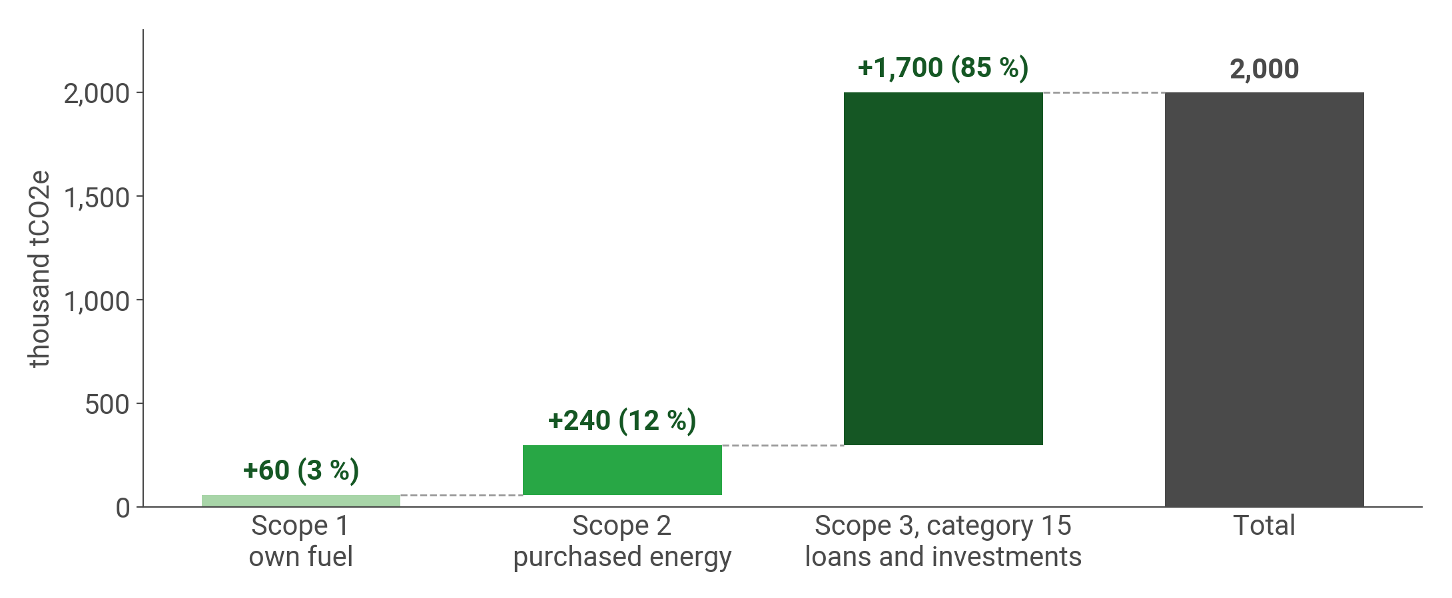
Financed emissions are 85 percent of the illustrative bank's footprint
1
2
3
4
5
6
The bank's own fuel, its purchased energy, and its loans and investments, in thousand tCO2e, for an illustrative ASEAN bank.
Notes:
1:11 to 1:12, 1 minute.
Say: Scope 1 is the bank's own fuel, Scope 2 the electricity it buys, and Scope 3 category 15 the emissions of the borrowers and investees it finances. For this illustrative bank the loan book is 1,700 thousand tonnes of 2,000. On CDP's evidence the real ratio is larger: financial institutions' financed emissions average over 700 times their direct emissions.
Ask: Ask the bank staff whether their institution reports Scope 3 category 15 today. Expect few hands, and ask what stops them; the usual answer is borrower data.
Misconception: A bank's climate footprint is its operations. Greening the branches changes Scope 1 and 2, which are 15 percent of the total in this example.

Slide 53
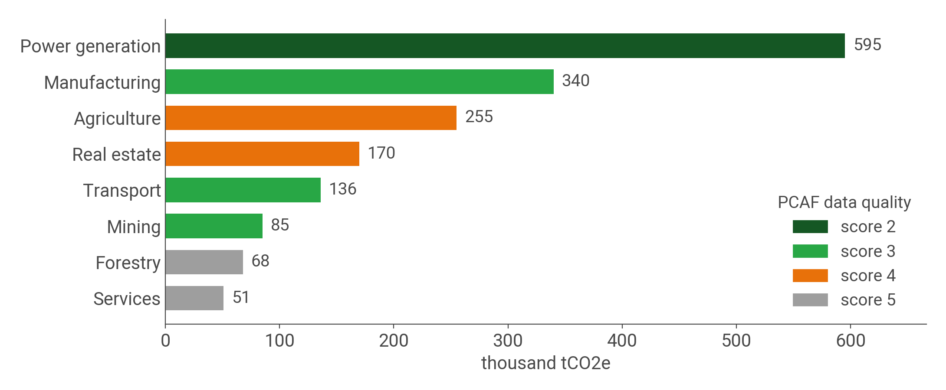
Financed emissions concentrate in power, manufacturing and agriculture
1
2
3
4
5
6
Financed emissions by sector in the loan book of the same illustrative ASEAN bank. Colour gives the PCAF data quality score.
Notes:
1:12 to 1:13, 1 minute.
Say: The bars divide the previous slide's Scope 3 bar by sector: the loan book of the same illustrative bank. Each bar is the emissions attributed to the lender by the PCAF method, the loan over the borrower's enterprise value times the borrower's emissions, summed by sector. Power, manufacturing and agriculture make up 70 percent of the total. The colour is the Partnership for Carbon Accounting Financials' data quality score: 2 is emissions the borrower reported or computed from its own energy data, 5 an estimate from sector averages.
Ask: Which bar would you trust least? Expect the two at score 5. Ask what it would take to move agriculture from score 4 to score 3; expect 'data from the borrowers themselves'.
Misconception: A financed-emissions figure is a measurement. Most of it is estimated from proxies, and the score says how far each number is from one the borrower reported.

Slide 54
Carbon intensity: emissions per USD million of revenue, weighted by holding
1
2
3
4
5
6
WACI, weighted average carbon intensity: each holding's emissions per USD million of revenue, weighted by its share.
Answers
How exposed the book is to carbon-intensive companies, whatever the size of the whole book
Unit
Tonnes of CO2 equivalent, tCO2e, per USD million of the borrower's revenue
Scopes counted
The borrower's Scope 1 and Scope 2 emissions
Source: TCFD (2021), Implementing the Recommendations, Table 3.
Notes:
1:13 to 1:14, 1 minute.
Say: Weighted average carbon intensity, WACI, measures how exposed a portfolio is to carbon-intensive companies. Each holding's Scope 1 and Scope 2 emissions are divided by its revenue in USD million, and the results are weighted by each holding's share of the portfolio. The TCFD asks asset owners and asset managers to disclose it for each fund or strategy. It answers a different question from financed emissions: carbon per unit of revenue, whatever the size of the book.
Ask: A bank doubles every loan in its book. Which of the two carbon measures changes? Expect financed emissions to double and WACI to stay the same.
Misconception: A low WACI means low climate risk. WACI counts carbon per dollar of revenue, and a book of low-carbon borrowers on a flood plain can have a low WACI and a large physical risk.

Slide 55
Climate VaR: the loss of portfolio value under one named scenario
1
2
3
4
5
6
Climate Value‑at‑Risk: the expected loss of portfolio value under a specified climate scenario.
Unlike VaR
VaR is a quantile at a confidence level; Climate VaR is a loss given one scenario, with no probability
Two parts
Physical and transition losses, and the scenario decides which of the two is larger
For a loan book
Exposure × rise in default probability × the scenario's loss given default, summed
Source: UNEP FI (2019), Changing Course, page 38.
Notes:
1:14 to 1:15, 1 minute.
Say: Climate Value‑at‑Risk is the expected loss of a portfolio's value under one specified climate scenario, split into a physical and a transition part. It borrows the name of Value‑at‑Risk and differs from it. Value‑at‑Risk is a quantile of a loss distribution at a stated confidence level, over days; Climate VaR is a loss conditional on one scenario over years to decades, and no probability is attached to the scenario. For a loan book the module counts the new defaults a scenario brings: exposure times the rise in default probability times the scenario's loss given default, summed over the book.
Ask: A risk committee asks for the 99 percent Climate VaR. What is missing from the question? Expect 'the scenario': Climate VaR names a scenario where market VaR names a confidence level.
Misconception: Climate VaR is a quantile, like market VaR. It is a scenario loss, and two scenarios give two Climate VaRs for the same book.

Slide 56
Three measures: financed emissions, carbon intensity and Climate VaR
1
2
3
4
5
6
FE_{i} = Outstanding_{i} / EVIC_{i} × Emissions_{i}
WACI = Σ_{i} w_{i} × Emissions_{i} / Revenue_{i}
Climate VaR = Σ_{i} Exposure_{i} × ΔPD_{i} × LGD_{i}
EVIC_{i}: the borrower's enterprise value including cash. w_{i}: the borrower's weight in the portfolio. Revenue_{i}: in USD million. ΔPD_{i}: the scenario's rise in default probability. LGD_{i}: loss given default in the scenario.
Notes:
1:15 to 1:16, 1 minute.
Say: Financed emissions measure how much carbon the bank finances: the loan's share of the borrower's enterprise value times the borrower's emissions. WACI measures how carbon-intensive the portfolio is per dollar of revenue, weighted by portfolio share. Climate VaR measures what the bank could lose: exposure times the scenario's rise in default probability times the scenario's loss given default. It leaves out the rise in loss given default on the defaults the bank expected anyway: for Lesson 1's rice book it gives USD 6.8 million against the 7.6 of the full rise in expected loss.
Ask: Which of the three does a disclosure rule ask for, and which a risk committee? Expect disclosure rules for the first two and the risk committee for the third.
Misconception: A carbon-heavy portfolio is a risky portfolio. The first two measures count carbon and the third measures a loss, and they can rank the same book differently.

Slide 57
The carbon of a steel loan and of a three-company portfolio
1
2
3
4
5
6
Loan to the steel mill
USD 50 million
Mill's enterprise value, EVIC
USD 500 million
Mill's emissions
200,000 tCO2e
Power utility
40 % of the portfolio, 800 tCO2e per USD million
Manufacturer
35 %, 200 tCO2e per USD million
Technology firm
25 %, 15 tCO2e per USD million
Predict How many tonnes of the mill's carbon are the bank's, and what share of the portfolio's WACI comes from the utility?
Illustrative steel loan and three-company portfolio of chapter 4, chosen for teaching.
Notes:
1:16 to 1:18, 2 minutes.
Say: Two small examples from chapter 4, both illustrative. The bank lends USD 50 million to a Vietnamese steel company worth USD 500 million including cash, which emits 200,000 tonnes a year. Separately, a portfolio holds three companies, a power utility, a manufacturer and a technology firm, with their weights and their carbon intensities per million dollars of revenue.
Ask: Everyone writes two numbers: the tonnes attributed to the bank, and the utility's share of WACI. Expect the first to be answered quickly and guesses near 40 percent for the second, the utility's weight.
Misconception: WACI needs the portfolio's total emissions. It needs each holding's intensity and weight, and the slide gives both for all three companies.

Slide 58
The utility is 40 percent of value and 81 percent of carbon intensity
1
2
3
4
5
6
1
Financed emissions = 50 / 500 × 200,000 = 20,000 tCO2e
2
WACI = 0.40 × 800 + 0.35 × 200 + 0.25 × 15
3
= 320 + 70 + 3.75 = 393.75, about 394 tCO2e per USD million
4
Utility share = 320 / 394 = 81 %
20,000 tCO2e for the steel loan; WACI about 394, 81 % of it from the utility
Illustrative steel loan and three-company portfolio of chapter 4, chosen for teaching.
Notes:
1:18 to 1:21, 3 minutes.
Say: The bank finances a tenth of the mill's enterprise value, so it is attributed a tenth of the mill's emissions: 20,000 tonnes. For WACI, multiply each weight by its intensity and add: 320 from the utility, 70 from the manufacturer and under 4 from the technology firm. The utility is 40 percent of the portfolio's value and 81 percent of its carbon intensity.
Ask: Who guessed above 70 percent for the utility? Ask what a portfolio manager would do with the result: sell the utility, engage with it, or hold it. Expect all three answers.
Misconception: A bank is attributed carbon in proportion to the size of its loan alone. PCAF divides the loan by the borrower's enterprise value including cash, so the same loan to a larger company is attributed less carbon.

Slide 59
18 percent of the book in agriculture, 3 percent in coal and power
Check
1
2
3
4
5
6
Agriculture's default probability rises 8 points, coal and power's 15 points. Which book of the Vietnamese bank has the larger Climate VaR?
A
Coal and power lending
B
Agriculture lending
C
The two are about equal
D
Neither can be ranked without emissions data
Illustrative bank portfolio, not measured Vietnamese sector data.
Notes:
1:21 to 1:23, 2 minutes.
Say: Read the stem aloud, then the four options. The room votes by show of hands, A to D, in twenty seconds. Count each letter aloud and write the counts on the board.
Ask: Before showing the answer, ask one delegate who chose A and one who chose D to give their reasons in one sentence each.
Key: B is the key. A tempts because coal is the carbon-intensive book, and the lesson has just ranked companies by carbon intensity. C tempts delegates who expect the sixfold difference in exposure to be offset by coal's larger transition shock. D tempts because the first two measures of the lesson need emissions data; Climate VaR needs exposure, the default shift and loss given default, and no emissions figure.

Slide 60
Vietnamese agriculture outranks coal on Climate VaR
1
2
3
4
5
6
B Agriculture lending
Why
Physical, agriculture: USD 5.4 billion × 8 % × 65 % = USD 281 million. Transition, coal and power: USD 0.9 billion × 15 % × 55 % = USD 74 million.
Tempting: A, Coal and power lending
Coal and power is the carbon-intensive book. Climate VaR multiplies exposure, default shift and loss severity, and agriculture's exposure is six times larger.
Takeaway Exposure and physical vulnerability outweigh carbon intensity.
Illustrative bank portfolio, not measured Vietnamese sector data.
Notes:
1:23 to 1:25, 2 minutes.
Say: Chapter 4 calls this the Vietnam inversion. Three drivers explain it: agriculture is six times the larger book, Mekong Delta farming is exposed to flooding that warming makes more frequent, and farm output is thinly insured, so uninsured losses flow into loss given default. The cross terms are smaller: USD 24 million of transition Climate VaR in agriculture and USD 7.2 million of physical Climate VaR in coal, which make the totals USD 305 and 81 million.
Ask: Return to the steel mill question of the first slide. Then ask which of the two books the bank would cut to reduce its risk, and which to reduce its carbon. Expect different answers.
Misconception: Carbon metrics measure climate risk. They measure a portfolio's contribution to emissions; Climate VaR measures what the portfolio can lose, and the two rankings can invert.

Slide 61
5
Climate stress testing
How large a climate loss takes the Thai bank of the opening to the Basel III floor?
Notes:
1:25 to 1:26, 1 minute.
Say: The Thai bank of the opening returns. Lessons 1 to 4 supplied the pieces: expected loss, the framework that owns the process, the scenarios and the measures. A climate stress test runs a scenario through the bank's book and asks whether capital survives. The lesson computes the loss the bank can absorb and compares it with the numbers the room wrote down at the start of the class.
Ask: Point to the guesses in the corner of the board. Does anyone want to change theirs now, before the arithmetic? Expect one or two delegates to lower their number.
Misconception: A stress test predicts the losses a bank will suffer. It computes the losses under one scenario, chosen to be severe and plausible, and a bank that passes has survived that scenario alone.

Slide 62
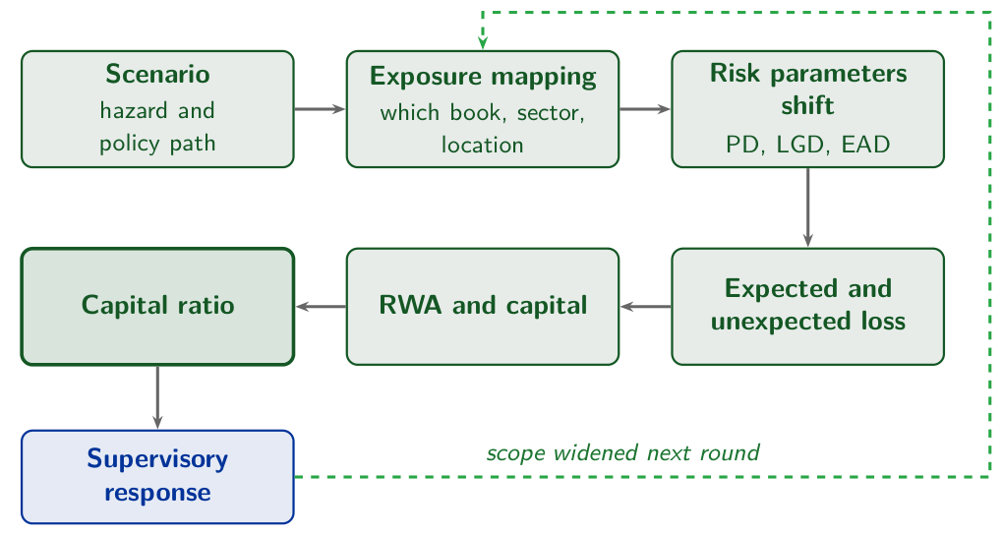
A stress test is a pipeline with a supervisor at the end
1
2
3
4
5
6
Scenario, exposure mapping, risk parameters, losses, capital and the ratio; the supervisor's response widens the next round.
Notes:
1:26 to 1:27, 1 minute.
Say: Chapter 5 builds a climate stress test from five design elements: the scenario, the mapping of the portfolio, the transmission to the risk parameters, the estimate of the losses and their impact on capital. The picture draws them as six stages and adds the supervisor, who reads the result and widens the next round. Each stage takes the output of the one before, so a mild scenario or a missing location early in the chain reaches the capital ratio at the end.
Ask: Point to the capital ratio at the end of the chain. Which stage before it would you trust least? Take two answers and return to them at that stage.
Misconception: A stress test is a measurement taken once. Chapter 5 calls it an iterated exercise: the supervisor reads the result and widens the scope of the next round.

Slide 63
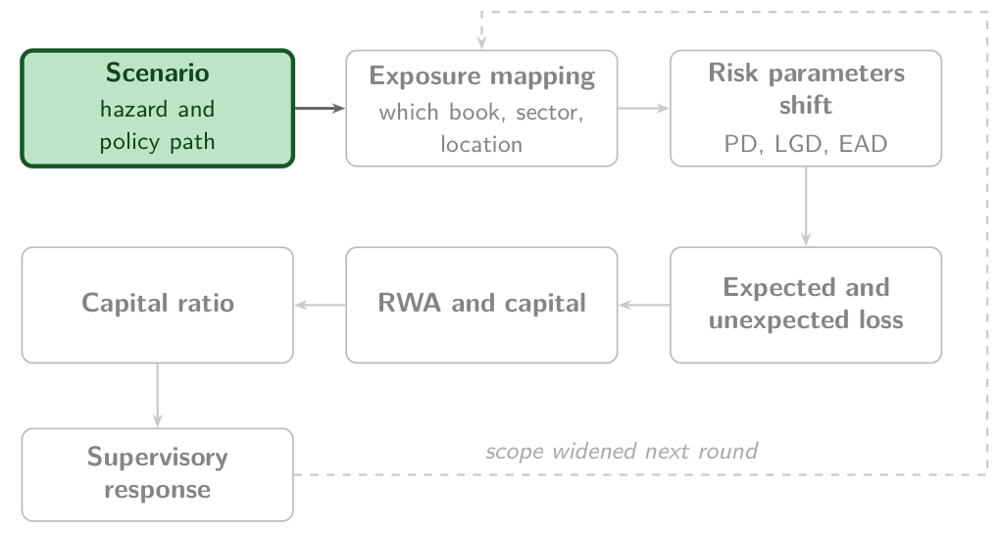
Scenario: the hazard and policy path every later stage takes as given
1
2
3
4
5
6
Scenario: a plausible path of climate hazards, carbon policy and the economy over a stated horizon.
How it works
NGFS pathways or a bespoke event such as a flood, over a planning cycle or over decades
In the Thai bank
Delayed Transition, an NGFS disorderly scenario: policy starts late and then moves fast
Basel expects
Principle 12: a range of plausible pathways, physical and transition, over several horizons
Source: BCBS (2022), Principles for the effective management and supervision of climate-related financial risks, Principle 12, paragraphs 44 to 48.
Notes:
1:27 to 1:28, 1 minute.
Say: The scenario is the first stage and the only one that holds no bank data. It fixes the path of temperature, hazards, carbon prices and output, and every later stage takes that path as given. Supervisors mostly take the NGFS pathways of Lesson 3; a bank adds bespoke events, a flood or a drought in its own region. The horizon is a second choice: a planning cycle of a few years, where the capital numbers mean most, or several decades, where physical risk grows. Chapter 5's Thai bank runs Delayed Transition, the NGFS disorderly scenario in which policy arrives late and then fast.
Ask: Which scenario would your supervisor choose for a book heavy in agriculture, Delayed Transition or a hot house world? Expect a split; Lesson 3 found the hot house world the severe case in ASEAN.
Misconception: A scenario is a forecast. It is one plausible path, chosen to be severe, and it has no probability attached; a bank runs several to see how the result moves.

Slide 64
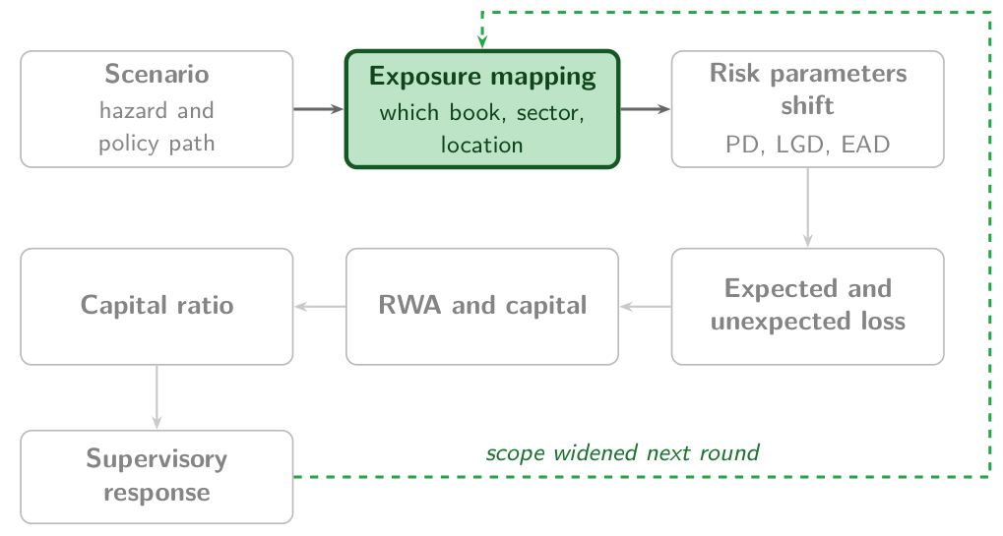
Exposure mapping: each loan gets a sector, a location and a borrower
1
2
3
4
5
6
Exposure mapping: assigning each loan, bond and holding to the sectors and places the scenario strikes.
How it works
Match each exposure to a sector code and a location, then hold the book fixed or let it change
In the Thai bank
THB 500 billion in five sectors, THB 100 billion of it in agriculture
Basel expects
Principle 12: weigh the limits of the scenarios and of the balance sheet assumption
Illustrative bank, not a real institution. Source: BCBS (2022), Principles for the effective management and supervision of climate-related financial risks, Principle 12, paragraphs 44 to 48.
Notes:
1:28 to 1:29, 1 minute.
Say: Exposure mapping decides which parts of the book the scenario reaches. Every loan, bond and holding gets a sector, for transition risk, and a location, for physical risk; a flood map is of no use to a bank that does not know where its borrowers' farms and factories stand. The second choice is the balance sheet. Supervisors mostly hold it fixed at the start date so that banks compare: the Bank of England's exercise of 2021 froze balance sheets at the end of 2020. Chapter 5's Thai bank maps THB 500 billion into five sectors, THB 100 billion of it agriculture.
Ask: Which stage does your institution find hardest? Expect exposure mapping: most banks cannot say where their borrowers' assets are.
Misconception: A sector code is enough to map physical risk. Two rice farms in one sector can stand on different flood plains; physical risk needs the location of the asset, and transition risk the sector.

Slide 65
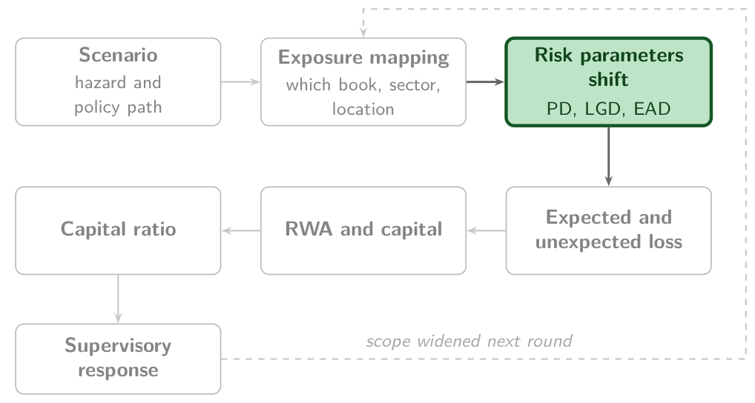
Risk parameters shift: the scenario raises PD and LGD and can move EAD
1
2
3
4
5
6
Risk parameters: default probability (PD), loss given default (LGD) and exposure at default (EAD).
How it works
PD scales with a stress multiplier; LGD adds the physical damage to the collateral
In the Thai bank
Agriculture: PD 5.0 % to 9.0 %, LGD 45 % to 65 %
Basel expects
Principle 12: physical and transition risk as drivers of credit, market, operational and liquidity risk
Illustrative bank, not a real institution. Source: BCBS (2022), Principles for the effective management and supervision of climate-related financial risks, Principle 12, paragraphs 44 to 48.
Notes:
1:29 to 1:30, 1 minute.
Say: The third stage turns the scenario into the numbers a credit model already uses. Default probability scales with a stress multiplier, as warming times the sensitivity β did for the Mekong rice farmers of Lesson 1; loss given default adds the physical damage to the collateral; exposure at default moves when borrowers draw on their credit lines. Lesson 3 did the same for Philippine agriculture with its γ coefficients. In chapter 5's Thai bank, agriculture's default probability goes from 5.0 to 9.0 percent and its loss given default from 45 to 65 percent.
Ask: Which parameter moves further for a flooded rice farm, PD or LGD? Expect PD; then point to LGD, which rises 20 points here because flooded land recovers less.
Misconception: A stress test needs a new credit model. It takes the bank's existing PD, LGD and EAD and moves them with the scenario.

Slide 66
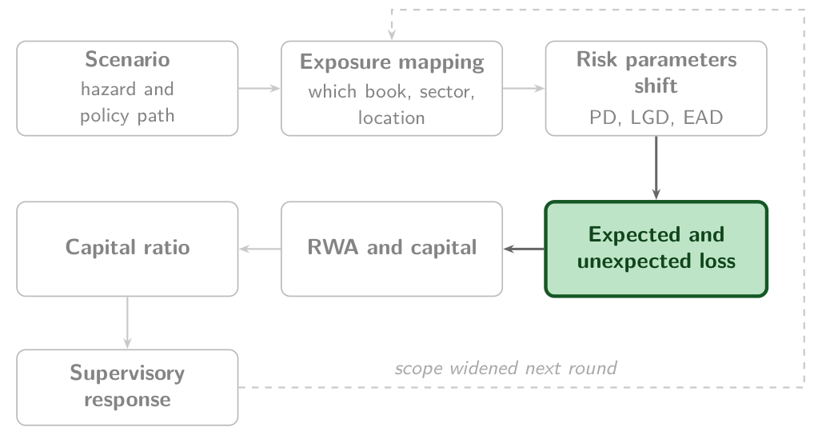
Expected loss is met by provisions, unexpected loss by capital
1
2
3
4
5
6
Expected loss: PD × LGD × EAD, the average loss. Unexpected loss: the loss above it in a bad year.
How it works
Expected loss per sector under the stressed parameters, summed over the book and set against the baseline
In the Thai bank
Expected credit loss on the five sectors rises from THB 6.5 to 14.1 billion
Basel expects
Basel III: provisions against expected losses, capital against unexpected losses
Illustrative bank, not a real institution. Source: BCBS (2011), Basel III, paragraph 31.
Notes:
1:30 to 1:31, 1 minute.
Say: Expected loss is the average: default probability times loss given default times exposure, per sector, summed over the book. Provisions cover it, booked before any borrower defaults. Unexpected loss is the loss above the average in a bad year, and capital covers it; Basel III draws that line. In chapter 5's Thai bank the expected credit loss on the five sectors roughly doubles under the scenario, from THB 6.5 to 14.1 billion, and agriculture accounts for the largest share of the rise.
Ask: Which sector would you guess drives the rise? Expect agriculture: it holds a fifth of the book and the largest share of the increase.
Misconception: Provisions and capital cover the same loss. Provisions cover the expected loss and are booked in advance; capital covers the unexpected loss above it.

Slide 67
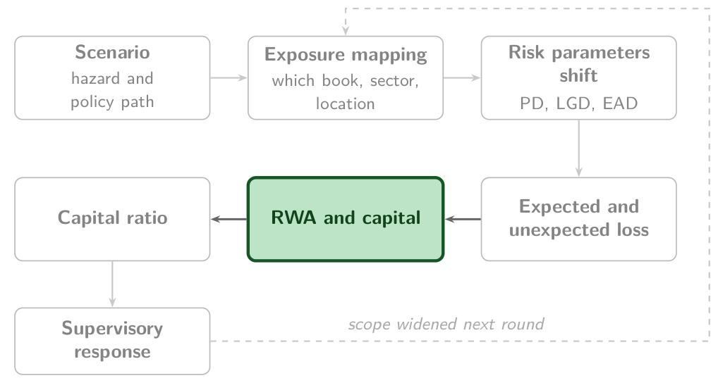
RWA and capital: losses cut capital, and downgrades raise the risk weights
1
2
3
4
5
6
Capital and RWA under stress: equity net of the scenario's losses, and exposures reweighted after downgrades.
How it works
Deduct losses beyond the provisions from common equity; reweight the exposures the scenario downgrades
In the Thai bank
The worked example holds risk-weighted assets fixed, so the loss moves capital alone
Basel expects
Principle 18: over short horizons, assess the impact on regulatory capital
Source: BCBS (2022), Principles for the effective management and supervision of climate-related financial risks, Principle 18, paragraphs 63 to 69.
Notes:
1:31 to 1:32, 1 minute.
Say: The fifth stage moves the losses onto the balance sheet. Losses beyond the provisions already booked come out of common equity, one for one. At the same time the scenario downgrades borrowers, and a downgraded exposure has a larger risk weight, so risk-weighted assets rise. Both moves push the ratio of the next stage down. Chapter 5's worked Thai bank holds risk-weighted assets fixed to keep the arithmetic to one step; the Philippine typhoon of Lesson 6 deducts their rise.
Ask: Losses cut capital by a tenth and downgrades raise risk-weighted assets by a tenth. By how much does the ratio fall? Expect 'a fifth'; it falls to 0.9 over 1.1 of its level, 18 percent lower.
Misconception: A stress hits capital alone. Downgrades raise risk-weighted assets as well, so the ratio falls from both sides, and a test that holds risk-weighted assets fixed shows the smaller fall.

Slide 68
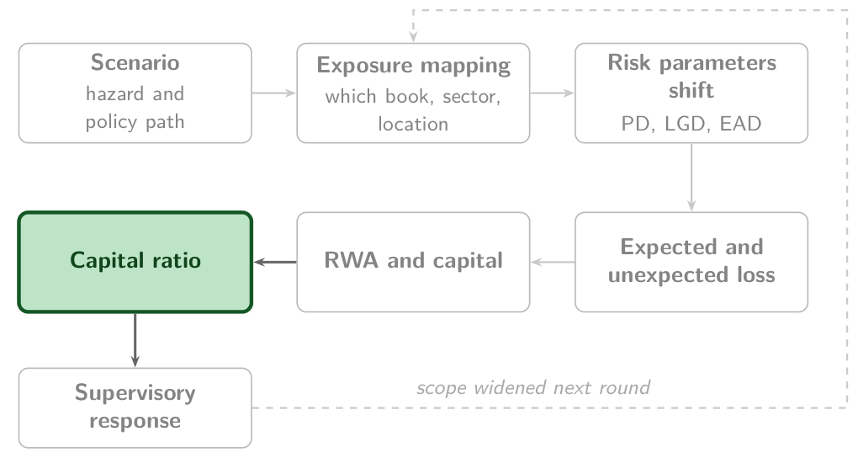
Capital ratio: the one number the supervisor compares with the floor
1
2
3
4
5
6
Capital ratio: regulatory capital over risk-weighted assets, compared with the minimum and the buffer.
How it works
One ratio per bank, scenario and year; the distance to the floor is the bank's headroom
In the Thai bank
Compared with Basel III's 10.5 %, the minimum and the buffer together
Basel expects
Principle 18: stress tests evaluate the bank's financial position under severe but plausible scenarios
Source: BCBS, Basel III: A global regulatory framework for more resilient banks and banking systems (rev. June 2011), para 64; BCBS (2022), Principles for the effective management and supervision of climate-related financial risks, Principle 18, paragraphs 63 to 69.
Notes:
1:32 to 1:33, 1 minute.
Say: The pipeline ends in one number per bank, scenario and year: regulatory capital over risk-weighted assets. It is compared with a floor. Under Basel III the minimum of 8.0 percent and the conservation buffer of 2.5 percent make 10.5 percent. A bank above the floor has headroom, the loss it can take before it falls into the buffer; a bank inside the buffer restricts its dividends and bonuses; a bank below the minimum is in breach. The Thai bank's ratio before and after the stress is the arithmetic of the worked example.
Ask: Two banks end the stress at the same ratio. Does the supervisor treat them alike? Expect 'yes'; then point out that the one that fell further holds the riskier book.
Misconception: A bank that passes is safe from climate risk. It stayed above the floor in the scenarios run; another scenario, a longer horizon or second-round losses can take it below.

Slide 69
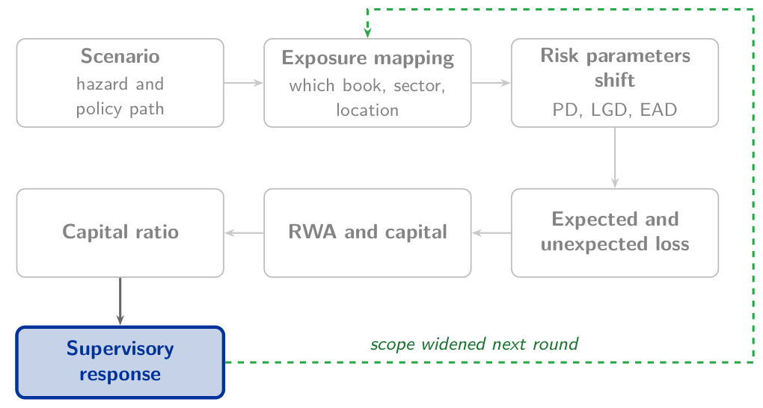
Supervisory response: findings in aggregate and a wider next round
1
2
3
4
5
6
Supervisory response: feedback to each bank, findings published in aggregate, and the scope of the next round.
How it works
Compare the banks, name their data gaps, and add banks, risks or horizons to the next round
In the Thai bank
The Bank of Thailand reads the ratio against 11 %
Basel expects
Principle 18: disclose findings in aggregate, with methods, assumptions and uncertainty
Source: Bank of Thailand, Notification 12/2555, capital requirements; BCBS (2022), Principles for the effective management and supervision of climate-related financial risks, Principle 18, paragraphs 63 to 69.
Notes:
1:33 to 1:34, 1 minute.
Say: The last stage belongs to the supervisor. It compares the banks, tells each one where its data and models fell short, and publishes the findings in aggregate; the Basel Committee's Principle 18 asks for the methods, assumptions and uncertainty alongside. The Bank of Thailand reads the ratio against its own floor of 11 percent, half a point above Basel III's 10.5. In the ECB's exercise of 2022, 104 banks took part, and the losses of the 41 that projected them came to about EUR 70 billion, a figure the ECB wrote significantly understates the risk. The response is a wider next round, which starts again at exposure mapping.
Ask: Ask a supervisor in the room what they asked banks for after their first round. Expect more data: locations, sectors and counterparties.
Misconception: A supervisor that finds a shortfall raises the bank's capital requirement. None of the exercises of the ECB, the Bank of England, the Bank of Thailand and MAS set capital on its result.

Slide 70
Four supervisory exercises differ on five design axes
1
2
3
4
5
6
No exercise reaches High on every axis, and none sets capital on its result.
Scope
Granularity
Horizon
Disclosure
Capital consequences
ECB
High
Medium
High
Medium
Low
Bank of England
Medium
High
High
High
Low
Bank of Thailand
High
Low
High
Low
Low
MAS
Medium
High
High
Medium
Low
Module's qualitative reading of published exercise design, not an external rating.
Notes:
1:34 to 1:35, 1 minute.
Say: Four exercises, five design choices. Scope: which banks, books and risks are in. Granularity: losses per counterparty or per sector. Horizon: how many years the scenarios run. Disclosure: how much of the method and the results the supervisor published; none of the four published results bank by bank. Capital consequences: whether a result changes a capital requirement. The ECB's exercise of 2022 covered 104 banks, the Bank of England's CBES went down to counterparties, the Bank of Thailand ran a pilot and MAS an industry-wide exercise. None of the four set capital on its result, so the last column reads Low throughout.
Ask: Which of the five choices would your supervisor fix first? Expect horizon or granularity; then ask what a bank must collect before a counterparty-level exercise can run.
Misconception: A bank that passes one supervisor's exercise has passed them all. Scope, granularity and horizon differ, so results do not compare across jurisdictions.

Slide 71
Regulatory capital absorbs losses, common equity first
1
2
3
4
5
6
Regulatory capital: Common Equity Tier 1, Additional Tier 1 and Tier 2, the layers Basel III counts as able to absorb losses.
Minimum and buffer
4.5 % in common equity, 6.0 % in Tier 1, 8.0 % in total, and a 2.5 % buffer on top: 10.5 %
A climate loss
Comes out of common equity first, one for one, and the capital ratio falls with it
In the Thai bank
THB 71 billion of capital against THB 500 billion of risk-weighted assets
Illustrative bank, not a real institution. Source: BCBS (2011), Basel III, paragraphs 49 and 50; BCBS (2011), Basel III, paragraph 129.
Notes:
1:35 to 1:36, 1 minute.
Say: Regulatory capital is what the bank can lose before its depositors and creditors do. Basel III counts three layers. Common Equity Tier 1 is shares and retained earnings, and absorbs losses while the bank keeps operating; Additional Tier 1 absorbs them as well; Tier 2 absorbs them once the bank has failed. The minimums are 4.5 percent of risk-weighted assets in common equity, 6.0 percent in Tier 1 and 8.0 percent in total, and the conservation buffer of 2.5 percent takes the total to the 10.5 percent of the opening question. A bank inside the buffer restricts its dividends and bonuses; below 8.0 percent it breaches the minimum.
Ask: Which layer does a loan loss reduce first? Expect 'common equity', through retained earnings, and confirm it.
Misconception: Capital is cash the bank keeps in reserve. Capital is funding the bank owes to nobody: the difference between its assets and its debts, and a loss reduces it one for one.

Slide 72
Risk-weighted assets weigh each exposure by its risk
1
2
3
4
5
6
Risk-weighted assets (RWA): exposures weighted by credit risk, plus market and operational risk; the ratio's denominator.
What it weighs
A riskier loan of the same size has a larger weight and needs more capital
Climate reaches it
Downgraded borrowers get larger weights, so a stress raises RWA while its losses cut capital
In the Thai bank
THB 500 billion, held fixed in the worked example
Illustrative bank, not a real institution. Source: BCBS (2011), Basel III, paragraph 50; Bank of Thailand, Notification 12/2555.
Notes:
1:36 to 1:37, 1 minute.
Say: Risk-weighted assets weigh each exposure by its credit risk, so a riskier loan of the same size counts for more and needs more capital, and market and operational risk add charges in the same units. They are the denominator of the capital ratio, and the ratio falls when capital falls or when risk-weighted assets rise. A climate shock does both: losses cut capital, and the borrowers it downgrades get larger risk weights. The Thai example of this lesson holds risk-weighted assets fixed at THB 500 billion, and the Philippine typhoon of Lesson 6 deducts their rise from the ratio.
Ask: A flood downgrades half of a bank's farm borrowers and none of them defaults. What happens to the capital ratio? Expect 'it falls', because risk-weighted assets rise.
Misconception: Risk-weighted assets are the bank's total assets. They are the assets weighted by risk, and two banks of the same size can need very different amounts of capital.

Slide 73
Provisions book expected credit losses before a borrower defaults
1
2
3
4
5
6
Provision: an allowance for expected credit losses, charged against profit, and so against capital, before any default.
Terms
Default probability, loss given default and exposure: the three terms of expected loss
Twelve months or life
Twelve months of expected loss, or the loan's whole life once its credit risk has risen significantly
Climate reaches it
A scenario that raises default probability raises the allowance, and capital falls by as much
Source: IFRS 9, section 5.5, Impairment.
Notes:
1:37 to 1:38, 1 minute.
Say: A provision is an allowance for expected credit losses. It is charged against profit, and so against capital, before any borrower defaults. Under IFRS 9 a bank provides for twelve months of expected loss while a loan's credit risk is unchanged, and for the loan's whole life once that risk has increased significantly. The arithmetic is Lesson 1's: default probability times loss given default times exposure. A climate scenario that raises default probability raises the provision at once, and the Philippine stress of Lesson 6 deducts new provisions from the ratio first.
Ask: When does a climate scenario reach the income statement: when borrowers default, or when the expected default probability rises? Expect 'when they default', then point to the twelve-month and lifetime rule.
Misconception: Provisions are losses that have already happened. They are expected losses, booked while the loans still perform.

Slide 74
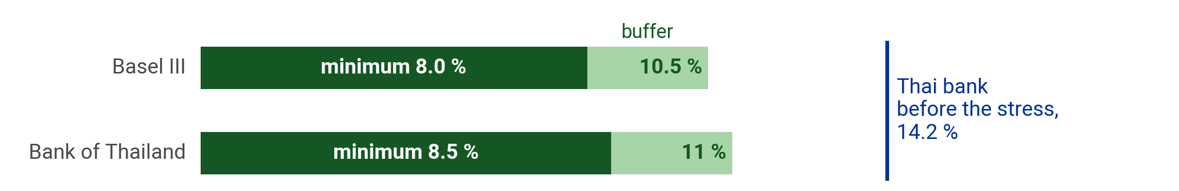
The stress test ends in one capital ratio
1
2
3
4
5
6
CAR_{post} = (Capital − Climate losses) / RWA
CAR_{post} ≥ 10.5 %
CAR: capital adequacy ratio. Capital: regulatory capital. Climate losses: the scenario's losses, all channels. RWA: risk-weighted assets. 10.5 %: Basel III's minimum with its buffer; the Bank of Thailand's is 11 %.
Source: BCBS, Basel III: A global regulatory framework for more resilient banks and banking systems (rev. June 2011), para 64; Bank of Thailand, Notification 12/2555, capital requirements.
Notes:
1:38 to 1:39, 1 minute.
Say: The losses of the scenario come out of capital, and the ratio of what is left to risk-weighted assets is compared with the floor. Basel III sets a minimum total capital ratio of 8.0 percent and adds a capital conservation buffer of 2.5 percent, 10.5 percent in all; the Bank of Thailand adds the same buffer to 8.5 percent, 11 percent in all. A bank inside the buffer keeps operating and restricts dividends and bonuses until it rebuilds capital; below the minimum it is in breach. The formula holds RWA fixed.
Ask: What happens to the ratio if the losses also raise risk-weighted assets, as downgraded borrowers do? Expect 'it falls further'; confirm it, and say the example leaves RWA fixed.
Misconception: A bank above 10.5 percent has no climate problem. The floor is the ratio to hold after the stress, and a supervisor asks how far above it the bank lands and under which scenario.

Slide 75
The Thai bank before the stress
1
2
3
4
5
6
Regulatory capital
THB 71 billion
Risk-weighted assets
THB 500 billion
Basel III minimum and buffer
10.5 %
Bank of Thailand floor
11 %: its 8.5 % minimum and the 2.5 % buffer
Predict Compute the ratio today, the capital 10.5 % requires and the loss the bank can absorb. Then compare the loss with your number from the start of the class.
Illustrative bank, not a real institution. Source: BCBS, Basel III: A global regulatory framework for more resilient banks and banking systems (rev. June 2011), para 64; Bank of Thailand, Notification 12/2555, capital requirements.
Notes:
1:39 to 1:41, 2 minutes.
Say: The inputs are those of the opening slide: chapter 5's worked Thai bank, with capital of THB 71 billion against THB 500 billion of risk-weighted assets. The bank is illustrative, and the foot of the slide says so; the 10.5 percent is the Basel Committee's and the 11 percent the Bank of Thailand's, and the foot cites both. Three numbers are asked for at 10.5 percent, in order, and each uses the one before.
Ask: Give the room ninety seconds with paper. Walk the room and look for delegates who subtract percentages from money. The usual slip is to take 10.5 percent of capital; the floor is 10.5 percent of risk-weighted assets.
Misconception: The floor applies to capital. It applies to the ratio of capital to risk-weighted assets, so the capital it requires is a share of RWA, and the bank can absorb the capital it holds above that share.

Slide 76
THB 18.5 billion of climate loss takes the Thai bank to the Basel III floor
1
2
3
4
5
6
1
CAR before = 71 / 500 = 14.2 %
2
Capital required = 0.105 × 500 = THB 52.5 billion
3
Headroom = 71 − 52.5 = THB 18.5 billion
4
Check: (71 − 18.5) / 500 = 10.5 %
5
At the Bank of Thailand's 11 %: 71 − 55.0 = THB 16.0 billion
The bank absorbs THB 18.5 billion at 10.5 %, THB 16.0 billion at 11 %
Illustrative bank, not a real institution. Source: BCBS, Basel III: A global regulatory framework for more resilient banks and banking systems (rev. June 2011), para 64; Bank of Thailand, Notification 12/2555, capital requirements.
Notes:
1:41 to 1:44, 3 minutes.
Say: Step 1 is today's ratio, 14.2 percent. Step 2 turns the floor into money: 10.5 percent of THB 500 billion is THB 52.5 billion. Step 3 subtracts it from capital, and the difference, THB 18.5 billion, is the loss the bank can absorb. Step 4 checks it: capital of 52.5 over 500 is exactly 10.5 percent. Step 5 repeats the arithmetic at the Bank of Thailand's 11 percent: THB 55.0 billion required, THB 16.0 billion of headroom.
Ask: Whose number from the opening was within five billion of 18.5? Ask for a show of hands, then ask the delegate furthest away what they assumed.
Misconception: Headroom is measured in percentage points. For a decision it is measured in money: the loss the bank can take before it falls into the buffer.

Slide 77
The Thai bank of the opening takes a THB 10 billion climate loss
Check
1
2
3
4
5
6
The same bank takes THB 10 billion of climate losses. Where does its capital ratio land?
A
14.2 %
B
16.2 %
C
12.2 %
D
2.0 %
Illustrative bank, not a real institution.
Notes:
1:44 to 1:46, 2 minutes.
Say: Read the stem aloud, then the four ratios. The room votes by show of hands, A to D, in twenty seconds. Count each letter aloud and write the counts on the board.
Ask: Before showing the answer, ask one delegate who chose A and one who chose B to give their reasons in one sentence each.
Key: C is the key. A tempts because 14.2 percent is the ratio before the stress, and a loss of 10 against 500 reads as small. B tempts because it adds the 2.0-point effect of the loss where it should subtract it. D tempts because 2.0 percent is the fall in the ratio: the right arithmetic answering a different question.

Slide 78
12.2 percent, 1.7 points above the Basel III floor
1
2
3
4
5
6
C 12.2 %
Why
(71 − 10) / 500 = 61 / 500 = 12.2 %: 1.7 points above 10.5 %, 1.2 above the Bank of Thailand's 11 %.
Tempting: A, 14.2 %
14.2 % is the ratio before the stress. The loss comes out of capital, and the ratio falls by 10 / 500 = 2.0 points.
Takeaway The loss comes out of capital, and the ratio falls by the loss over RWA.
Illustrative bank, not a real institution. Source: BCBS, Basel III: A global regulatory framework for more resilient banks and banking systems (rev. June 2011), para 64; Bank of Thailand, Notification 12/2555, capital requirements.
Notes:
1:46 to 1:48, 2 minutes.
Say: Every billion of loss costs this bank 0.2 points of ratio, because RWA is THB 500 billion. A loss of 10 takes 2.0 points and leaves 1.7 above the floor, 1.2 above the Bank of Thailand's 11 percent; a loss of 18.5 takes all 3.7. Return to the question of the lesson's first slide and to the guesses on the board: the answer is THB 18.5 billion at 10.5 percent, THB 16.0 billion at 11.
Ask: Ask the room how the answer changes if the scenario also raises risk-weighted assets by ten percent. Expect 'less headroom'; the denominator grows and the ratio falls further.
Misconception: The loss is compared with the bank's total assets. It is compared with capital, and the ratio is what the supervisor reads.

Slide 79
6
ASEAN climate vulnerability
Why is a typhoon over open ocean no risk to a bank?
Notes:
1:48 to 1:49, 1 minute.
Say: Lesson 6 applies the module to Vietnam, Thailand and the Philippines. Southeast Asia is where climate risk becomes a credit, market and operational risk most directly, because the region is high on hazard, exposure and vulnerability at once. The lesson ends with a Haiyan-class typhoon over Central Visayas and the Philippine banking system's capital ratio after it.
Ask: Take three answers in thirty seconds. Expect 'nobody lives there', 'no assets' and 'no loans'. Keep them on the board: each names the missing exposure.
Misconception: Risk is the size of the hazard. A hazard becomes a risk only where it meets exposed assets that can be damaged, and a bank's risk is where its borrowers are.

Slide 80
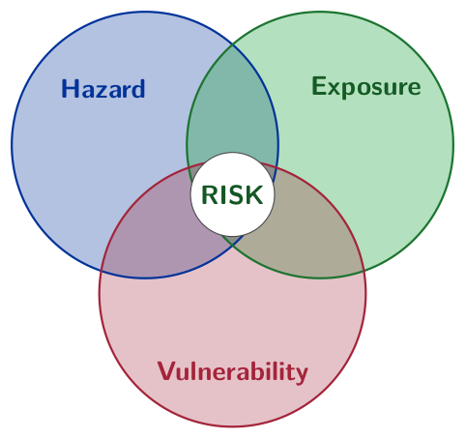
Risk is hazard, exposure and vulnerability at once
1
2
3
4
5
6
Risk needs hazard, exposure and vulnerability together.
Notes:
1:49 to 1:50, 1 minute.
Say: Chapter 6 uses the three terms of the risk identity. The hazard in Southeast Asia is tropical: typhoons, monsoon flooding and sea-level rise arrive together. The exposure is large: long coastlines, agriculture as a large share of output and work, and people living in coastal and delta zones. The vulnerability is high: middle incomes, thin insurance and limited early warning. A region can be high on one term and manage; ASEAN is high on all three.
Ask: Point to the RISK disc: what does a typhoon need, besides wind, to reach a bank's books? Expect 'something in its path' and 'someone unable to absorb it', and name them exposure and vulnerability.
Misconception: Risk is the hazard. The hazard is one of three terms, and the same typhoon is a different risk to two banks with different books.

Slide 81
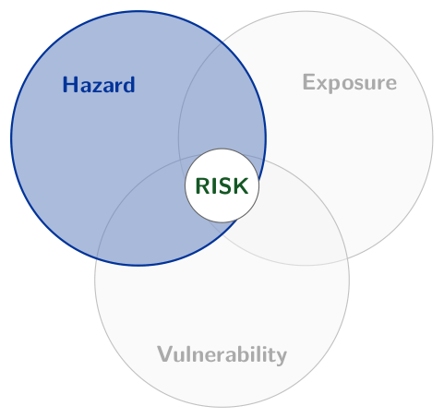
Hazard: the physical event or trend that can cause damage
1
2
3
4
5
6
Hazard: the potential occurrence of a natural or human-induced physical event or trend that may cause loss and damage.
In ASEAN
Typhoons and floods: about 20 cyclones enter the Philippine area a year, and 8 or 9 cross it
In a loan book
Hazard maps and storm tracks laid over the bank's sites and its collateral
A bank can change
Nothing: it chooses only where its lending meets the hazard
Source: IPCC (2022), AR6 Working Group II, Annex II: Glossary; PAGASA, Tropical Cyclone Information.
Notes:
1:50 to 1:51, 1 minute.
Say: The IPCC defines a hazard as the potential occurrence of a natural or human-induced physical event or trend that may cause loss and damage. In Southeast Asia the hazards are tropical: typhoons, monsoon floods and a rising sea. About 20 tropical cyclones enter the Philippine Area of Responsibility each year, and 8 or 9 cross the country. A bank measures the hazard with maps and storm tracks laid over its own sites and over its collateral. It cannot change the hazard; it chooses where its lending meets it.
Ask: Which hazard map does your institution use to value collateral, if any? Expect few answers, and ask what the national weather agency publishes.
Misconception: The hazard is the risk. A typhoon over open ocean is a hazard and a risk to no bank, because nothing the bank finances is in its path.

Slide 82
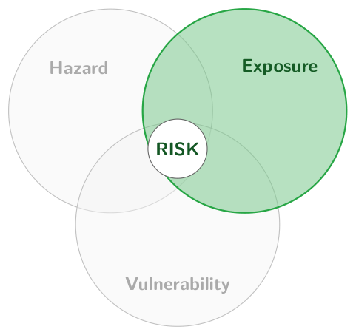
Exposure: people and assets in places a hazard can reach
1
2
3
4
5
6
Exposure: the presence of people, livelihoods, infrastructure or economic assets in places that could be adversely affected.
In ASEAN
Long coastlines, river deltas, and agriculture as a large share of output and work
In a loan book
Loans and collateral mapped by location and by sector
A bank can change
Where it lends, and how much it lends in each place
Source: IPCC (2022), AR6 Working Group II, Annex II: Glossary.
Notes:
1:51 to 1:52, 1 minute.
Say: The IPCC defines exposure as the presence of people, livelihoods, infrastructure and economic assets in places that could be adversely affected. ASEAN's exposure is large: long coastlines, river deltas, and agriculture as a large share of output and work, with many people living in coastal and delta zones. For a bank, exposure is its loans and its collateral, mapped by location and by sector. A bank changes its exposure through where it lends and how much it lends in each place.
Ask: Could your institution list its loans by province or district today? Expect 'by branch' from most, which stands in for where the collateral is.
Misconception: Exposure is fixed by geography. It follows the bank's choice of where to lend, and it changes each time a loan is made or repaid.

Slide 83
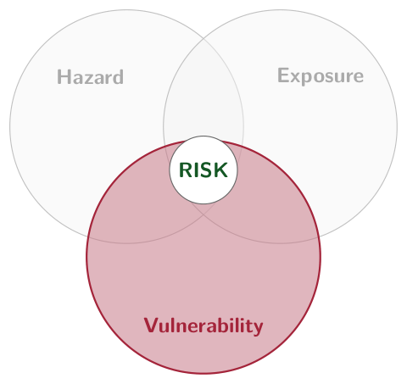
Vulnerability: the propensity to be harmed and a lack of capacity to cope
1
2
3
4
5
6
Vulnerability: the propensity to be adversely affected, including sensitivity to harm and lack of capacity to cope and adapt.
In ASEAN
Middle incomes, thin insurance and limited early warning
In a loan book
The borrower's insurance, the building standard of the collateral, the borrower's cash buffer
A bank can change
What it finances and insures: adaptation loans and blended structures among them
Source: IPCC (2022), AR6 Working Group II, Annex II: Glossary.
Notes:
1:52 to 1:53, 1 minute.
Say: The IPCC defines vulnerability as the propensity or predisposition to be adversely affected, including sensitivity to harm and a lack of capacity to cope and adapt. In ASEAN, middle incomes, thin insurance and limited early warning keep it high. In a loan book it is the borrower's insurance, the building standard of the collateral and the borrower's cash buffer. A bank changes vulnerability through what it finances and insures: adaptation loans, lending tied to insurance, and the blended structures that close the lesson.
Ask: Of hazard, exposure and vulnerability, which can a bank change? Expect 'vulnerability' and 'exposure', and note that the hazard is beyond any bank's reach.
Misconception: Adaptation is a matter for governments. Banks lower vulnerability by what they finance, and a borrower who has adapted is a better credit.

Slide 84
Vietnam, Thailand and the Philippines face different dominant hazards
1
2
3
4
5
6
An ordinal comparison from chapter 6; the ranking is stable across data vintages.
Vietnam
Thailand
Philippines
Primary hazard
Sea-level rise, delta flooding
Subsidence-flood, drought
Typhoons, recurrent
Annual losses
Moderate and rising
Episodic but severe
Highest of the three
Insurance
Thin
Deepest of the three
Thin
Notes:
1:53 to 1:55, 2 minutes.
Say: Vietnam's risk is the Mekong Delta: sea-level rise, delta flooding and saltwater intrusion, where Lesson 1's rice portfolio lends. Thailand's is episodic flooding around a subsiding Bangkok, and drought; its insurance market is the deepest of the three. The Philippines faces recurrent typhoons and the highest annual losses. Chapter 6 ranks the three countries without scores, because the ranking is stable across data vintages and the scores are not.
Ask: Which country's supervisor should prescribe a typhoon scenario, and which a flood of industrial estates? Expect the Philippines and Thailand; recall the 2011 Thai floods.
Misconception: ASEAN is one risk profile. The three countries differ in hazard, loss pattern and insurance, and each supervisor needs its own scenario.

Slide 85
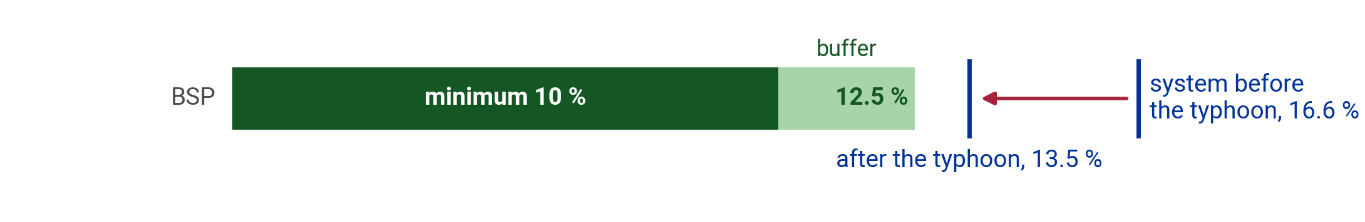
Sector shocks become one portfolio shock, then a capital ratio
1
2
3
4
5
6
r_{portfolio} = Σ_{i} w_{i} × r_{i}
CAR_{post} = CAR_{pre} − provisions − RWA effect − market losses
w_{i}: sector i's share of the loan book. r_{i}: the relative rise in sector i's default probability; the sum is the book's rise when the sectors start from one default rate. CAR: capital adequacy ratio; the deductions are points of it. BSP: 10 % minimum, 12.5 % with its buffer.
Source: Bangko Sentral ng Pilipinas, Report on Recent Trends in the Philippine Financial System, Issue No. 2024-03; Bangko Sentral ng Pilipinas (2013). Circular No. 781, 15 January 2013: Basel III Implementing Guidelines on Minimum Capital Requirements. Full text: Supreme Court E-Library.
Notes:
1:55 to 1:57, 2 minutes.
Say: The first formula weights each sector's relative rise in default probability by its share of the book, which gives the book's rise when the sectors start from similar default rates. A large shock to a small sector moves the portfolio less than a moderate shock to a large one. The second takes the ratio from before the stress and subtracts three effects in percentage points: new provisions for the higher defaults, the rise in risk-weighted assets as borrowers are downgraded, and market losses on securities.
Ask: Which of the three deductions would be largest after a typhoon? Expect provisions, since the typhoon hits borrowers first; the worked example confirms it.
Misconception: The 10.5 percent of Lesson 5 is the floor everywhere. The Bangko Sentral ng Pilipinas sets a minimum of 10 percent and adds a 2.5 percent buffer for universal and commercial banks, and each stressed ratio is compared with its own supervisor's rule.

Slide 86
A Haiyan-class typhoon makes landfall over Central Visayas
1
2
3
4
5
6
Agriculture
+80 % relative rise in default probability
Real estate
+40 %
Services and tourism
+25 %
Capital ratio, end-2023
16.6 %
BSP minimum and buffer
10 %, and 12.5 % with the 2.5 % buffer
Predict Does the banking system stay above the BSP minimum after the typhoon? Write down the ratio you expect.
Illustrative stress scenario, not a BSP exercise. Source: Bangko Sentral ng Pilipinas, Report on Recent Trends in the Philippine Financial System, Issue No. 2024-03; Bangko Sentral ng Pilipinas (2013). Circular No. 781, 15 January 2013: Basel III Implementing Guidelines on Minimum Capital Requirements. Full text: Supreme Court E-Library.
Notes:
1:57 to 1:59, 2 minutes.
Say: Chapter 6's worked example applies the toolkit to a Category 5 typhoon of the Haiyan class making landfall in Central Visayas. The sector shocks are assumed and relative to each sector's own baseline; the foot of the slide labels them. The starting ratio is measured: the Philippine banking system's solo capital adequacy ratio in December 2023, from the Bangko Sentral ng Pilipinas, cited at the foot. The BSP's minimum is 10 percent, and universal and commercial banks hold a 2.5 percent buffer on top.
Ask: Everyone writes a ratio. Take a show of hands: above the minimum or below? Expect a split, with the 80 percent shock to agriculture pulling guesses down.
Misconception: An 80 percent rise means 80 percent of farm borrowers default. The rise is relative to the sector's own baseline: a default rate of 4 percent becomes 7.2 percent.

Slide 87
The system holds at 13.5 percent, 3.5 points above the BSP minimum
1
2
3
4
5
6
1
Chapter 6 assumes a weighted rise in default probability of about 22.6 %
2
Chapter 6's assumed deductions: provisions 1.8, RWA 0.9, market 0.4 points
3
CAR = 16.6 − 1.8 − 0.9 − 0.4 = 13.5 %
4
13.5 − 10 = 3.5 points above the BSP minimum
5
13.5 − 12.5 = 1.0 point above the minimum with the buffer
The system clears 10 % by 3.5 points and 12.5 % by 1.0
Illustrative stress scenario, not a BSP exercise. Source: Bangko Sentral ng Pilipinas, Report on Recent Trends in the Philippine Financial System, Issue No. 2024-03; Bangko Sentral ng Pilipinas (2013). Circular No. 781, 15 January 2013: Basel III Implementing Guidelines on Minimum Capital Requirements. Full text: Supreme Court E-Library.
Notes:
1:59 to 2:02, 3 minutes.
Say: The sector shocks average to about 22.6 percent across the book, weighted by each sector's share. Provisions for the extra defaults take 1.8 points of ratio, downgrades raise risk-weighted assets by the equivalent of 0.9 points, and market losses take 0.4. From 16.6 percent the system lands at 13.5, 3.5 points above the BSP minimum, and 1.0 above the 12.5 percent that universal and commercial banks hold with the buffer. The 22.6 percent and the three deductions are chapter 6's assumptions; it gives no sector weights.
Ask: Whose ratio was above 13? Ask a delegate who predicted a breach what they expected to happen, and keep the answer for the check on the next slide.
Misconception: The largest sector shock decides the result. The book's rise weights each shock by its sector's share, so the 80 percent shock to agriculture moves the book by less than its size.

Slide 88
A system 3.5 points above its minimum
Check
1
2
3
4
5
6
The Philippine system clears its minimum by 3.5 points after the typhoon. What does the system average hide?
A
A system ratio below 12.5 %, the BSP minimum with its buffer
B
A capital shortfall at the largest banks
C
Losses on the banks' government bond holdings
D
Capital breaches at small banks based in the Visayas
Illustrative stress scenario, not a BSP exercise. Source: Bangko Sentral ng Pilipinas, Report on Recent Trends in the Philippine Financial System, Issue No. 2024-03; Bangko Sentral ng Pilipinas (2013). Circular No. 781, 15 January 2013: Basel III Implementing Guidelines on Minimum Capital Requirements. Full text: Supreme Court E-Library.
Notes:
2:02 to 2:04, 2 minutes.
Say: Read the stem aloud, then the four options. The room votes by show of hands, A to D, in twenty seconds. Count each letter aloud and write the counts on the board.
Ask: Before showing the answer, ask one delegate who chose A and one who chose B to give their reasons in one sentence each.
Key: D is the key. A tempts because the BSP adds a 2.5 percent buffer to its 10 percent minimum; the system's 13.5 percent clears the 12.5 as well. B tempts because the largest banks dominate the system average; they lend across all the islands, which spreads the shock. C tempts because market losses are one of the three deductions; at 0.4 points they are the smallest.

Slide 89
Banks lending mostly in the Visayas can breach while the system holds
1
2
3
4
5
6
D Capital breaches at small banks based in the Visayas
Why
The system average is 13.5 %. The typhoon strikes one region, and a bank lending mostly there takes the shocks on most of its book; chapter 6 finds a handful such banks below 10 %.
Tempting: A, A system ratio below 12.5 %, the BSP minimum with its buffer
With its 2.5 % buffer the BSP asks 12.5 %, and the system's 13.5 % clears it by 1.0 point.
Takeaway Systemic risk is concentrated: the system average hides the banks that breach.
Illustrative stress scenario, not a BSP exercise. Source: Bangko Sentral ng Pilipinas, Report on Recent Trends in the Philippine Financial System, Issue No. 2024-03; Bangko Sentral ng Pilipinas (2013). Circular No. 781, 15 January 2013: Basel III Implementing Guidelines on Minimum Capital Requirements. Full text: Supreme Court E-Library.
Notes:
2:04 to 2:06, 2 minutes.
Say: Chapter 6 concludes that the aggregate system survives while a handful of smaller Visayas-concentrated banks breach the minimum: the systemic risk is concentrated, and a supervisor reading only the system average would miss it. The policy response the chapter names is bank-level climate stress testing, parametric crop cover at portfolio level, and blended finance for resilient infrastructure.
Ask: Return to the open-ocean typhoon of the lesson's first slide. Where does a Visayas typhoon meet exposure? Expect 'the regional banks' borrowers'. Ask what data a supervisor needs to see it.
Misconception: A stress test of the system is a stress test of every bank. The average hides the tail, and the supervisor needs bank-level results.

Slide 90
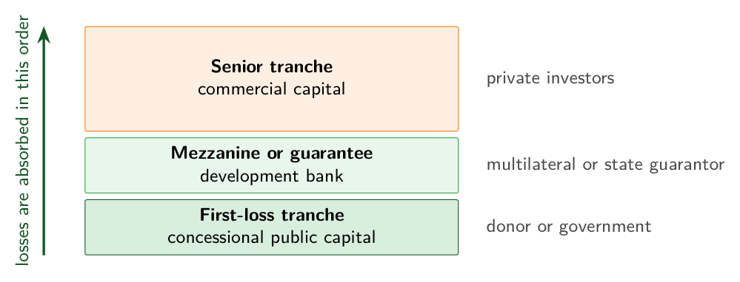
Blended finance puts public money in the first-loss layer
1
2
3
4
5
6
Losses fall first on concessional public capital, then on the guarantee, then on the commercial senior tranche.
Notes:
2:06 to 2:07, 1 minute.
Say: Adaptation finance pays for sea walls, drainage and resilient crops before the storm, and blended finance draws private money into it. The stack orders the losses. A donor or government takes the first loss with concessional capital; a development bank or state guarantor stands in the middle; commercial investors hold the senior tranche. The split varies by deal and the order does not. Parametric instruments, such as the Philippine catastrophe bonds, pay on a measured trigger like wind speed, so the money arrives within days.
Ask: Which tranche would your bank take, and at what price? Expect the senior tranche; then ask what first-loss share would make a coastal-protection loan bankable.
Misconception: Blended finance is a subsidy that crowds out private money. The first-loss layer makes the senior tranche investable, and each public dollar is judged by the private capital it mobilises.

Slide 91
Every lesson uses a tool the credit risk function already has
1
Climate enters expected loss through its terms, and their rises multiply.
2
A bank manages climate risk before it discloses it.
3
Scenarios have no probabilities; ASEAN books lose most in a hot house world.
4
Carbon and loss differ: Vietnamese agriculture outranks coal on Climate VaR.
5
The Thai bank absorbs THB 18.5 billion of loss before it reaches 10.5 %.
6
The system average hides the concentrated banks that breach.
Illustrative bank, not a real institution. Source: BCBS, Basel III: A global regulatory framework for more resilient banks and banking systems (rev. June 2011), para 64.
Notes:
2:07 to 2:09, 2 minutes.
Say: One line per lesson, in the order taught. Line 5 answers the opening question: the Thai bank can absorb THB 18.5 billion of climate loss before it reaches the Basel III floor, the gap between 14.2 and 10.5 percent of THB 500 billion of risk-weighted assets, and THB 16.0 billion before the Bank of Thailand's 11 percent. Compare it once more with the guesses written in the corner of the board at the start of the class.
Ask: Ask each table to pick the one line that would change a decision in their own institution next month, and say it aloud. Expect lines 4 and 6 from the bank staff and line 2 from the supervisors.
Misconception: Climate risk management is a separate discipline. Every line uses a tool a credit risk function already has: expected loss, scenarios, exposure, capital ratios.

Slide 92
Acknowledgements
Developed by the University of Twente for WP3 of GREEN FINANCE (Erasmus+ CBHE 101237817)
Generative AI as a writing and research assistant: Claude (Anthropic), Opus 4.8, Opus 5 and Opus 5.5, July to September 2026
Confined to brainstorming, language editing, literature classification, and coding assistance
The authors remain fully responsible for accuracy, references, and conclusions
Released under a Creative Commons Attribution 4.0 International licence (CC BY 4.0)
Notes:
2:09 to 2:10, 1 minute.
Say: Thank the room and the hosts at the University of Twente. The module is part of Work Package 3 of the GREEN FINANCE project, co-funded by the Erasmus+ programme. The disclosure of generative AI follows the coordinator's instructions of July 2026: the tool, its versions, the period and the uses. The materials are released under CC BY 4.0, so delegates may reuse and adapt them with attribution.
Ask: Open the floor for the five minutes of questions that remain in the slot. Expect questions on data: where a bank finds borrower emissions and asset locations in ASEAN.
After the deck: Point delegates to the Module 4 page of the project site for the handout, the six lesson decks and the exercises, and to chapter 4's lab for the 50-borrower portfolio.

Slide 93
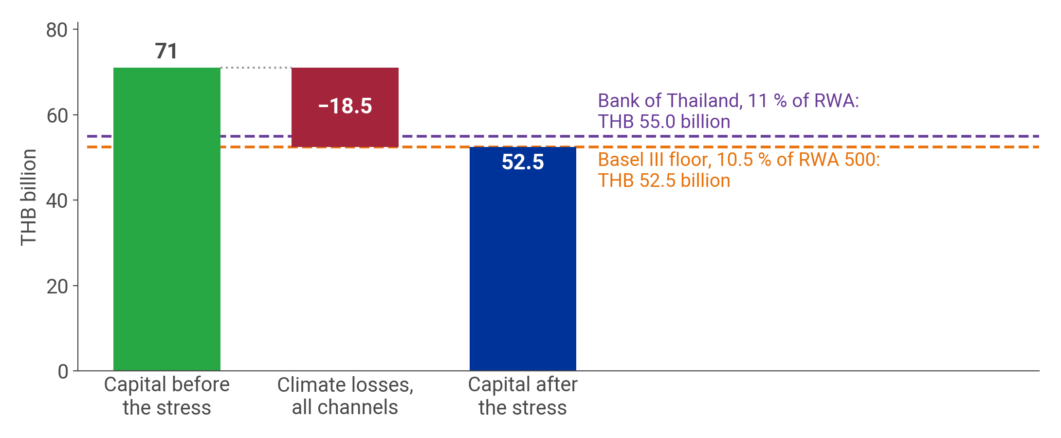
Capital falls from THB 71 billion to the THB 52.5 billion floor
1
2
3
4
5
6
The illustrative Thai bank's capital before and after the stress, against what the Basel III and Thai floors require.
Notes:
Backup, after the close: shown when a question asks for it.
Say: The waterfall shows the Thai bank's stress test of lesson 5. The first bar is capital of THB 71 billion; the loss bar removes THB 18.5 billion; the last bar, THB 52.5 billion, meets the lower dashed line, the capital the Basel III floor requires. The upper line, THB 55.0 billion, is the Bank of Thailand's 11 percent, and the bank ends THB 2.5 billion inside that buffer. Chapter 5 sets the loss at exactly the bank's headroom: any further loss takes the bank into the buffer, where it restricts dividends and bonuses. The Lesson 5 deck works this bank under Delayed Transition; the module's other scenarios, plus 2.0 degrees in Lesson 1 and a hot house path in Lesson 3, belong to other books.
Ask: What would the bank do on the day this result arrives? Expect 'raise capital', 'cut dividends' and 'reduce exposures'. Ask which of the three the supervisor can order.
Misconception: A bank that lands exactly on the floor has passed. At zero headroom the next loss restricts its distributions, and chapter 5 treats the result as the trigger for capital action.

