Slide 1

Serbia
Country Updates, MC Meeting, 30th April, 2024

Slide 2
COST 19130 FinAI Serbian team:
1. Dr. Vladimir Simović, MC member, Institute of economic sciences
2. Prof. dr. Lidija Bajraktarović, MC member, Singidunum University
3. Prof. dr. Miljan Vučetić, MC substitute, Vlatacom Institute, AI department
4. Marko Bajraktarović, School of electrical enginering, University of Belgrade
5. Dr. Ivan Nikolić, Institute of economic sciences
Contribution Topics:
WG1
WG2
WG3

Slide 3
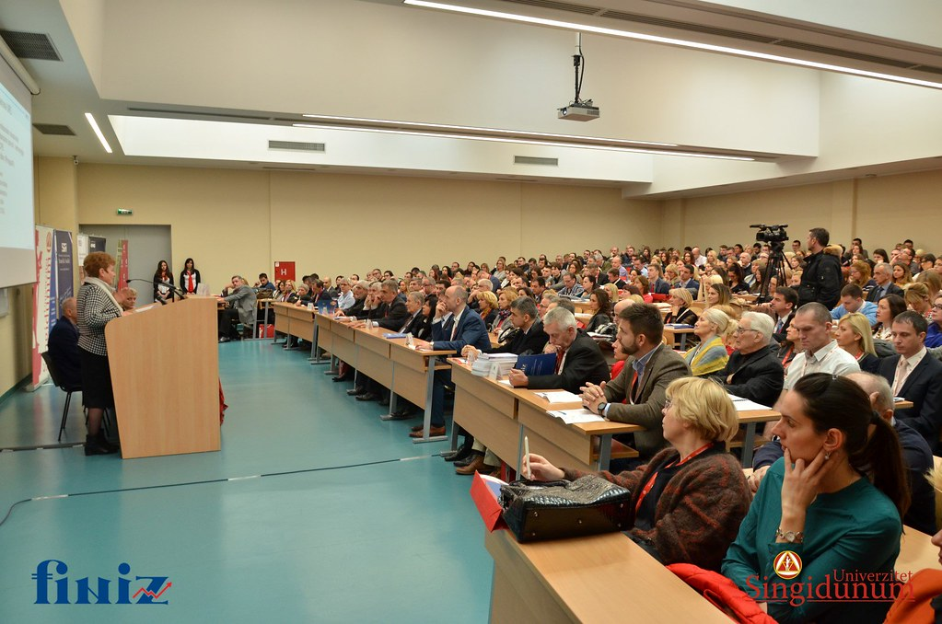
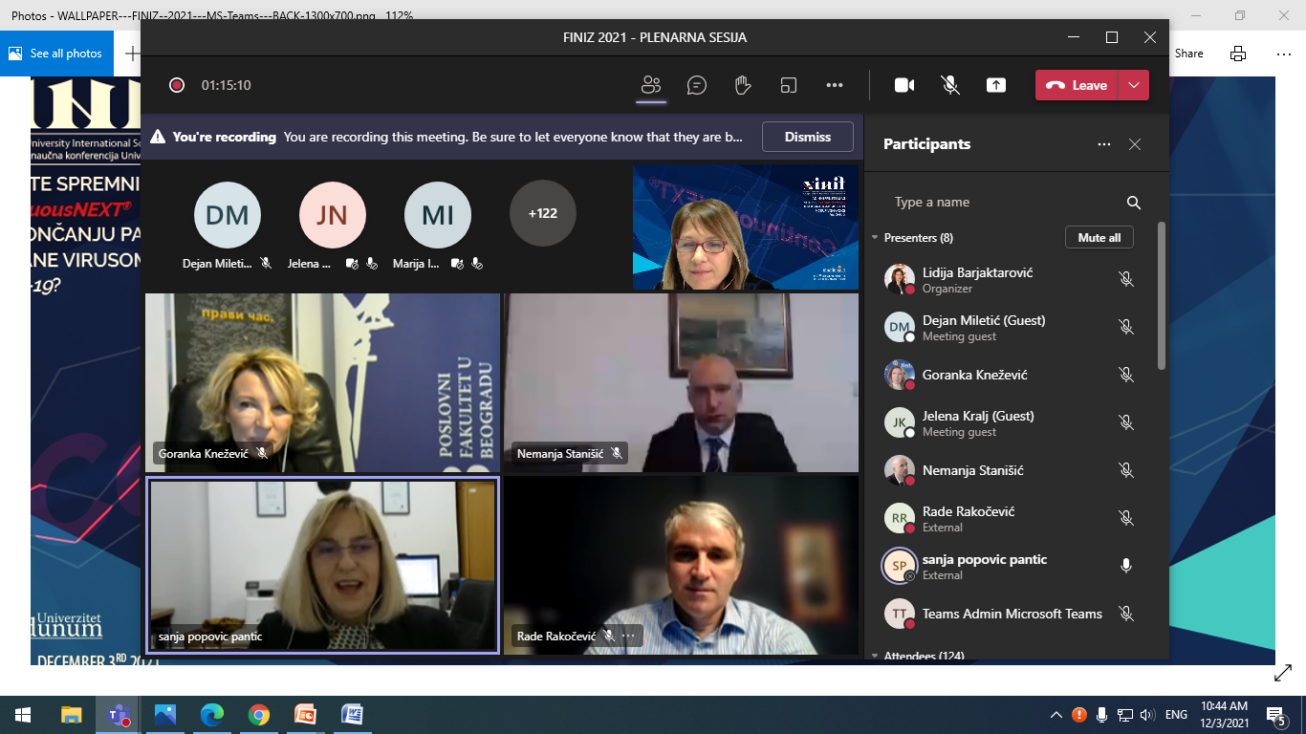
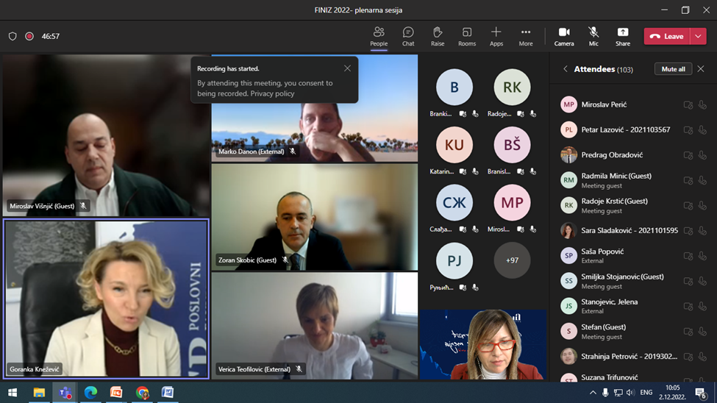
Conferences, presentations, talks and meetings:
International scientific conference FINIZ 2020 Belgrade
Project presentation at a plenary session
One research paper published in book of proceedings
Promotions: two announcement on professional portals and video report about the plenary session at LinkedIn FINIZ
International scientific conference FINIZ 2021 Belgrade
One session organized as panel discussion in cooperation with CFA Society Serbia on the topic: Fintech in the corona era
Intesa Invest Belgrade and Erste bank Serbia were panel participants
Promotions: two announcement on professional portals and video report about the panel discussion at LinkedIn FINIZ
Espoo 2022
Research results presentation at WG3 session:
Overview of Sustainable Banking in the
Western Balkan Region

Slide 4
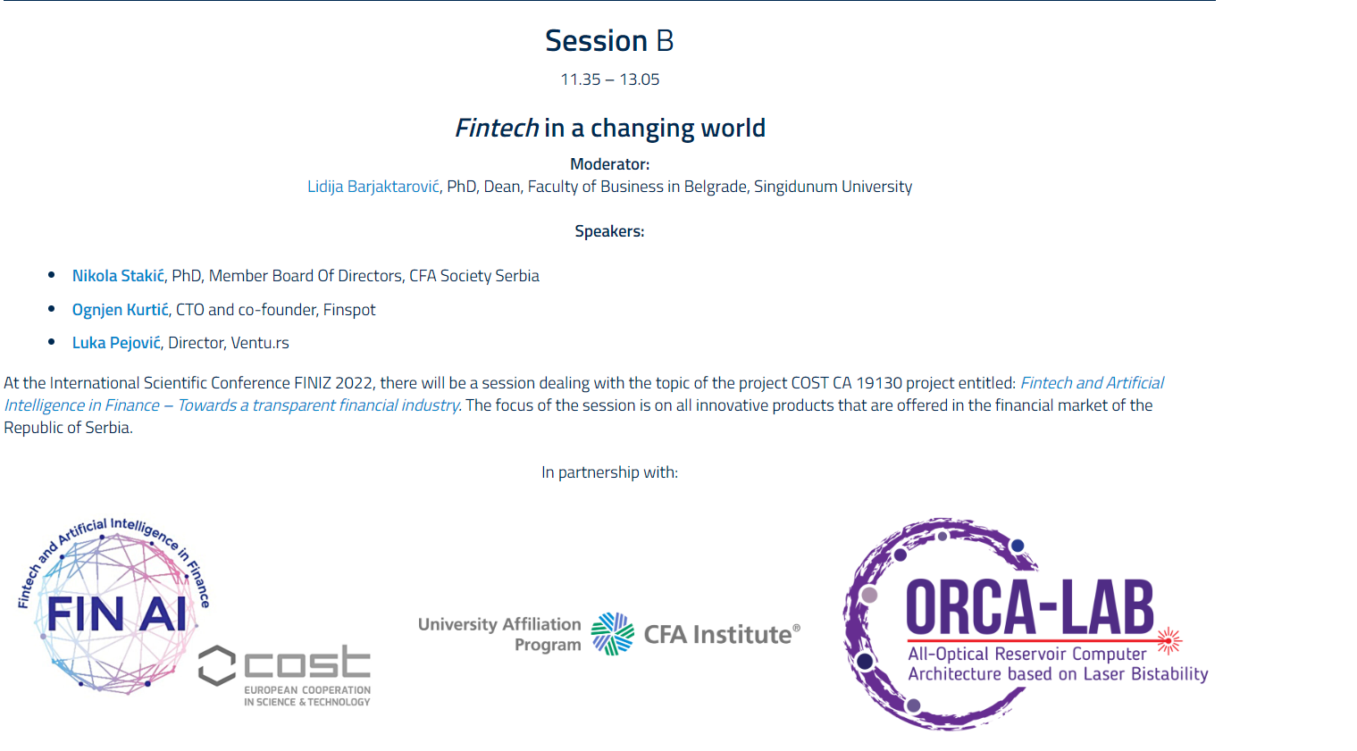

Conferences, presentations, talks and meetings:
International conference of economics and business
Presented one research paper
International scientific conference FINIZ 2022 Belgrade
It was held on 02nd of December in 2022
Panel discussion in cooperation with CFA Society Serbia on the topic: Fintech in a changing world
Promotions: two announcement on professional portals and video report about the panel discussion at LinkedIn FINIZ
International scientific conference FINIZ 2023 Belgrade
It was held on 07th of December in 2023
Panel discussion in cooperation with CFA Society Serbia on the topic: Fintech as a response to a sustainable business of financial sector
Promotions: two announcement on professional portals and video report about the panel discussion at LinkedIn FINIZ
Woman in Fintech – Coimbra 2023
Research results presentation in cooperation with University of Economics Bratislava: Linguistic summaries in explaining, classifying and ranking entities in the context of financial data

Slide 5
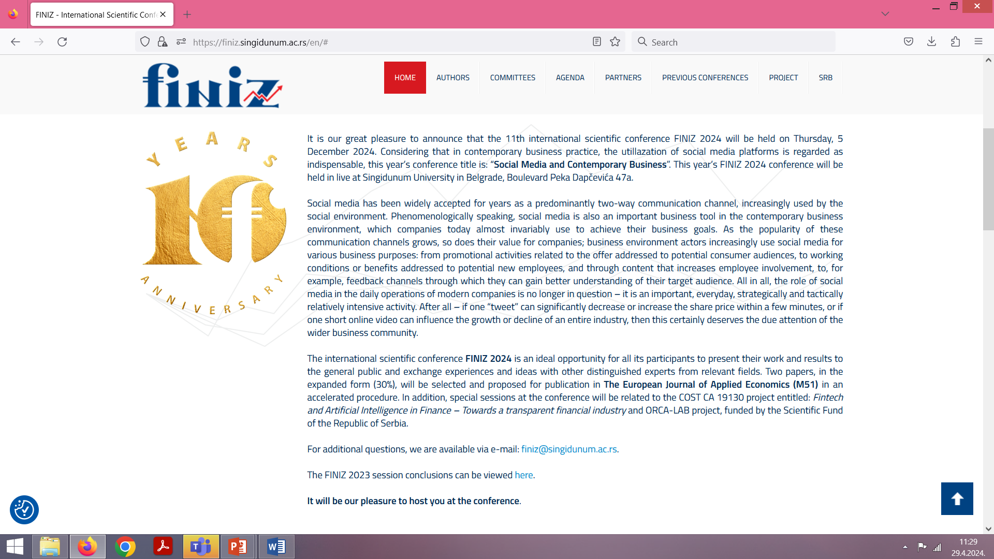
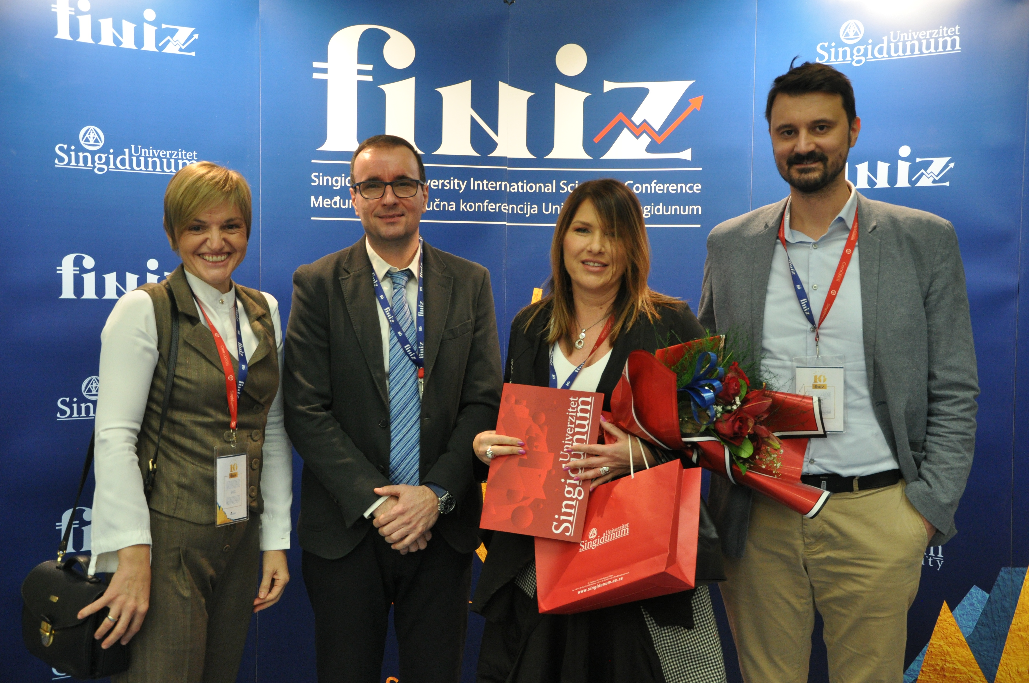
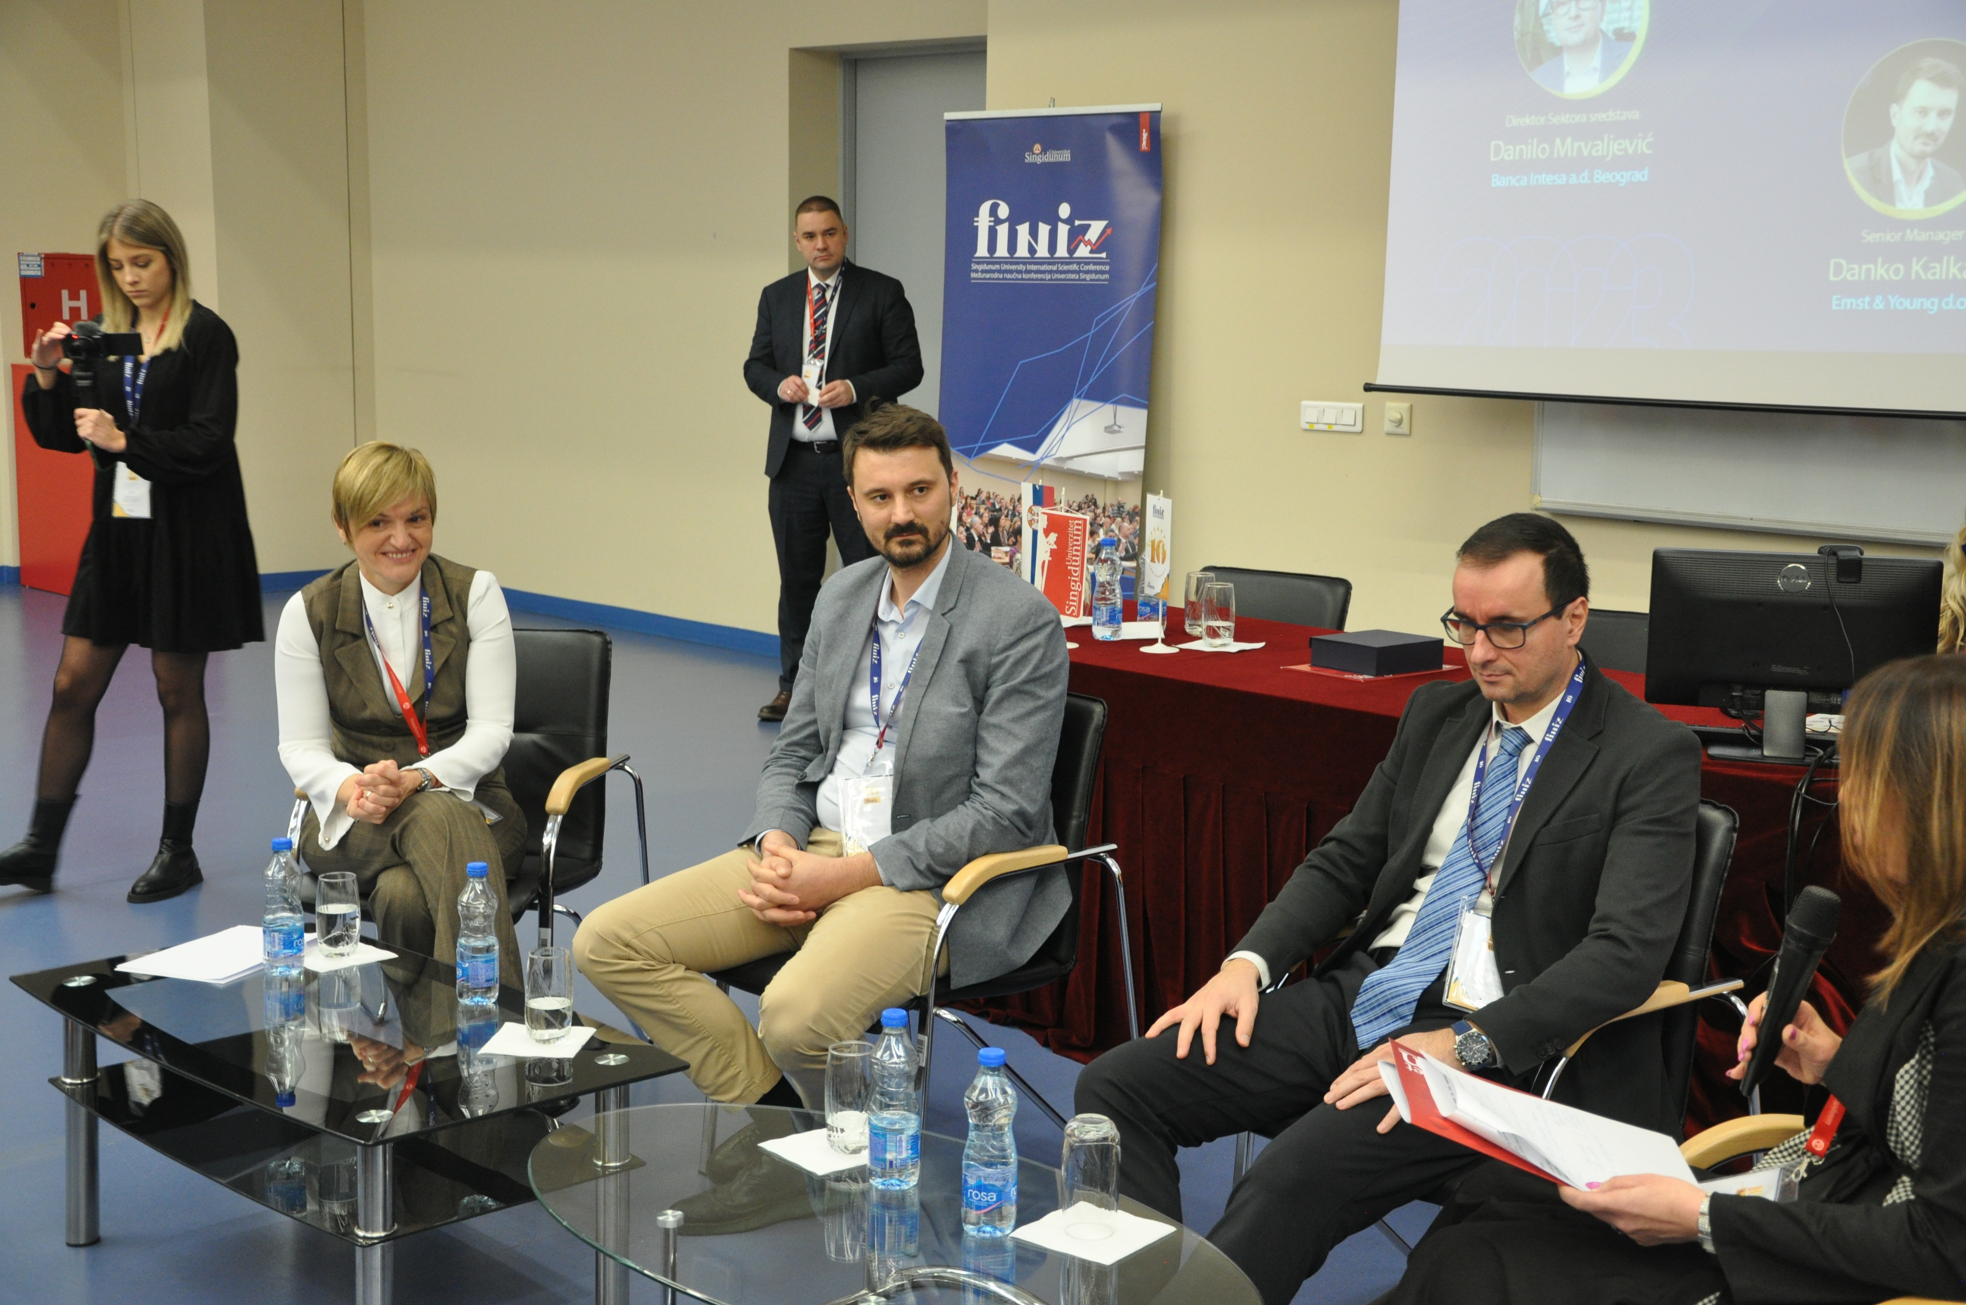
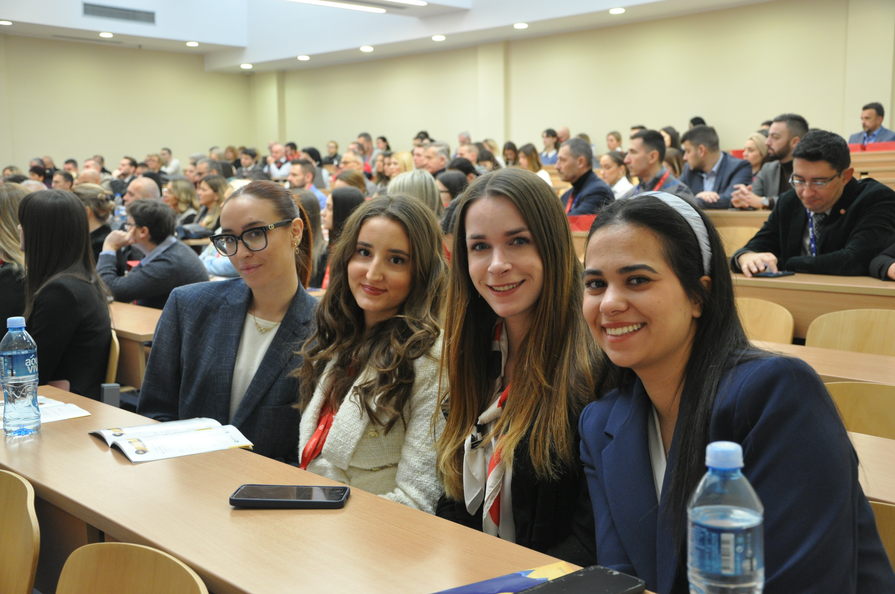
Planned Activities
International scientific conference FINIZ 2024 Belgrade
It will be organized on December 5t^{h} 2024
https://finiz.singidunum.ac.rs/en/
Presentation of achieved results of the project COST CA 19130
Panel discussion in cooperation with CFA Society Serbia
Project promotions: website, social networks and professional portals

Slide 6
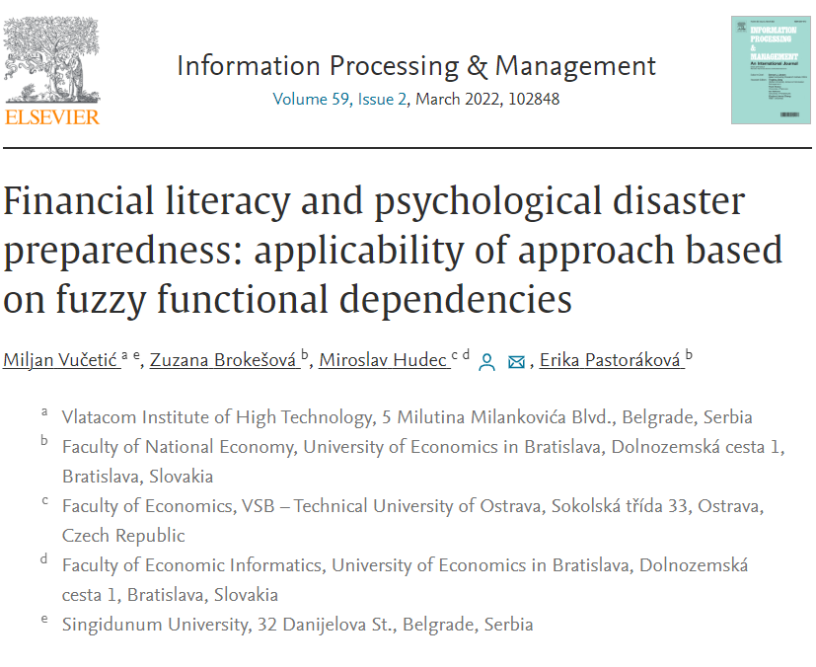
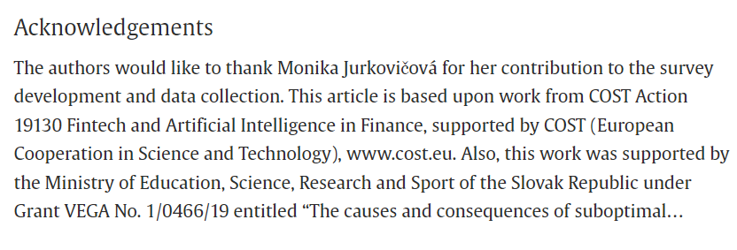
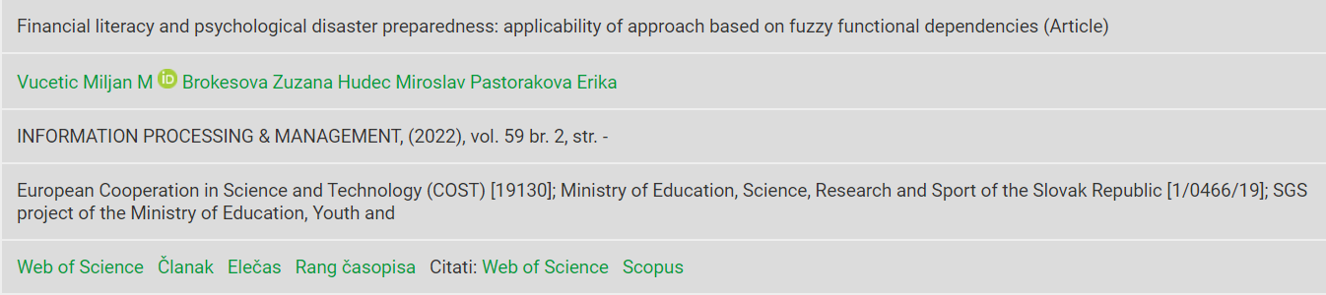
Publications:
Proceedings:
Barjaktarović, L., Barjaktarović, M., Konjikušić, S. (2020). Echo State Networks Usage for
Stock Price Predictions. Paper presented at FINIZ 2020 - People in the focus of process
automation. doi:10.15308/finiz-2020-97-102
Journals:
Jović, Ž. & Nikolić, I. (2022). The Darker Side of Fintech: the Emergence of New Risks.
Zagreb International Review of Economics and Business, Zagreb, 25(s1):45-63,
doi: 10.2478/zireb-2022-0024.
Q1 Journals:
Vučetić, M., Brokešová, Z., Hudec, M., Pastoráková, E. (2022). Financial literacy and
psychological disaster preparedness: applicability of approach based on fuzzy functional
dependencies, Information Processing & Management, 59(2), 102848,
https://doi.org/10.1016/j.ipm.2021.102848.
Hudec, M., Vučetić, M., Barčaková, N. (2023). An extended proximity relation and quantified aggregation
for designing robust fuzzy query engine, Knowledge-based systems, under review.

Slide 7
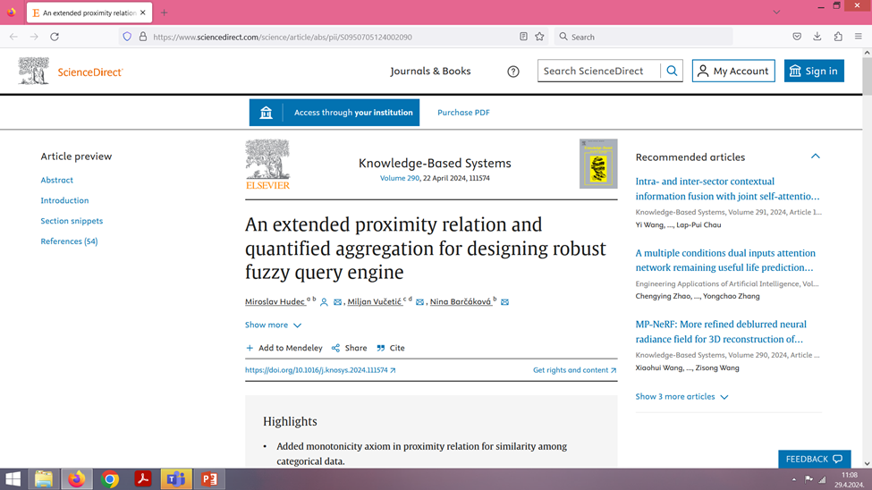
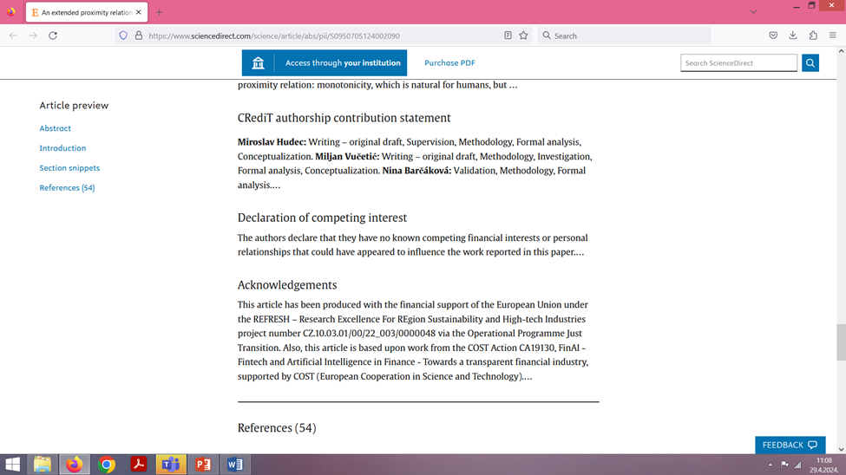
Publications: Proceedings: Q1 Journals:
Barjaktarović, L., Barjaktarović, M., Todorović, M.,Obradović, A. (2023) Toward Stock Price Forecasting on Newly Acquired BELEX Dataset, The book of proceedings – FINIZ 2023, 07th December, Belgrade, p. 154-161, DOI: https://doi.org/10.15308/finiz-2023-154-161
Barjaktarović, L., Kalkan, D. (2023) Are Serbian Companies ready for the German Supply Chain Due Diligence Act?, The book of proceedings – FINIZ 2023. 07th December, Belgrade, p. 143-153, DOI: https://doi.org/10.15308/finiz-2023-143-153
G. Pisoni, E. Mináriková, M. Hudec, H. Skaftadottir, B. Molnár, M. Vučetić, D. Sedláková, Reducing Complexity by using Linguistic Summaries for Business Intelligence Reporting, 17th IADIS INTERNATIONAL CONFERENCE INFORMATION SYSTEMS 2024, pp. 174 - 178, Mar, 2024, Porto Portugal
M. Hudec, M. Vučetić, N. Barčáková, An extended proximity relation and quantified aggregation for designing robust fuzzy query engine, KNOWLEDGE-BASED SYSTEMS, Vol. 290, Feb, 2024 – Q1 journal IF = 8.8

