Slide 1
COST Fin AI Country Update
Denmark
Created by Dolores Romero Morales

Slide 2
MC Members Denmark
Dolores Romero Morales, Professor in Operations Research, Coordinator and scientific leader of H2020 RISE NeEDS project, www.riseneeds.eu, Department of Economics, Copenhagen Business School, Denmark
Alexandros Iosifidis, Head of the Machine Learning and Computational Intelligence research group and eader of the Machine Intelligence research area in AU Centre for Digitalisation, Big Data, and Data Analytics, Aarhus University, Denmark
Jimmy Martinez-Correa, Associate Professor, Department of Economics, Copenhagen Business School, Denmark (MC Substitute)

Slide 3
Papers
Mathematical Optimization Modelling for Group Counterfactual Explanations, E. Carrizosa, J. Ramírez Ayerbe, D.\ Romero Morales. Forthcoming in European Journal of Operational Research, 2024. doi.org/10.1016/j.ejor.2024.01.002.
Supervised Feature Compression based on Counterfactual Analysis, V. Piccialli, D. Romero Morales, C. Salvatore. Forthcoming in European Journal of Operational Research, 2023. doi.org/10.1016/j.ejor.2023.11.019.
A New Model for Counterfactual Analysis for Functional Data, E. Carrizosa, J. Ramírez Ayerbe, D. Romero Morales. Forthcoming in Advances in Data Analysis and Classification, 2023. doi.org/10.1007/s11634-023-00563-5.
Counterfactual Analysis and Target Setting in Benchmarking, P. Bogetoft, J. Ramírez Ayerbe, D. Romero Morales. European Journal of Operational Research, 315(3):1083-1095, 2024. 10.1016/j.ejor.2024.01.005
Generating Collective Counterfactual Explanations in Score-Based Classification via Mathematical Optimization, E. Carrizosa, J. Ramírez Ayerbe, D. Romero Morales. Expert Systems With Applications, 238(D):121954, 2024. doi.org/10.1016/j.eswa.2023.121954

Slide 4
Papers
On Clustering and Interpreting with Rules by Means of Mathematical Optimization, E. Carrizosa, K. Kurishchenko, A. Marín, D. Romero Morales. Computers and Operations Research, 154:106180, 2023. doi.org/10.1016/j.cor.2023.106180
On optimal regression trees to detect critical intervals for multivariate functional data, R. Blanquero, E. Carrizosa, C. Molero-Río, D. Romero Morales. Computers and Operations Research, 152:06152, 2023. doi.org/10.1016/j.cor.2023.106152
On mathematical optimization for clustering categories in contingency tables, E. Carrizosa, V. Guerrero, D. Romero Morales. Advances in Data Analysis and Classification, 17:407--429, 2023. doi.org/10.1007/s11634-022-00508-4
The tree based linear regression model for hierarchical categorical variables, E. Carrizosa, L. Mortensen, D. Romero Morales, M.R. Sillero-Denamiel. Expert Systems With Applications, 203(7): 117423, 2022. doi.org/10.1016/j.eswa.2022.117423

Slide 5
Papers
On Sparse Optimal Regression Trees, R. Blanquero, E. Carrizosa, C. Molero-Río, D. Romero Morales. European Journal of Operational Research, 299(3):1045--1054, 2022. doi.org/10.1016/j.ejor.2021.12.022
Interpreting Clusters via Prototype Optimization, E. Carrizosa, K. Kurishchenko, A. Marín, D. Romero Morales. Omega, 107:102543, 2022. doi.org/10.1016/j.omega.2021.102543
On Clustering Categories of Categorical Predictors in Generalized Linear Models, E. Carrizosa, M. Galvis Restrepo, D. Romero Morales. Expert Systems With Applications, 182:115245, 2021. doi.org/10.1016/j.eswa.2021.115245
On Sparse Ensemble Methods: An Application to Short-Term Predictions of the Evolution of COVID-19, S. Benítez Peña, E. Carrizosa, V. Guerrero, M.D. Jiménez-Gamero, B. Martín-Barragán, C. Molero-Río, P. Ramírez-Cobo, D. Romero Morales, M.R. Sillero-Denamiel. European Journal of Operational Research, 295(2):648--663, 2021. doi.org/10.1016/j.ejor.2021.04.016

Slide 6
Papers
Optimal Randomized Classification Trees, R. Blanquero, E. Carrizosa, C. Molero-Río, D. Romero Morales. Computers and Operations Research, 132:105281, 2021. doi.org/10.1016/j.cor.2021.105281
Mathematical optimization in classification and regression trees, E. Carrizosa, C. Molero-Río, D. Romero Morales. TOP, 29(1):5--33, 2021. doi.org/10.1007/s11750-021-00594-1
Enhancing the Interpretability in Factor Analysis by means of Mathematical Optimization, E. Carrizosa, V. Guerrero, D. Romero Morales, A. Satorra. Multivariate Behavioral Research, 55(5):748--762, 2020. doi.org/10.1080/00273171.2019.1677208
On a Mathematical Optimization approach for Feature Selection in Data Envelopment Analysis, S. Benítez Peña, P. Bogetoft, D. Romero Morales. Omega, 96:102068, 2020. doi.org/10.1016/j.omega.2019.05.004
Sparsity in Optimal Randomized Classification Trees, R. Blanquero, E. Carrizosa, C. Molero-Río, D. Romero Morales. European Journal of Operational Research, 284(1):255--272, 2020. doi.org/10.1016/j.ejor.2019.12.002

Slide 7
STSM
Jasone Ramírez Ayerbe, PhD student at Universidad de Sevilla, 2021.

Slide 8

Events

Slide 9

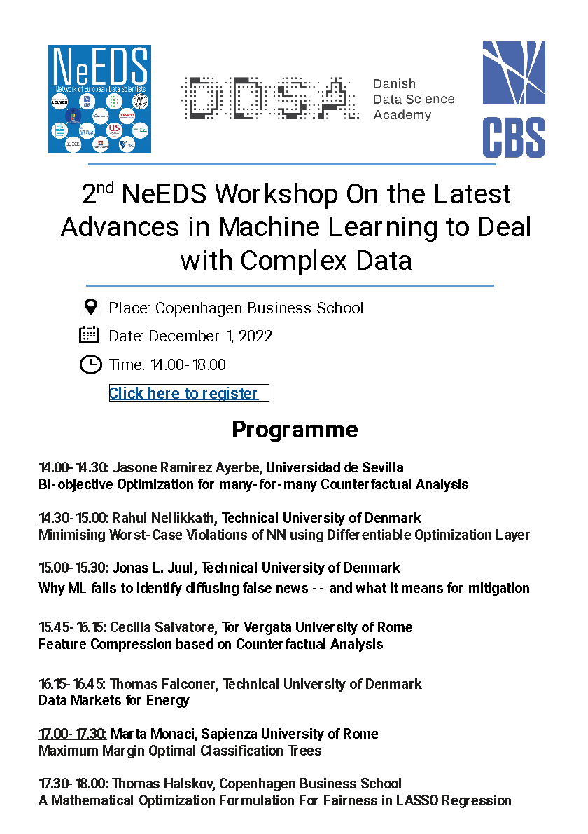

Events

